Slide 1
Digital Disruption is Changing the World:
It is time to transform your Security Culture
Robert DeSimone – Sr. Account Executive

Slide 2





Notes:
[[ STORY: THE CAPABILITIES OF THE NEW DIGITAL WORLD IS CREATING OPPORTUNITES WHILE ALSO DISTRUPTING TRADITIONAL MODELS ]]
Business Models are being disrupted
A bank has more developers in house than the biggest social media platform on the planet.
Uber
Storms the taxi industry without owning
a single car
Airbnb
More beds than the largest hospitality company
Netflix
86 million global subscribers
– no TV channel
Companies like Uber, Airbnb and Netflix have created new business models that leverage data and information sharing to make better decisions. They are showing the power of being able to leverage rapid access and processing to information along with new business models and new ways to engage customers.
Powered by cloud and mobile, these companies have shown how quickly digital disruption reshapes once slow-moving markets.

Slide 3


Notes:
It is our fault… We ask them to be more efficient, because we ask them to be. We push them to be. We need them to work faster.
And there are new technologies that make it easier for them to spill your brains all over the street.
Cloud apps, mobile devices, web access
These just add to their ability to lead data.
We can’t really expect them to be accountable when we have no provided the tools for them to take ownership of data security. It is something done by IT, but people “over there” in the background, behind the curtain. It is an automated thing.
Certainly there are policies and procedures in place, but these

Slide 4


Notes:
Automated Technology
Sharing it’s not all done in one house.
Shadow IT – Cloud apps, personal email, social media, mobile, IM users are using apps that help them be productive but can also pose a risk to data (is the app safe and well built, or filled with holes, or even built with the intent to steal?) security if they bypass IT and existing policy enforcement safeguards.
As more organizations embrace digital transformation , they face challenges presented by emerging trends such as cloud, IoT and analytics and the collection of information.

Slide 5


Notes:
What your employees believe!! IT is taking care of it….

Slide 6


Notes:
[95% OF ALL SECURITY INCIDENTS INVOLVE HUMAN ERROR – IBM 2014 Cyber Security Intelligence Index
Technology alone is not the answer to this central challenge
Elephant in the room image – Culture/People Problem
Without a workforce where data security is ingrained, mistakes will continue to take place. [It’s time to “upgrade” your users]
Here are just some examples of serious breaches and problem that are the result of people making errors.
Australian Immigration
Emailed 500,000 records of G20 delegations to a sport organization
University of Virginia
Emailed all students PII to entire student body
Pentagon
The cyber security officials over at Pentagon reported that it was a spear phishing attack onto the Pentagon’s unclassified Joint Staff emailing system, compromising the email credentials of over 4,000 military and civilian personnel.
https://www.hackread.com/pentagons-network-hacked-with-phishing-attack/
Australian Red Cross Blood Services
1.3 Million records leaked due to human error (published to a publicly-facing website). The ramifications of the spill of donor data range from identity theft to possible blackmail. Worse still, people could be dissuaded from donating blood if they fear their details won’t be kept safe.
http://www.itnews.com.au/blogentry/sorry-isnt-good-enough-when-sensitive-data-is-compromised-440505?eid=65&edate=20161102&utm_source=20161102&utm_medium=newsletter&utm_campaign=sc_weekly
http://www.abc.net.au/news/2016-10-28/red-cross-blood-service-admits-to-data-breach/7974036
Phishing is becoming much more popular as a tool for external threats to break in. Even in large-scale breaches involving thousands of systems across the globe, the initial attack vector was rarely a sophisticated exploitation of a zero-day vulnerability. Rather, the initial vector was more often a spear-phishing email that tricked an employee or vendor into providing his or her remote-access credentials or opening an attachment containing a malicious payload.
Snapchat
The Snapchat data wasn't stolen by a coding mastermind who penetrated the company's servers using some unknown flaw. Instead, it was stolen by an attacker who exploited a much simpler, more human vulnerability: trust. The attacker pretended to be Snapchat chief executive Evan Spiegel and tricked an employee into emailing over the information, according to a blog post the company posted Sunday about the incident. Roughly 700 current or former employees had information including their names, Social Security numbers and wage data compromised in the attack, according to the Los Angeles Times.
https://www.washingtonpost.com/news/the-switch/wp/2016/03/01/the-human-problem-at-the-heart-of-snapchats-employee-data-breach/
Illinois Prison
On Aug. 14, IDOC discovered that the names, job ranks/positions, salaries and Social Security numbers of more than 1,000 employees who worked at Dixon and Lawrence correctional centers during fiscal year 2015 were inadvertently transmitted in a FOIA request that was released to that citizen.
http://www.chicagotribune.com/news/local/breaking/ct-idoc-human-error-caused-data-breach-20150821-story.html
Hellgate High
Mark Thane said an email sent from Hellgate High School Assistant Principal and athletic director Lynn Farmer's email address contained 1,100 student records by mistake.
http://www.nbcmontana.com/news/keci/hellgate-high-blames-data-leak-on-human-error_20160510204220913/9815874
TESCO (Grocery store chain un the UK)
3 executives charged with accounting fraud.
Around £2bn was wiped off Tesco's stock market value in September 2014 after the company warned that it had uncovered "serious issues" in its accounts. The company was plunged into its worst ever crisis and its market value tumbled by a further £1bn one month later when Tesco reported a 92pc drop in interim profits and admitted that the accounting hole had grown to £263m, greater than expected.
TOSHIBA
overstated its profits by nearly $2 billion over the past 7 years
NORTEL
A history of playing lose with accounting practices that make things look good when they were not.

Slide 7


Notes:
[[ STORY: DRIVE HOME THAT THE USER IS THE POINT OF FAILURE THAT HAS NOT BEEN SUFFICIENTLY ADDRESSED ]]
Organizations need to shift thinking of the culture so that data value is always considered.
84% of business leaders say culture is critical to business success
64% say it is more important than strategy and operating model
BUT
50% say their culture is badly managed and needs an overhaul
Why?
Especially when the new workforce – the millennials – are already ingrained with the potential to collaborate, share, collect, and otherwise manipulate information.

Slide 8



Notes:
Baby steps – It isn’t easy but that isn’t the reason to not do it.
Growth and innovation in the now and in future will depend on the proper security and management of information.
Customers, partners, and governments are demanding greater data security and the same levels of security across regions.
On one side is the need to comply with legislation, and on the other the need for your entire organization to be accountable for the protection of data created in house or sent from another party. The success of accountability and compliance is TRUST.
Trust means your customers will buy your products on-line. It means they’re confident you’ll keep their data safe and secure. Trust means your suppliers know your systems won’t fail them. And it means you have the confidence to move your business forward by embracing technology and the opportunities it has to offer.
Organisations need to build trust into the fabric of their digital operation. With trust in your data and security, with resilience built into your systems, and with the knowledge that your digital transformations will succeed, you’ll have the confidence to embrace your digital future, allow you freedom from the old business processes with customers, partners, suppliers, and enjoy the exponential impact it has on your growth.
Cybersecurity is now part of business operations. Those responsible for creating, sharing, processing, and otherwise using information must take ownership of that information’s security.
______________________-
Other thoughts:
Work from anywhere
Access the data you need
Collaborate without needless roadblocks
Protect your company/team/customers/society
Digital Trust:
Trust means your customers will buy your products on-line. It means they’re confident you’ll keep their data safe and secure. Trust means your suppliers know your systems won’t fail them. And it means you have the confidence to move your business forward by embracing technology and the opportunities it has to offer.
Organisations need to build trust into the fabric of their digital operation. With trust in your data and security, with resilience built into your systems, and with the knowledge that your digital transformations will succeed, you’ll have the confidence to embrace your digital future, and enjoy the exponential impact it has on your growth.

Slide 9


Notes:
[[ STORY: WITH TITUS YOU CAN IMPRINT CONSTANT SECURITY VIGILENCE INTO YOUR EMPLOYEES – FOSTER FEELINGS OF OWNERSHIP OF DATA SECURITY ]]
TITUS is uniquely qualified to lead that “data aware” culture change. TITUS intersects with users in their daily workflow reminding them, educating them, and empowering them to be a part of the security ecosystem.
As your users become more security conscious, they will make better decision when handling sensitive information, or when engaging in any activity that could put information at risk.

Slide 10

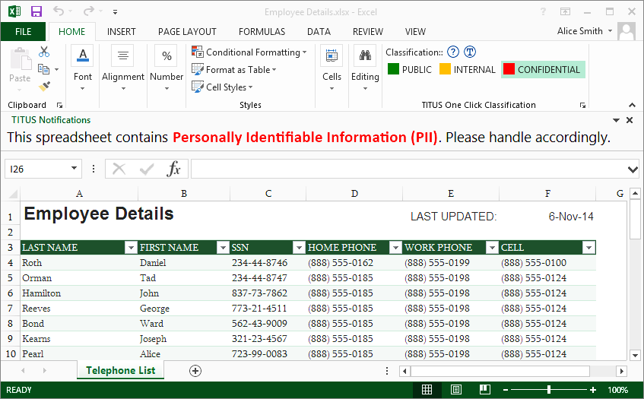


Slide 11
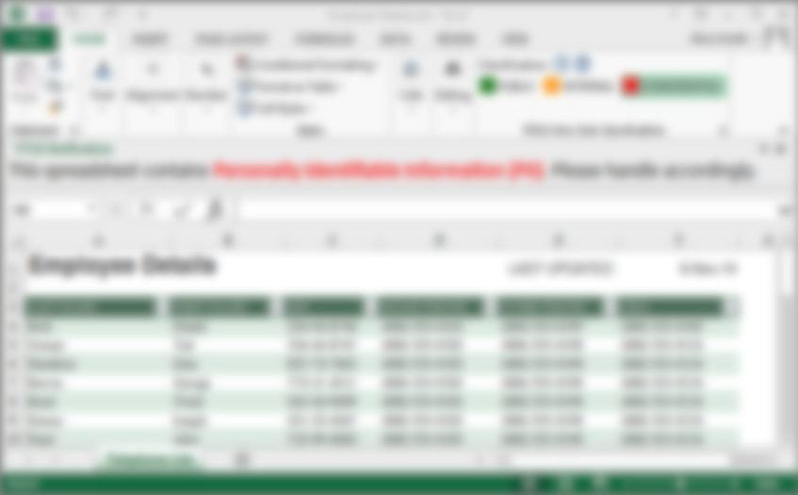

Notes:
<BUILD> Educate:
Transform how users behave with digital information as you prompt them to identify/classify or let them know the sensitivity of the data they are handling through policy alerts or markings in the document. Catch the mistakes before that are made.
With knowledge of the data value, people can make better decisions on how it is used, shared, collected. Will also help ensure people can FIND the appropriate data to make the right decisions

Slide 12
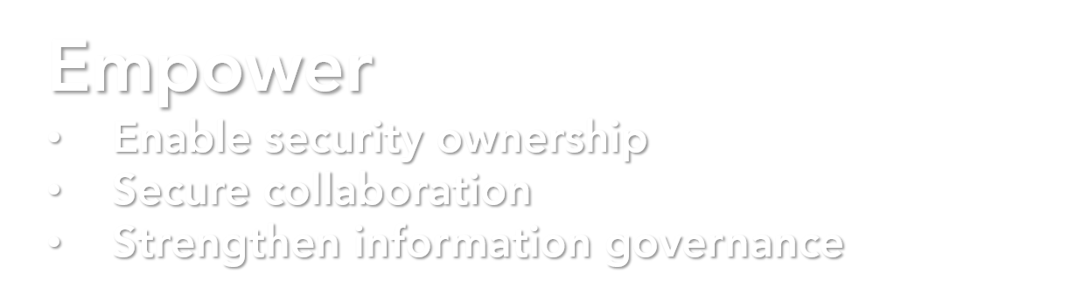
Notes:
<BUILD> Empower:
Give employees the ability to comply with their obligations to protect information. Most employees want to do good, give them the opportunity and the tools to do so. Give them ownership of data security
With identified data, collaboration can be secured – sharing to the right people, via the right technologies, to the right locations.
End to end information governance, who has access, it’s status, where it is (discovery), when it should be archived and deleted, defending deletion in court – all enhanced with identity and metadata

Slide 13
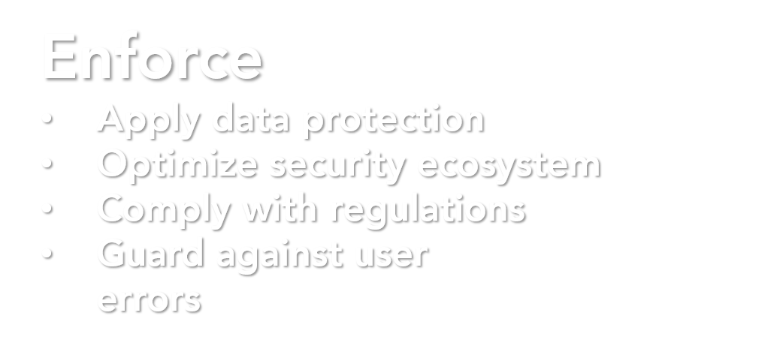
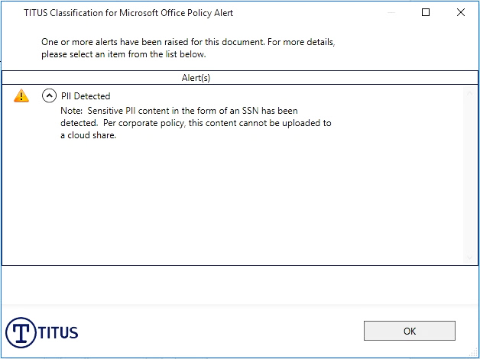
Notes:
<BUILD> Enforce:
Simplify the application of protection technologies – make it easy for the user to choose the right access rights, the right level of security by asking them simpler questions: what is this data?
Identity helps your other security solutions, your other investment, be more accurate, more efficient, and more effective. Increase ROI and enhance your capabilities to earn trust
Be sure that information is shared, protected, and disposed of in accordance with legislation.

Slide 14
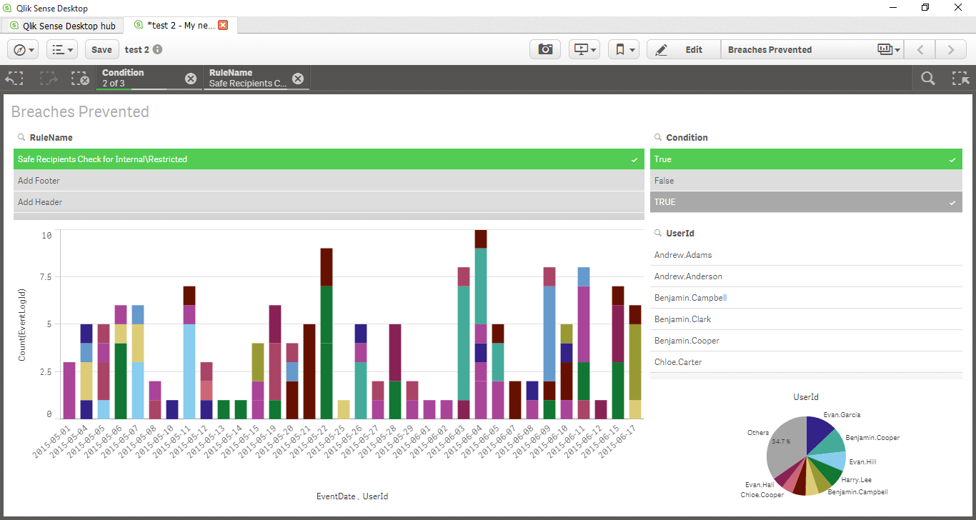
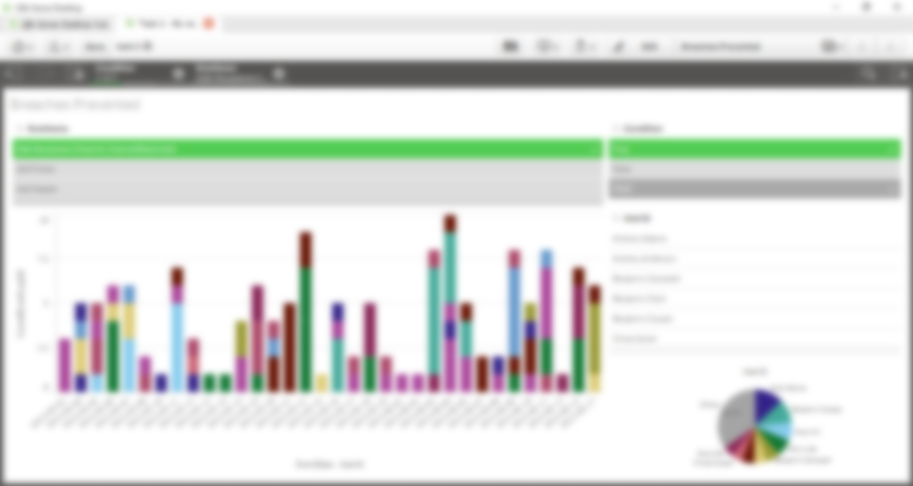
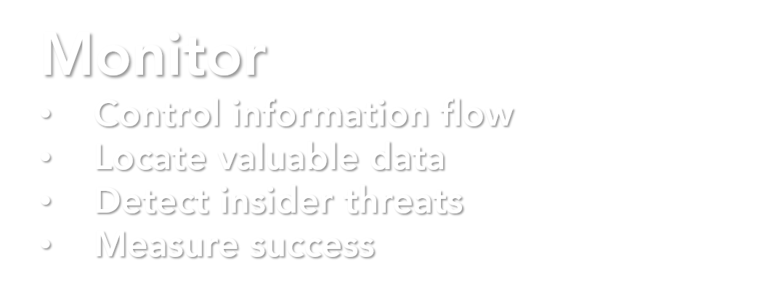
Notes:
<BUILD> Monitor:
When identified, you can ensure that information is only going to the right people, locations, devices, apps, etc.
Find and identify all your information, on premise or in the cloud
Because we are monitoring within MS Office productivity apps, we can see how users are working with data – moreover, knowing the sensitivity makes it possible to focus on what they are doing with the most sensitive data – the stuff that counts. Maybe they need more training, maybe the policies need adjustment, or maybe you have someone up to no good. The difference between emailing 10 documents and emailing 10 Restricted files is huge.

Slide 15



Notes:
[[ STORY: TO CAPTURE THE BENEFITS OF DIGITAL TRANSFORMATION YOU NEED YOUR CUSTOMERS, PARTNERS, AND EVEN YOUR EXECUTIVE, TO TRUST THAT THE INFORMATION IN YOUR HANDS WILL BE PROTECTED ]]
Capturing the potential of the new digital world of mobile workforces, cloud services, bid data, faster processing, social media… this requires Trust that the data will be protected as it moves, replicates, shifts, collects, and is shared.
You have invested in security technology, but we know breaches are still happening… because we have not invested properly in our users, our people, our cultures.
At TITUS, we’re already working with Global 2000 brands who are starting to make this transition, leveraging the TITUS platform.
Let us help you achieve your goals and secure your sensitive information.

Slide 16















Notes:
We provide a set of products called the TITUS Classification Suite. The suite enables end users to identify and protect the information they are working with - whether that information is in Outlook email, Office documents, or any file type on the Windows desktop.
Our classification products also include TITUS Mobile for Classification, which is an easy to use email and document security solution for mobile devices that prevents data loss and ensures the right users have access to the right information.
Finally, our TITUS Illuminate product allows you to discover, identify, automatically classify and protect your data at rest across the enterprise, on premise and in cloud shares. It also provides visibility into a data inventory, allowing you to make risk based decisions based on various trends (where it’s being stored for example).
Let’s have a look at some sample use cases to show how TITUS products can help solve your business problems.

Slide 17
TITUS Use Cases
Email – Safe Recipient, Earning Data, LDAP
Regulatory – GDPR, ITAR, PCI, NERC, CUI, etc.
Legal/HR – Safe Recipient, Defensible Deletion, Retention, Audit
Records Management – DAR, Content Management
Encryption
DLP/CASB
DAR – Cloud Migration (Box, Dropbox, OneDrive, FileShares), Audit, GDPR, CUI
Security Change – Digital Transformation

Slide 18
The TITUS Methodology
Delivering Data Classification Success

Slide 19


Requirements for Success
20% Data Classification Software
80% Classification Deployment Methodology
Notes:
A successful data classification project has two important ingredients:
Data Classification Software – which we have spent some time discussion and reviewing already
Leverages a deployment methodology – often customers get focused on the product component of the solution, which of course makes sense as TITUS is an enterprise software company. However, just as important is to recognize that TITUS offers its customers a data classification deployment methodology to walk them through the phases and stages towards a successful rollout and adoption

Slide 20
Why a Deployment Methodology for Classification?
More than just security labels
Foundational to multiple aspects of information management and control
Project should be holistic in nature but implemented in focussed phases
Notes:
So why did TITUS decide to create methodology if we are an enterprise software company?
1) TITUS has been selling and deploying data classification solutions for more than 10 years and along the way we have learned that while technology is an important component, how customers plan and communicate classification throughout their organization is a critical success factor. As a result, this is more than just security labels and we know what it takes to make a deployment successful and have harnessed those best practices into our methodology.
2) Being a foundational technology provides data classification a lot of opportunity to drive outcomes across many use cases and integrations into other security platforms. Therefore, it is important to leverage the methodology as a way to stay focused on key success factors for the particular stage you are in and drive towards deployment success
3) Data classification is evolutionary – this means that customers should realize that after the first deployment across the enterprise they will eventually mature their labels and policies across phases to address new business requirements as well as compliance requirements that may appear in their particular industry. As a result, the methodology is a guide that can be used to help ensure the appropriate steps continue to followed throughout that evolution.

Slide 21













A Blueprint for Success
Data Classification (TITUS) Deployment Methodology
Organizational Readiness
Implementation
Evolution
Alignment
Readiness
Analysis
Design
Configure
UAT
Deploy
Measure
Operational
Communicate | Transform Security Culture
Notes:
The TITUS Deployment Methodology is comprised of 8 stages and 4 phases with an overarching view into best practices for communicating to employees and ultimately transforming security culture.
The first phase is organizational readiness which focuses on ensuring all the important business components are in place to eventually finalize the classification configuration for the phase of deployment.
The second phase is implementation which involves working with the security as well as deployment team to build, test and ultimately deploy the classification configuration.
The third stage is evolution, which is all about how to measure and report on the status of the rollout as it relates to the business outcomes the customer is trying achieve. Based on the reports, this phases also drives planning into evolution and sets the stage for the next phase of the enterprise’ classification strategy
Finally, the last stage of the methodology is becoming operational and managing TITUS in a production environment

Slide 22





Data Classifiction Deployment Methodology
Blueprint for Success
Built on Experience
User Adoption Best Practices
Outcome Driven
Provides Resources
Notes:
The TITUS Deployment Methodology is built on five assets:
Blueprint for success: with the methodology TITUS’ goal is to provide a blueprint that they can use as an input into their respective project plans for deployment
Built on experience: TITUS is often asked how do other enterprises deploy this? As a result, this methodology takes into account experience from enterprise customers around the world so our customers know they are following best practices
Provides best practices for user adoption: One of the most important components of the TITUS deployment methodology is what we have learned around how to effectively communicate this change to an organization such as best practices as well as creative ideas for positioning data classification to the user community.
Outcome Driven: The TITUS Deployment Methodology goes beyond just providing best practices, it is oriented around delivering outcomes for customers at stage in the journey. This helps to ensure customers are following steps that other enterprises have taken to be successful.
Provides Resources: from our experiences, TITUS has accumulated quite a few resources that customers have leveraged during their data classification rollout that we are happy to share with the TITUS customer community – some of these are outlined on the next slides…

Slide 23
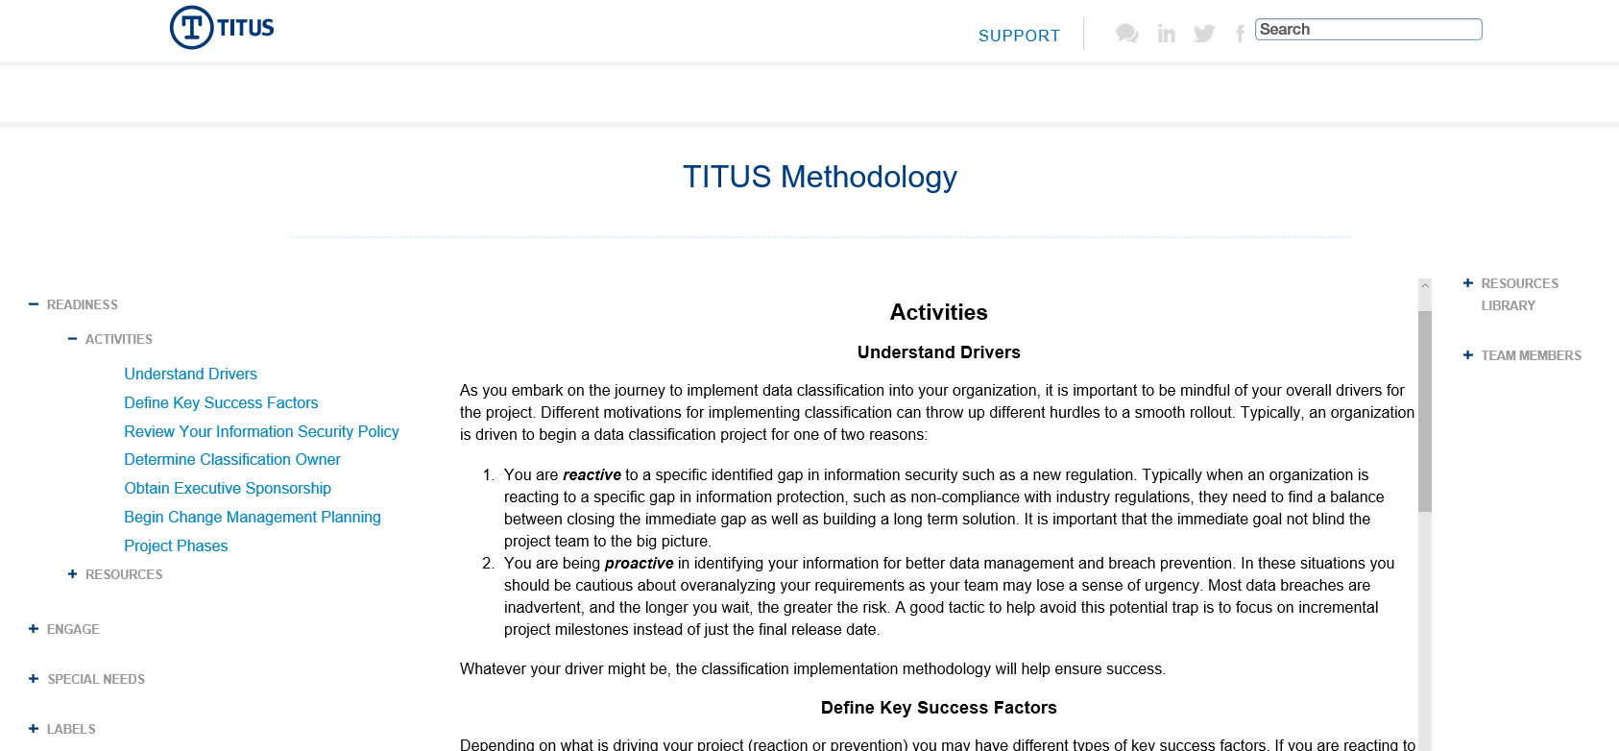
Methodology Portal

Slide 24
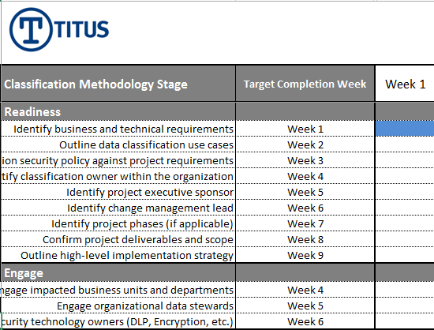
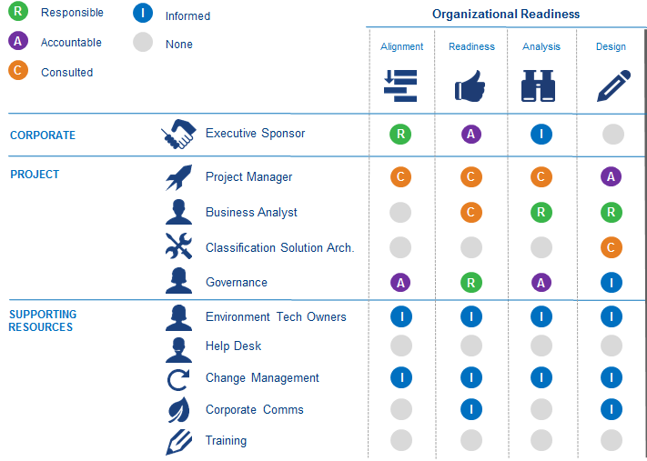
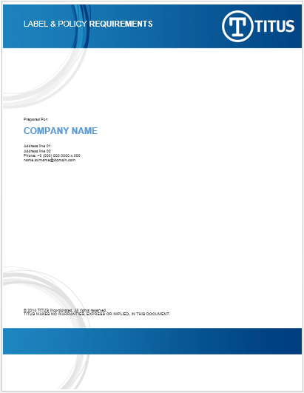

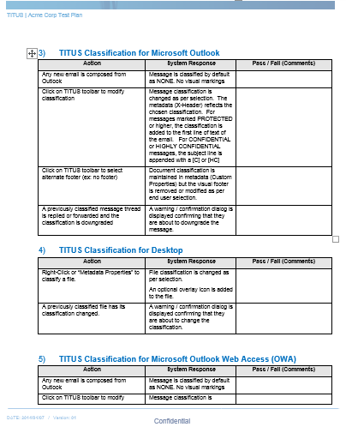
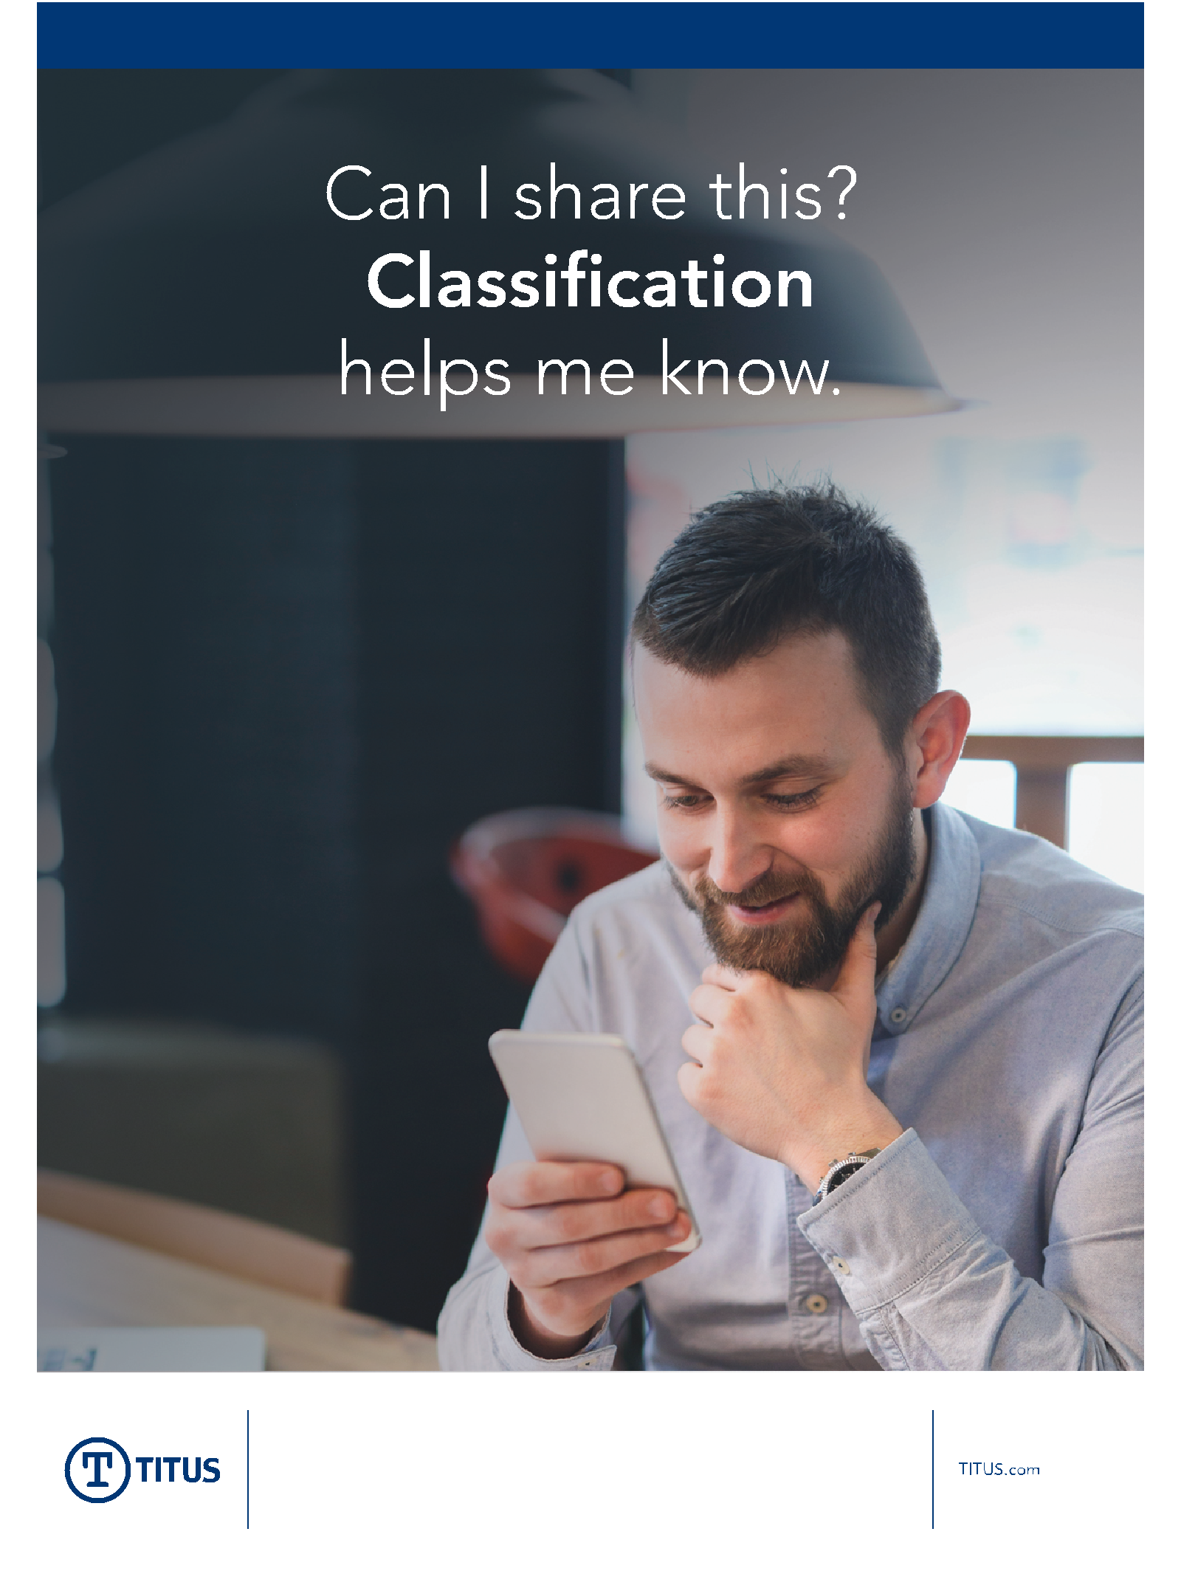
Resources to Get Started
Sample Project Docs
(Req. & Test Plan)
Sample Awareness Posters
Sample Project Plan
Sample RACI Matrix
Notes:
Resources to get starting include:
Sample project plan – built around capturing best practices that an enterprise should consider while going through each stage of their deployment
Sample RACI: https://en.wikipedia.org/wiki/Responsibility_assignment_matrix. Often TITUS is asked, who should be involved in the project from the business and IT? This RACI is snapshot to providing a starting point for cutomers
Same project docs – while a customer will not copy this exactly, these documents are a framework that other customers have used to build requirements as well as test plans for TITUS

Slide 25
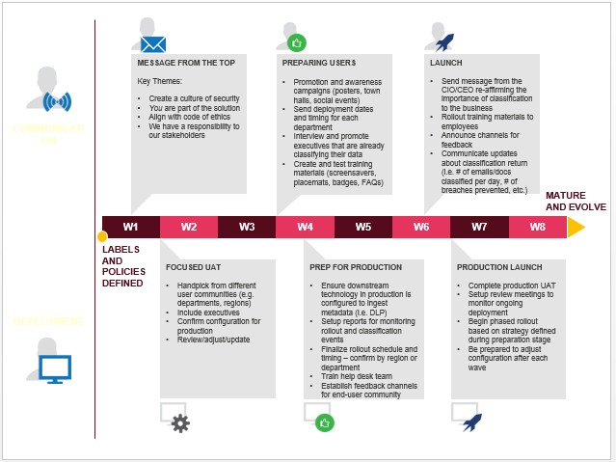
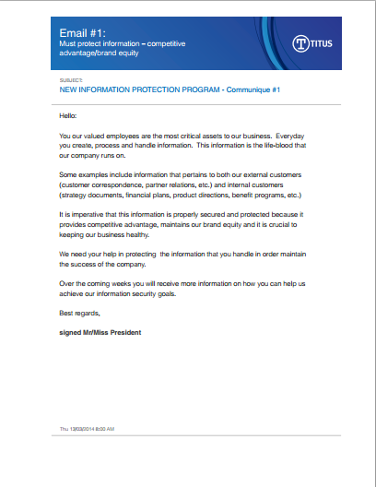
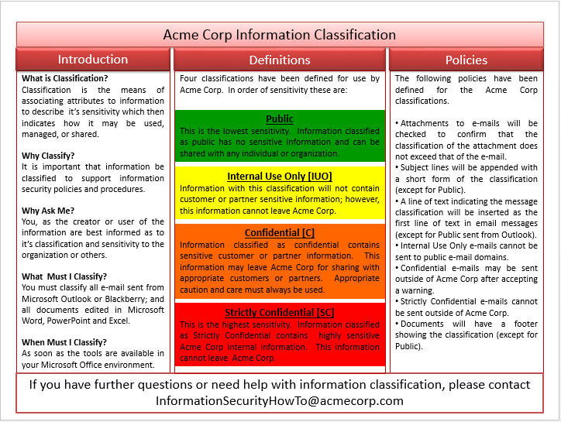
Communication Resources
Sample Executive Communication Template
Sample Employee Communication Tools
Notes:
In addition to resources to get started, TITUS also offers communication resources such as:
Sample executive communication template – this is a template that customers could use to present their classification deployment strategy at an executive meeting
Sample employee communication tools – TITUS has provided customers guidance on how to effectively communicate classification across their employee community. As part of this guidance, we have helped shape and develop communication tools such as email campaigns as well as placemats to reference classification labels/policies

Slide 26







Functional Enablement
Maturity
RUN
WALK
CRAWL
Unstructured Data
Time
Notes:
In addition to resources – TITUS is also happy to offer customers guidance on how to build their data classification labels and schema. TITUS always suggests customers take a crawl (build), walk (build) and eventually run (build) approach when it comes to building a data classification configuration.

Slide 27






Data Classification Templates
Strategic Objectives
Outcomes
Data Classification Templates
Crawl
Walk
Run
Accurately Identify Information Assets
Classification Labels and Levels
Level of User Engagement
Data Coverage
Universal vs. Group Policy
Transform
Security Culture
Awareness
Education
Culture Change Validation
Manage and Control Information
Control Sharing Based on Classification in Email
Control Data Sharing across the Network and Cloud
Apply Protection based on Data Classification
Notes:
To take it one step further, TITUS is happy to also provide customers with sample templates/configurations for each of these stages, with the first being “crawl”.
The objective of these templates is to provide customers with guidance on what classification labels and policies should be used to achieve three strategic outcomes:
Accurately Identify Information Assets
Transform Security Culture
Manage and Control Information
Note: if the customer would like more information about templates – please reach out to Steve Healy and/or Mark Cassetta

Slide 28


TITUS Customer Engagement
Agreement with TITUS is Signed
Onboarding
License Letter
License Key
Support Portal
Methodology Portal
Technical Account Mgr*
Professional Services*
PS Kick-Off
Methodology Review
Deployment Planning
*If Purchased
Notes:
To summarize how/when customers get fully engaged with the methodology – once we have our license agreement in place we are happy to onboard you with the software as well as access to our support and methodology portal. At that time the professional services team will work with our customers to kick off the project and provide a more detailed overview of the TITUS Deployment Methodology during initial deployment planning.

