Slide 1
The Evolving File Analysis Marketplace
ARMA Charlotte-Piedmont and Triangle Chapters
Steve Bradley, Director
January 12, 2017

Slide 2

Steve is a Director with HBR in the Information Governance group. With over 25 years of experience, Steve advises clients in the areas of information governance and compliance, records and information management, document management and litigation readiness. Steve works with legal, compliance, IT and information governance professionals to lower costs, reduce risks, ensure compliance and strategically leverage the value of their data and information resources. Prior to HBR, Steve was a Director with Consilio and the Huron Consulting Group. He previously co-founded and served as a principal at Camden Place, and has extensive experience working within the charitable and non-profit sector, having served as a board member and/or strategic advisor to a number of organizations, addressing areas such as governance, vision crafting, mission alignment, communications, and resource development.
Steve Bradley
HBR Consulting
Director
sbradley@hbrconsulting.com
312-638-5123

Slide 3
The Evolving File Analysis Marketplace - Agenda
What
  Defining File Analysis (FA)
  The File Analysis Marketplace
  Primary FA Use Cases
Who
  General Audience / Buyers / Roles
  Representative Vendors
Why
  Key RIM/IG Drivers and Use Cases
How
  Implementation Examples
When
  Key Takeaways and Recommendations

Slide 4
What - Defining File Analysis (FA)
File Analysis at its core involves simply the analysis of electronic file metadata and content found in unstructured data repositories
Two Primary Levels of Analysis
  File System Metadata
    Includes information about individual files
    Examples include contextual metadata about associated servers, volumes, shares, folders, and identity related information such as company / department / group / user permissions and ownership; as well as file specific metadata such as file owner, last author, author, file extension / item type, and create, last modified, and last accessed dates
  File Content
    Includes information within individual files
    Represents a much more granular level of detail, and subsequently a larger data footprint and supporting set of infrastructure requirements

Slide 5
What - Defining File Analysis (FA)
FA has evolved from a more distinct set of tools allowing for basic scanning, data collection, and analysis into more robust technology and platform offerings
Actionable intelligence gleaned from detailed metadata and contextual analysis allow users to better manage and govern unstructured repositories, including:
  Email
  File Shares
  ERM / EDM / ECM Systems
  SharePoint
  File sync and share sites such as Box.net or Dropbox
  Data Archives
  Business Intelligence (BI) / Data Warehouse Environments

Slide 6
What - The File Analysis Marketplace
The FA Marketplace is still emerging and evolving, including more specialized niche oriented vendors, as well as established vendors offering a variety of technologies from areas such as:
  eDiscovery
  Information Security / Privacy / Data Loss Prevention (DLP)
  RIM / IG / EDM / ECM
  Data Archiving / Storage / Disaster Recovery (DR)
  Identity and Access Management (IAM)
  Business Intelligence (BI) / Decision Analysis
  Big Data Analytics
Key Source: Gartner’s Market Guide for File Analysis
  First Published in September 2014
  Latest (2016) version: https://www.gartner.com/doc/3446718/market-guide-file-analysis-software

Slide 7
What – Primary FA Use Cases
Use Case | Description
Risk Mitigation | This includes security and risk professionals seeking to develop policies and controls for (among other things) access to data via classification according to risk or security needs.
Governance/Policy Management | FA can assist with data being classified and flowing into the appropriate platforms for governance, record keeping, compliance and analytics. In some instances, file analysis is also used as an initial step for e-discovery purposes.
Efficiency and Optimization | Organizational efficiency is based upon providing users with the data where and how they want to use it, such as in EFSS or SaaS collaboration solutions, across users and devices, and accessible from anywhere. The most common storage management use cases are to reduce the storage footprint and/or to improve storage efficiency.
Analytics | Involves presenting data in a way that provides insight to the organization for business value and anomaly detection.
Source: Excerpted from Gartner: Market Guide for File Analysis Software (19 September 2016)

Slide 8
Who – General Audience / Buyers / Roles
Audience / Buyer / Role | Use Case(s)
Business Intelligence | Analytics
Chief Analytics Officers (CAOs) | Analytics
Chief Data Officers (CDOs) | Governance/Policy Management Analytics
Chief Information Security Officers (CISOs) | Risk Mitigation
Data Architects | Governance/Policy Management Efficiency and Optimization
Data Scientists | Analytics
Information Stewards | Governance/Policy Management
IT: security | Risk Mitigation
IT: storage, infrastructure and operations leaders | Efficiency and Optimization
Legal: general counsel, chief legal officer | Governance/Policy Management
Litigation: support and general forensics | Governance/Policy Management
Risk managers, compliance and privacy authors, auditors | Risk Mitigation
Source: Excerpted from Gartner: Market Guide for File Analysis Software (19 September 2016)

Slide 9
Who – Representative Vendors
Dropped From the 2016 List
Vendor Name | Product | Comments
Acaveo | Smart Information Server | Out of business as of late 2016
AvePoint | AvePoint Compliance Guardian | Identified more with InfoSec / DLP markets than FA
CommVault | Simpana | Identified more with Data Archiving / Backup markets than FA
Covertix | SmartCipher | Identified more with InfoSec market than FA
Imperva | SecureSphere File Activity Monitor | Identified more with InfoSec / Web App Security markets than FA
Microsoft (Equivio) | Zoom for Information Governance | Functionality absorbed into Office 365 eDiscovery offerings
Nuix | Nuix Information Governance, Nuix Web Review and Analytics, Nuix Sensitive Data Finder, Nuix Incident Response | Identified more with eDiscovery market than FA
Proofpoint | Proofpoint Enterprise Governance | Identified more with InfoSec / Digital Risk Monitoring markets than FA
Rational Enterprise | Rational Governance | Identified more with eDiscovery market than FA
ZyLAB | Intelligent Information Governance | Identified more with eDiscovery market than FA
Source: Excerpted from Gartner: Market Guide for File Analysis Software (4 August 2015, and 19 September 2016)

Slide 10
Who – Representative Vendors
New to the 2016 List
Vendor Name | Product
Capax Discovery | Enterprise Archive Solution (EAS) Data Light
Controle | eGovern
Druva | inSync
Egnyte | Egnyte Connect, Egnyte Protect
Haystac | Indago
Kazoup | Kazoup analytis platform
Titus | Titus Classification Suite, Titus Illuminate
ZL Technologies | ZL File Analysis and Management
Source: Excerpted from Gartner: Market Guide for File Analysis Software (4 August 2015, and 19 September 2016)

Slide 11
Who – Representative Vendors
On Both the 2015 and 2016 List
Vendor Name | Product
Active Navigation | Discovery Centre, Action Pack, Analysis Pack
Adlib Software | Adlib Elevate platform, PDF Enterprise
BeyondRecognition | BeyondRecognition
Bloomberg | Bloomberg Vault File Analytics
Condrey Corporation | Senergy, Galileo, Aurora
Cryptzone | Security Sheriff, Compliance Sheriff, Site Sheriff)
dataglobal | dg analyze, dg file, dg classification
Exterro | Exterro File Analytis
HPE | HPE ControlPoint, Storage Optimizer
IBM | StoredIQ
Index Engines | Catalyst
SailPoint (fka Whitebox Security) | SailPoint SecurityIQ
Spirion (fka Identity Finder) | Spirion
STEALTHbits | StealthAUDIT, STEALTHbits File System Clean-up, STEALTHbits File Activity Monitor
Veritas (formerly Symantec) | Data Insight, Information Map
Varonis | Metadata Framework
Source: Excerpted from Gartner: Market Guide for File Analysis Software (4 August 2015, and 19 September 2016)

Slide 12
Who – Representative Vendors
Primary Use Cases Supported by 2016 List Vendors
Capax Discovery
Data Global
Egnyte
Index Engines
Spirion
STEALTHbits
Varonis
Veritas
Active Navigation
Adlib Software
BeyondRecognition
Bloomberg
Controle
Cryptzone
Druva
Exterro
SailPoint
Titus
Governance/Policy
Management
Condrey
Haystac
Efficiency/
Optimization
Risk Mitigation
Kazoup
HPE
IBM
ZL Technologies
Analytics
Source: Gartner: Market Guide for File Analysis Software (19 September 2016)
Gartner’s Note: Though most vendors support some elements of each use case, vendors are listed in the above diagram according to the major use case supported and what customers acquire the solution for.

Slide 13
Why – Key RIM/IG Drivers and Use Cases
Key RIM/IG drivers include:
  Risk and cost reduction
  Increased efficiency and usability of business critical data
  Information governance and compliance
Key RIM/IG use cases include:
  Assessment, identification, and discovery of unstructured content
  Defensible disposition and ROT Removal
  Sensitive data identification / protection
  Data inventory, cleanup, remediation, and migration
  Improved governance, compliance and application of controls
  Large data set review during M&A/Divestitures and eDiscovery early case assessment (ECA)
  Analytics and leveraging of actionable intelligence to drive decision making and define, monitor, and demonstrate success

Slide 14
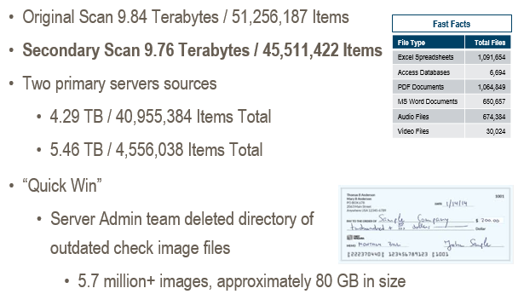
How – Implementation Examples
Initial Discovery and Quick Win ROT Removal

Slide 15
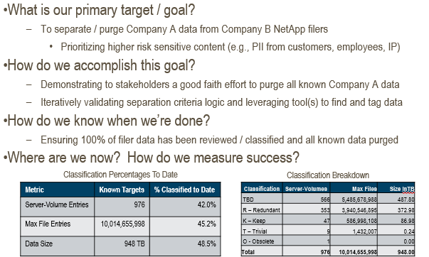
How – Implementation Examples
M&A/Divestiture Large Data Set Review

Slide 16
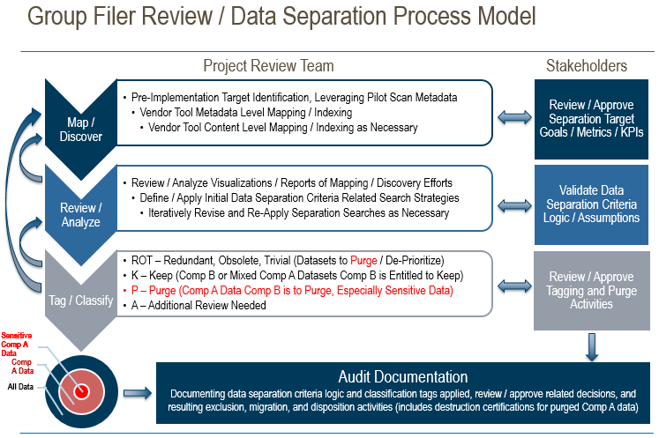
How – Implementation Examples
M&A/Divestiture Large Data Set Review

Slide 17
When – Key Takeaways and Recommendations
Currently the FA Market is still emerging and evolving
Before looking to procure a vendor solution:
  Do a survey of your information and technology landscape
    How much do we know about our unstructured data?
      Key metrics include: volume of data, growth rate, age, ownership, content types
    What tools, software, or vendor relationships do we have that can be leveraged to uncover more actionable intelligence?
    How would our organization benefit from a FA solution?
    Who would benefit and get behind such an effort?
  Consider how unstructured data fits within your current policy framework and an overall content placement strategy
    Do we have clarity/consensus on:
      How a RRS applies to electronic data?
      Where electronic content should be placed so proper controls may be applied?

Slide 18
When – Key Takeaways and Recommendations
Nuggets of Wisdom
Driving on a paved road is easier than blazing a trail
Test the water before diving in head first
  Leverage free or low cost scanning / data collection options first
  Take advantage of vendor trial / pilot offers to try before you buy
Remember KISS and JBGE
  Consider ways to optimize real world compliance by simplifying and clarifying RIM/IG related policies and controls
The best business cases align with the strategic vision, mission, and priorities of your organization

Slide 19

Wrap Up
Steve Bradley
Director
HBR Consulting
sbradley@hbrconsulting.com
312-638-5123
Thank you for your participation!

