Slide 1
What’s New in Information Governance for 2016?
The Emerging Role of Shadow IT &
Other Hot Topics
Part 1
ARMA Triangle IG Seminar
Research Triangle Park, NC
April 7, 2016
Jason R. Baron, Esq.
Information Governance and eDiscovery Group
Drinker Biddle & Reath LLP
Washington, D.C. 20005
© Jason R. Baron 2016

Slide 2

Part I: The Emerging Role of Shadow IT, and Other Hot Topics

Slide 3


We have entered the era where
Big Data is ….

Slide 4

Living in an exponential world

Slide 5

The World Has Changed
We are not just managing thousands or millions of paper files
We are at an inflection point in history in terms of data volume
IDC Report: 1800 new exabytes this year
  (1 exabyte=data equivalent of 50,000 yrs of continuous movies)
Open data policies vs. “the iceberg”:
a vast amount of information is
“hidden” underneath the web —how is it
to be reliably preserved and accessed?

Slide 6

Email is still the 800 lb. gorilla of ediscovery

Slide 7
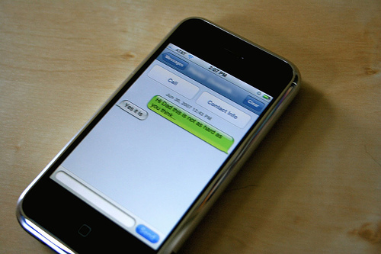
Beyond email: text messaging, social media

Slide 8

Moving to the Cloud

Slide 9

World of Mobile Devices & Social Media Apps

Slide 10
President Obama & Snapchat
The Obama Administration is Now on Snapchat (law.com, 1/12/16).
The White House is the latest big-name entity to set up an account on Snapchat, a messaging application that is especially popular with teen-agers and young adults.
Though content on the social media site can disappear, pursuant to federal law, the White House will have to keep required records.
Jason R. Baron, an attorney at Drinker Biddle & Reath and former director of litigation at the National Archives and Records Administration (NARA), explained that the government’s requirements on social media documents are not less strict than those regarding printed documents.
“All presidential communications or correspondence created in the White House that qualify as presidential records must be preserved, regardless of media type,” Baron told Legaltech News. “The same laws apply to all media, namely, the Presidential Records Act for messages created or received by the President and his immediate staff, and the Federal Records Act for the rest of government. I would expect that the folks at NARA will be asked to issue guidance covering Snapchat very soon.”
After sending, documents on Snapchat can quickly disappear – and that that could pose some challenges for the government.
“Snapchat is new territory for the White House and for the government in general, so some amount of additional attention needs to be paid in deciding how to go about preserving substantive communications that are capable of automated deletion,” Baron said.
Source: http://www.law.com/sites/articles/2016/01/12/the-obama-administration-is-now-on-snapchat/#ixzz3xk9BW8FY

Slide 11
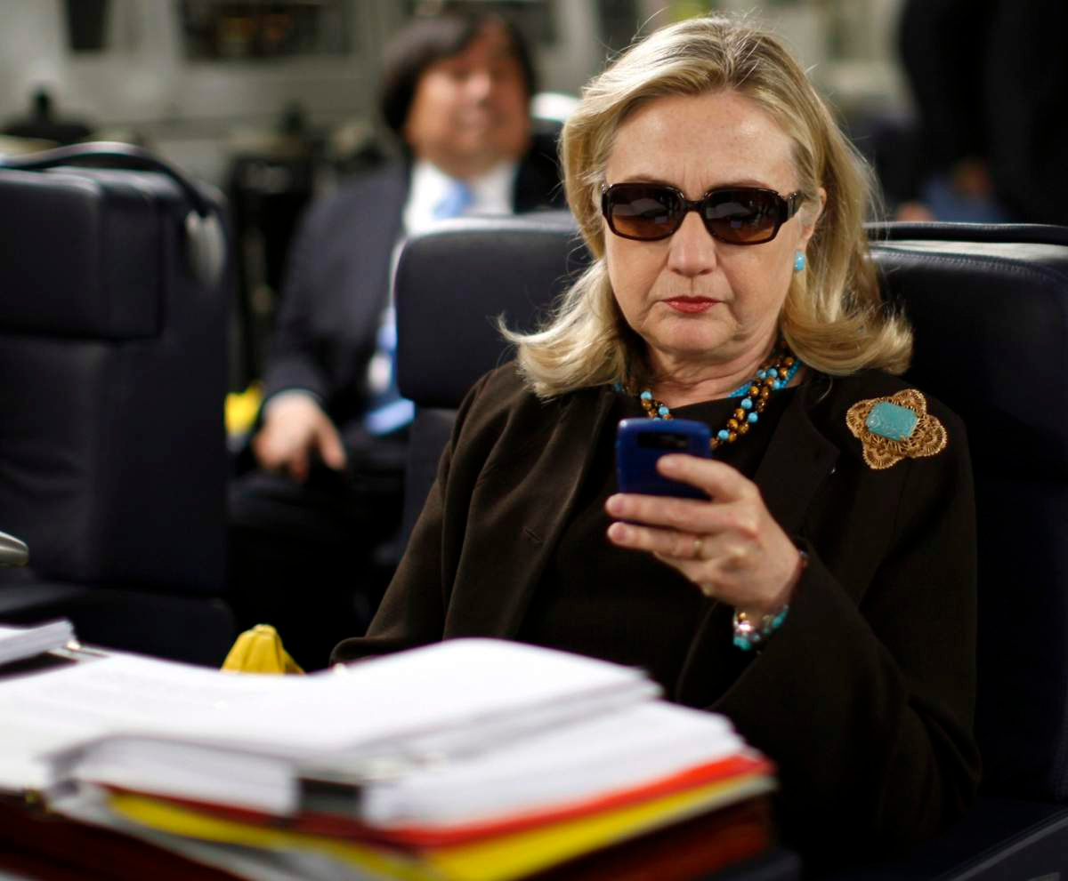
Heard any news lately about federal recordkeeping?

Slide 12
Nytimes
“Hillary Clinton Used Personal Email Account at State Dept., Possibly Breaking Rules,”
Michael Schmidt, New York Times, March 3, 2015
“It is very difficult to conceive of a scenario — short of nuclear winter — where an agency would be justified in allowing its cabinet-level head officer to solely use a private email communications channel for the conduct of government business.” -- Jason R. Baron

Slide 13
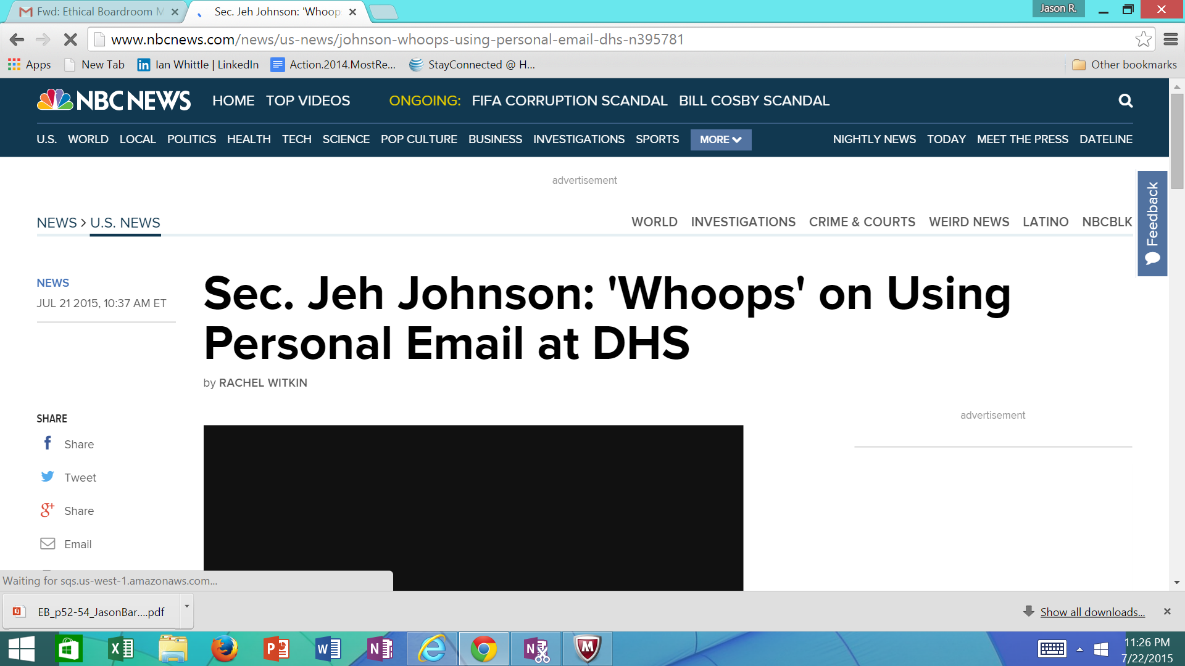

Slide 14
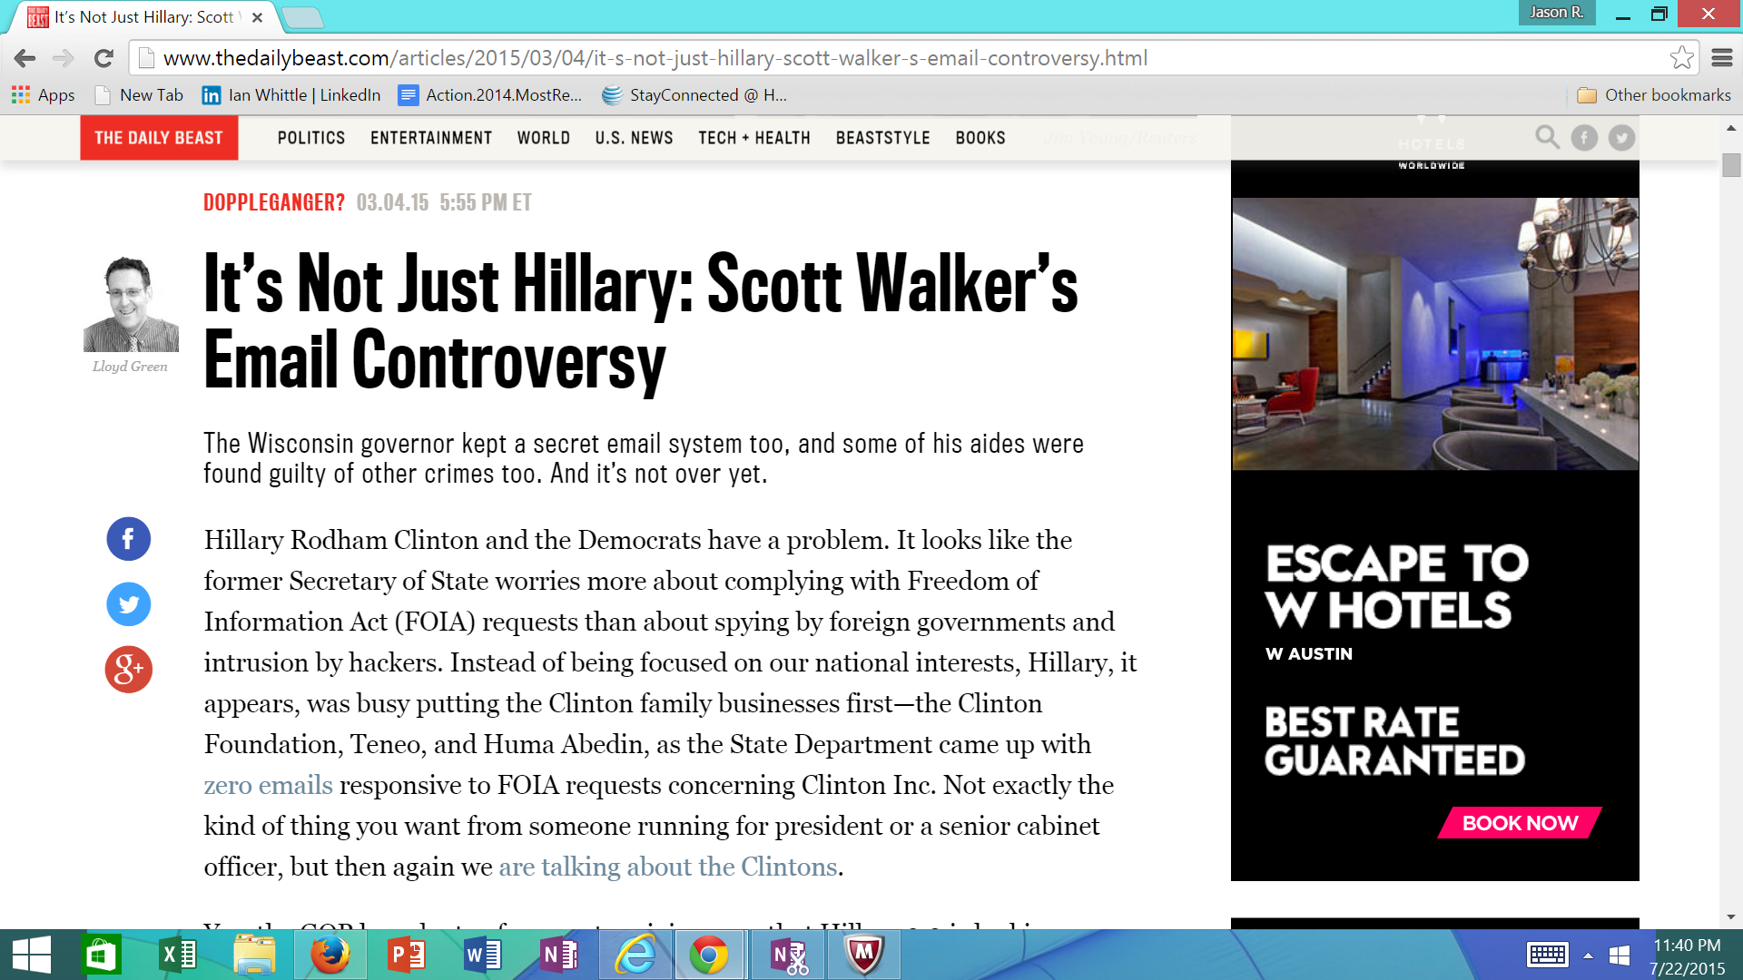

Slide 15
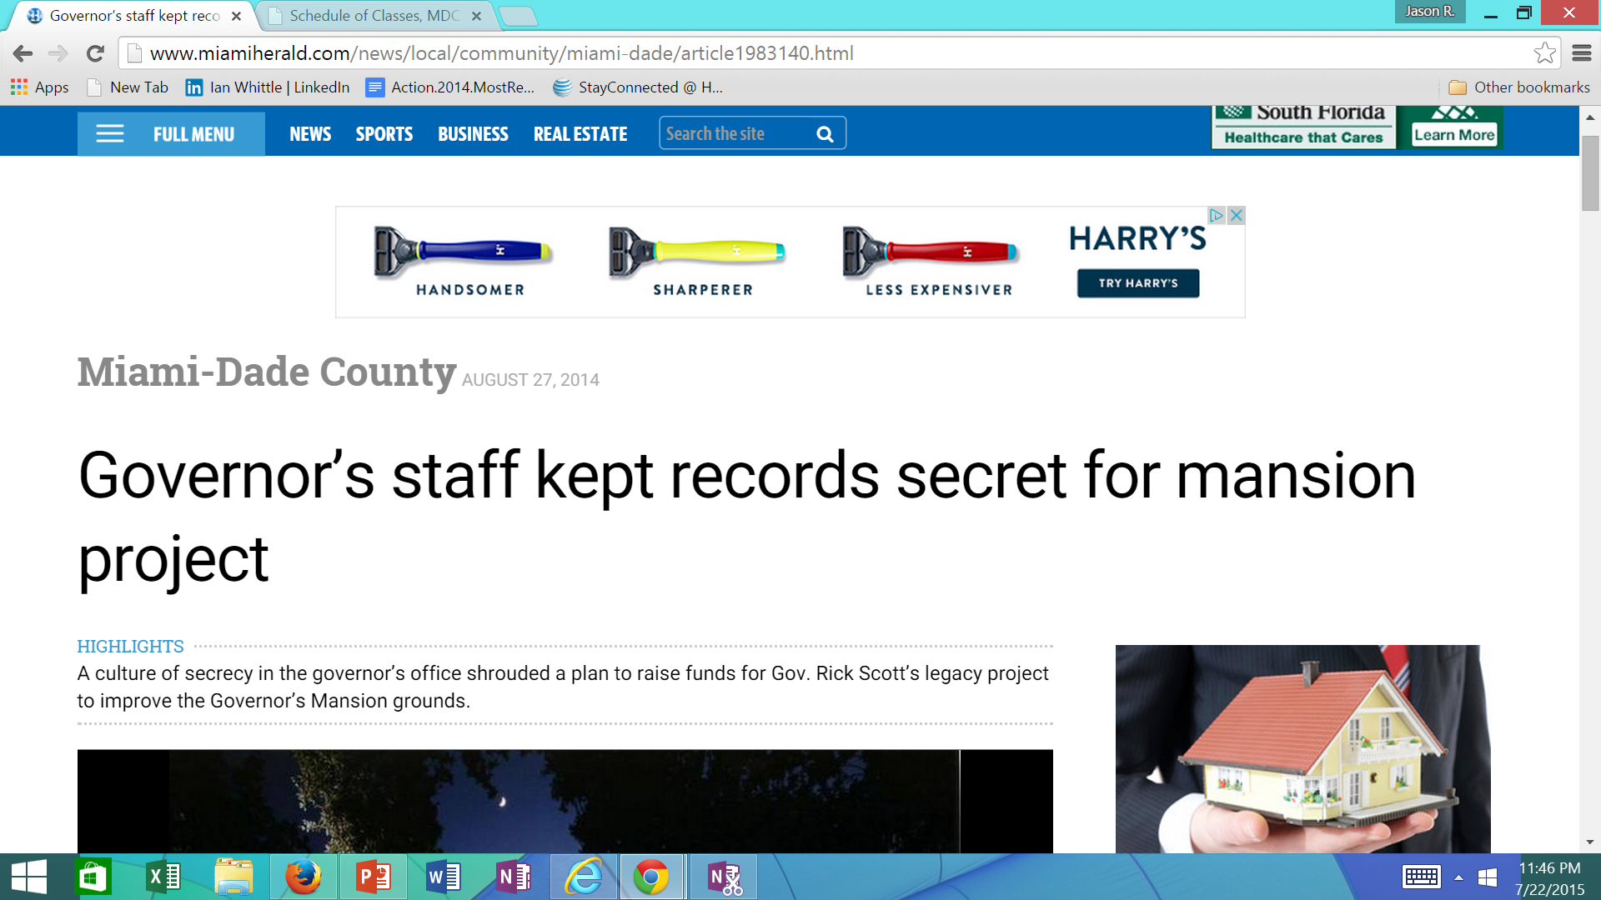

Slide 16
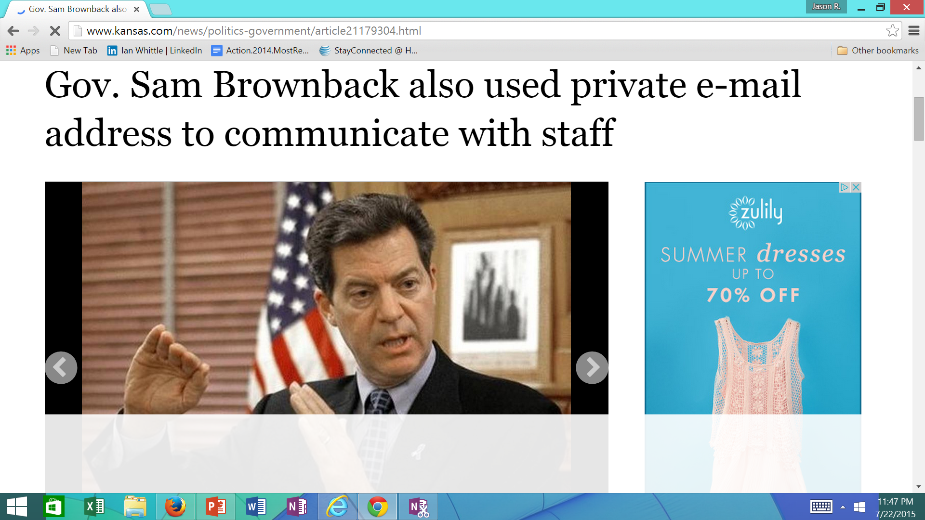

Slide 17
Headlines
Kansas Governor Sam Brownback:
  "Most of the time I call people or I just go over to their office. That's how I do most of my communication," Brownback said Monday. "And if I communicate in e-mail, it's directly to their state accounts, I mean, that I know of. There may be some that are different. But that's how most of the communication's done. Most of the communication's done orally or over the phone.“
    Tribune News Service May 19, 2015

Slide 18

Text messages ‘deleted’ on the day of the GW Bridge scandal…

Slide 19
From Propublica March 2015: “All The Other Times A Politician Avoided Official Email” (excerpts) http://www.slate.com/articles/news_and_politics/propublica/2015/03/hillary_clinton_email_scandal_former_secretary_of_state_is_hardly_the_first.html
Colin Powell relied on personal emails while secretary of state, Politico, March 2015
Since news of Clinton’s use of private email for White House business broke, an aide to Colin Powell says he “might have occasionally used personal email addresses” to correspond with staff and officials during his tenure as Secretary of State^{[1]}.
Bush Advisers’ Approach on E-Mail Draws Fire, New York Times, April 2007
The Bush Administration admits that as many as 22 political advisers to the president, including Bush advisor Karl Rove, used their Republican National Committee email accounts for White House related business. At the time, the RNC automatically purged emails after 30 days.
Jeb Bush Owned Personal Email Server He Used as Governor, NBC News, March 2015
A Mar. 4, 2015 report from NBC News finds that from 1999 to early 2007 Jeb Bush used his own private email server for official business as Florida Governor.
Trove of Palin E-Mails Draws Press to Alaska, New York Times, June 2011
In 2011, Sarah Palin releases more than 24,000 pages of emails sent from a private account while she was Alaska’s governor, responding to public records requests made in 2008. The emails reveal less-than scandalous details of her life,including her early attempts to meet John McCain, a draft ghostwritten letter to the editor in response to criticism against her and plans to see a controversial Christian pastor in Juno, Alaska.
Christie administration may have violated public records law, (Bergen County)Record, January 2014
The Record releases a cache of emails sent from personal accounts between top Chris Christie aides that reveals their plan to create a traffic jam over the George Washington Bridge possibly as retribution against the mayor of Fort Lee who refused to endorse Christie in the 2013 New Jersey gubernatorial election.
After Pledge of Sunlight, Gov. Cuomo Officials Keep Their Email in the Shadows, ProPublica, May 2014
ProPublica finds that top advisers to New York Gov. Andrew Cuomo conduct government business through personal email accounts including Howard Glaser. ProPublica recently obtained emails from Glaser in which he touted his "significant, critical, and current input" on a deal that weakened rules to prevent misdeeds in the mortgage market.

Slide 20
Caution is needed; soundbites and headlines can be misleading
Guidance is somewhat of a moving target from 2000 thru 2015: same rules were not in place and so one needs to be careful in comparing apples and oranges
Using a private email system from a government computer is not per se a records violation (although it increasingly may raise security issues)
  Rather, its not copying or transferring records of public business from the device or account that causes the problem
Using a private email system for non-official business like campaigning may actually be perfectly appropriate
  the problem comes when one is mixing public/private business on the desktop or on one’s own device, or when directing staff on the government payroll to perform campaign-related duties

Slide 21
More cautions
Having one’s own smartphone or blackberry isn’t a bad thing
  One can partition a phone’s accounts to conduct public business on one button and keep Gmail or another private service on another button
Having two devices is probably better, but clumsy

Slide 22
Pending California Supreme Court Case on Whether Email on a Private Network Constitutes a Public Record (City of San Jose v. Superior Court, 169 Ca. Reptr. 3d 840 (Cal. Ct. App. March 27, 2014)
California Public Records Act defines public records to be:
“Any writing relating to the public’s business if it is prepared, owned, used, or retained by any state or local agency”
Public access request sought:
“Any and all voicemails, emails or text messages sent or received on private electronic devices used by the Mayor or members of the City Council or their staff, concerning the city of San Jose….”

Slide 23
Pending California Supreme Court Case on Whether Email on a Private Network Constitutes a Public Record (City of San Jose)
ISSUE JOINED: does the public have a right to inspect email and texts sent or received by public officials and employees on their private electronic devices using their private accounts?
Trial court said yes, if messages relate to public business
Intermediate appellate court said no, email was not a public record (individuals are not “public agencies” where email is stored)
Case has been briefed and is awaiting the scheduling of oral argument sometime later this year or early next

Slide 24
Pending California Supreme Court Case on Whether Email on a Private Network Constitutes a Public Record (City of San Jose)
Outcome hasn’t been decided, so let’s all vote:
Who here believes that emails and texts discussing public business, sent by public officials on their own private devices over a private commercial network, should be considered “public records” to be made available under freedom of information or right of access laws?

Slide 25

Lesson 1: No one knows where everything is

Slide 26
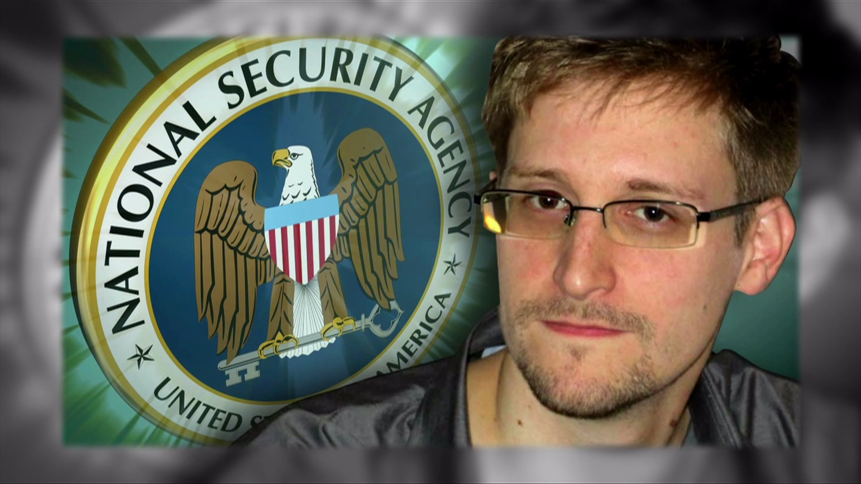
Lesson 2: No one knows what everyone is doing

Slide 27
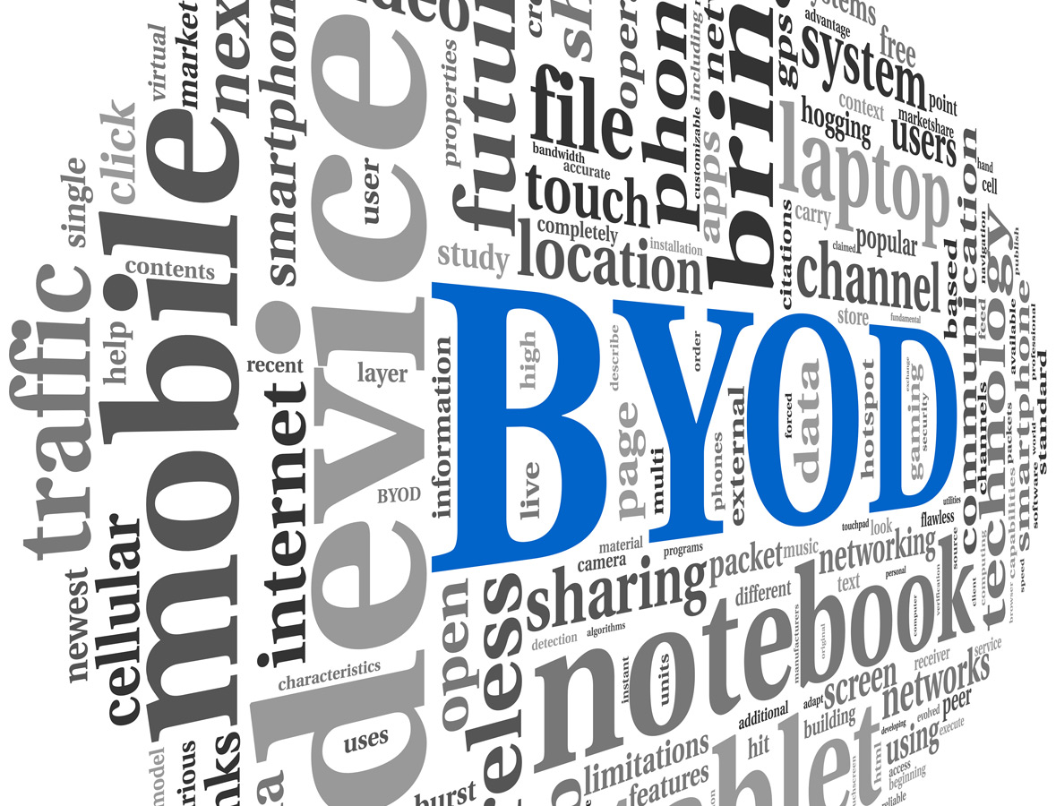
One issue: Bring Your Own Device policies

Slide 28
Beyond BYOD: We Have A Shadow IT Problem

Slide 29
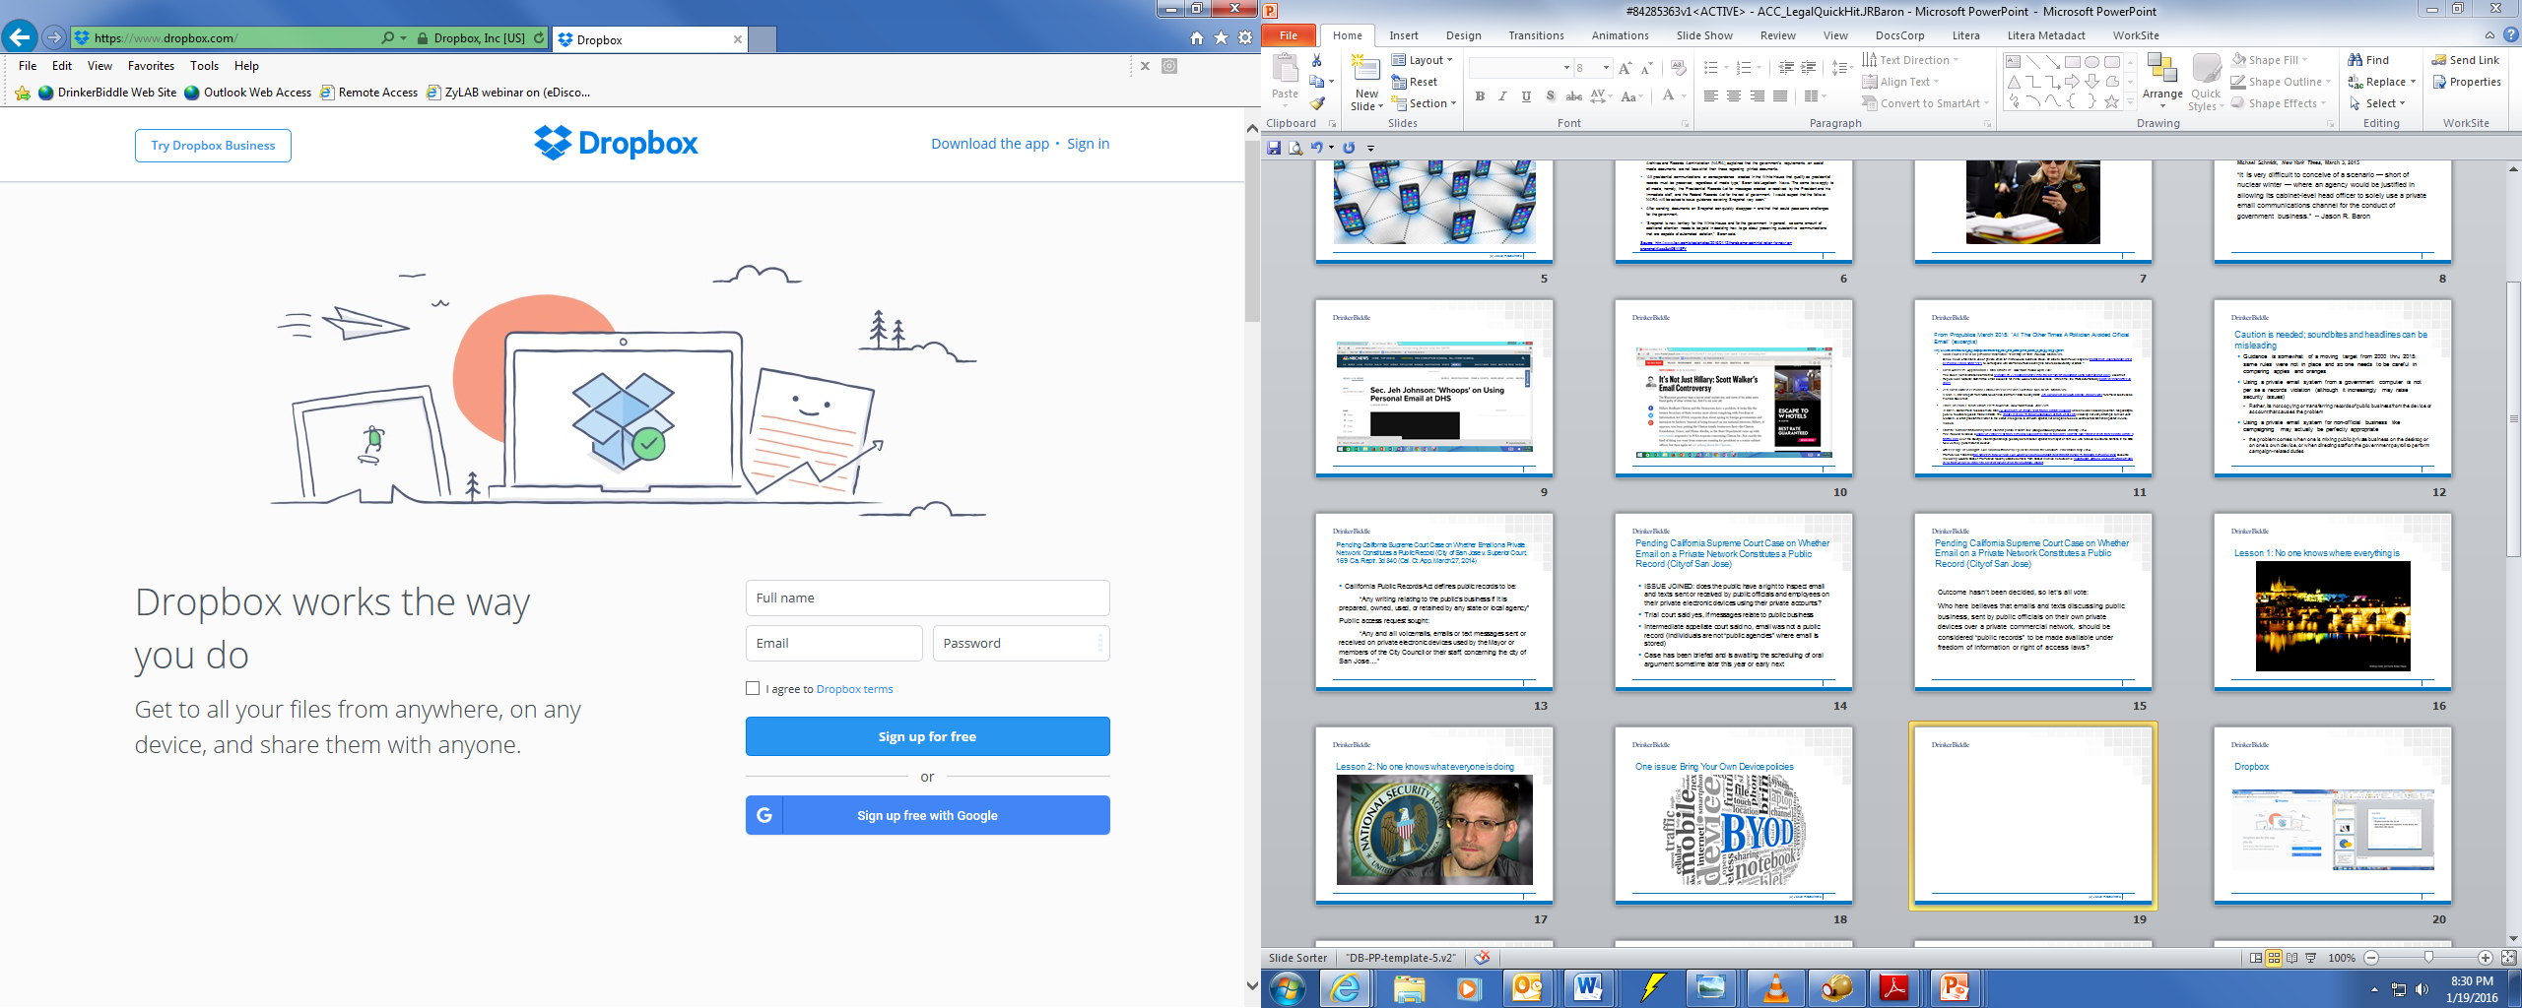

Slide 30
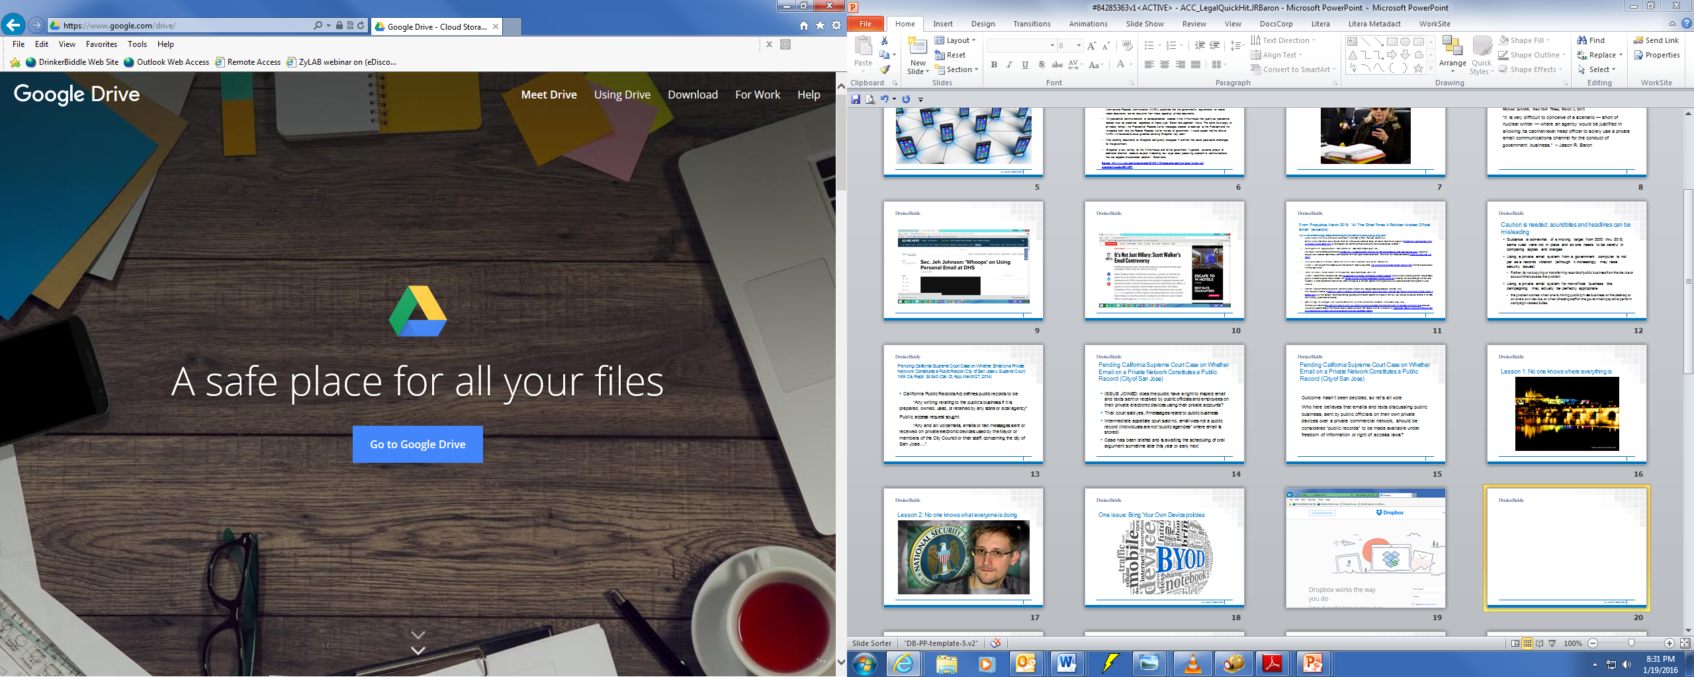

Slide 31

Field of Dreams Principle: If IT builds it….

Slide 32
Related But Distinct Policy Challenges
SHADOW IT
APPS
BYOD
BYOD
SHADOW IT APPS

Slide 33
Best Practices in Confronting the Reality of Shadow IT
1) Develop a robust information governance policy that covers the emergence of shadow IT in the workplace
2) Educate employees
3) Employ IT solutions to protect information
    Allowing remote access thru directed means (e.g., Citrix)
    Require passwords and screen timeouts
    Make it easy to copy or forward messages to official recordkeeping systems
4) Make agency systems and devices easier and more attractive to use than alternatives (good luck)

Slide 34
Best Practices in Confronting the Reality of Shadow IT l
5) Periodically reevaluate employee practices and company policies
6) Practice what you preach
    To executives in the C-suite reading this: If you won’t do it, they won’t do it. Use your own shadow IT practices as a bellweather for what will work best with your agency’s culture
See J.R. Baron & Amy R. Marcos, “Beyond BYOD: What Lies in the Shadows,” The Ethical Boardroom (2015), http://ethicalboardroom.com/technology/beyond-byod-what-lies-in-the-shadows/

Slide 35

Most important lesson to be learned about confronting the shadow IT challenge…..
Don’t practice Black Swan information governance: be proactive!

Slide 36

A New Era of Government “
[P]roper records management is the backbone of open Government.”
President Obama’s Memorandum dated November 28, 2011 re “Managing Government Records” http://www.whitehouse.gov/the-press-office/2011/11/28/presidential-memorandum-managing-government-records

Slide 37
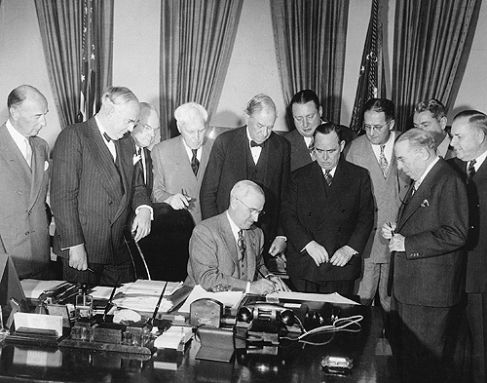
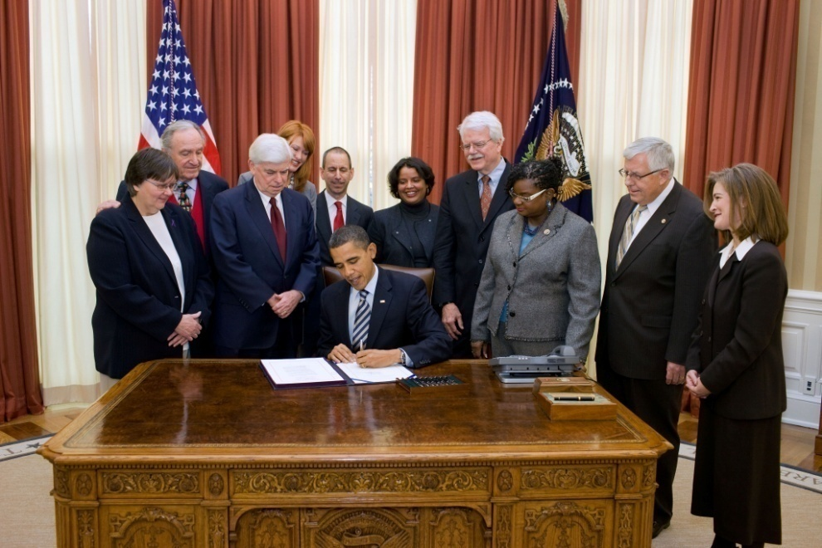
Presidential Memorandum

Slide 38
Presidential Memorandum
From President Obama’s Memorandum on Managing Government Records, dated 11/28/11:
  “Decades of technological advances have transformed agency operations, creating challenges and opportunities for agency records management. Greater reliance on electronic communication and systems has radically increased the volume and diversity of information that agencies must manage. With proper planning, technology can make these records less burdensome to manage and easier to use and share. But if records management policies and practices are not updated for a digital age, the surge in information could overwhelm agency systems, leading to higher costs and lost records.

Slide 39
Archivist/OMB Directive
M-12-18, Managing Government Records Directive, dated 8/24/12:
1.1 By 2019, Federal agencies will manage all permanent records in an electronic format.
1.2 By 2016, Federal agencies will manage both permanent and temporary email records in an accessible electronic format.
http://www.whitehouse.gov/sites/default/files/omb/memoranda/2012/m-12-18.pdf

Slide 40


Process Optimization Problem: The transactional toll of user-based recordkeeping schemes (“as is” RM)

Slide 41

…. and the need for better, automated solutions ….

Slide 42

The demise of RM….
John Mancini, President of AIIM:
  “If by traditional records management you mean manual systems—even if they are computerized – then I would say traditional records management is dead. The idea that we could get busy people to care about our complicated retention schedules, and drag and drop documents into folders, and manually apply metadata document by document according to an elaborate taxonomy will soon seem as ridiculous as asking a blacksmith to work on a Ferrari.”

Slide 43
RM wish list for 2016….
RM’s “easy button”: the elusive goal of zero extra keystrokes to comply with RM requirements (capture)
A technology app that automatically tags records in compliance with RM policies and practices (categorize)
Supervised learning RM with minimal records officer or end user involvement (learn)
Rule-based and role-based RM
Advanced search

Slide 44
NARA’s “Capstone” Policy:
The Path Forward
Email archiving in short term, synced to existing proprietary software on email system
Designation of key senior officials as creating permanent records, consistent with existing records schedules
Additional designations of permanent records by agency component
“Smart” filters/categorical rules built in based on content, to the extent feasible to do
Non-senior official email records and non-tagged records designated as temporary to be held for set retention period.

Slide 45
Capstone Officials
Capstone accounts
Other accounts
Key staff accounts
Other accounts
Capstone officials may include:
  Officials at or near the top of an agency or an organizational subcomponent
  Key staff members that may be in positions that create or receive presumptively permanent email records

Slide 46
Capstone Guidance: A New Approach to Managing Email Records
Must agencies use a specific technology to implement Capstone?
No, Capstone implementation is not dependent on a specific technology or software. This approach is designed to utilize technologies that already exist at many agencies. Agencies may use native email systems, email archiving applications (which many agencies are already utilizing for other purposes), or other repositories to implement Capstone. Evolving technologies, such as auto-categorization and advanced search capabilities, may enable agencies to cull out transitory, non-record, and personal email. In the absence of a technological solution, agencies must rely on policy, procedures, and training to fully implement Capstone.
NARA BULLETIN 2013-2 (8/29/13)

Slide 47
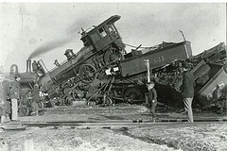
How To Avoid A Train Wreck With Email Archiving….
Capture E-mail But Utilize Records Management!

Slide 48

The Coming Age of Dark Archives (and the inability to provide access unless we have smart ways of extracting signal from noise)

Slide 49
Emerging New Strategies:
“Predictive Analytics”
Improved review and case assessment: cluster docs thru use of software with minimal human intervention at front end to code “seeded” data set
Slide adapted from Gartner Conference
June 23, 2010 Washington, D.C.

Slide 50
Judicial endorsement of predictive analytics in document review by Judge Peck in da Silva Moore v. Publicis
Groupe (SDNY Feb. 24, 2012)
This opinion appears to be the first in which a Court has approved of the use of computer-assisted review. . . . What the Bar should take away from this Opinion is that computer-assisted review is an available tool and should be seriously considered for use in large-data-volume cases where it may save the producing party (or both parties) significant amounts of legal fees in document review. Counsel no longer have to worry about being the ‘first’ or ‘guinea pig’ for judicial acceptance of computer-assisted review . . . Computer-assisted review can now be considered judicially-approved for use in appropriate cases.

Slide 51
What is the hottest topic in applying predictive coding to the information governance space?
Autocategorization.

Slide 52
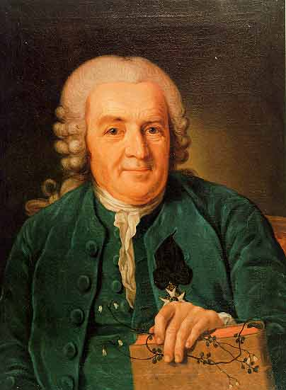
Homage to Carl Linnaeus (1707-1778)

Slide 53
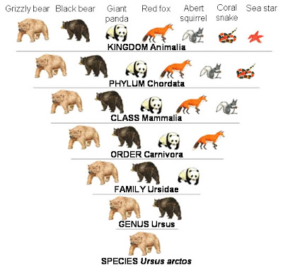
Linnaean classification of the animal kingdom
Kingdom: Animalia
Phylum: Chordata
Subphylum: Vertebrata
Superclass: Tetrapoda
Class: Mammalia
Subclass: Theria
Infraclass: Eutheria
Cohort: Unguiculata
Order: Primata
Suborder: Anthropoidea
Superfamily: Hominoidae
Family: Hominidae
Subfamily: Homininae
Genus: Homo
Subgenus: Homo (Homo)
Specific epithet: sapiens

Slide 54
We should be leveraging the power of predictive analytics to improve information governance . . .
-- RM: defensible disposal of low value information
-- Regulatory compliance
-- Risk mitigation – segregating sensitive materials…
(PII, proprietary, etc.)
-- Business intelligence
-- E-discovery
-- Collaboration across enterprise
-- Providing access to dark data & archives

Slide 55

To Advance the Cause of IG, Lawyers & RM & IT & Others Need To Cross Intellectual Boundaries

Slide 56
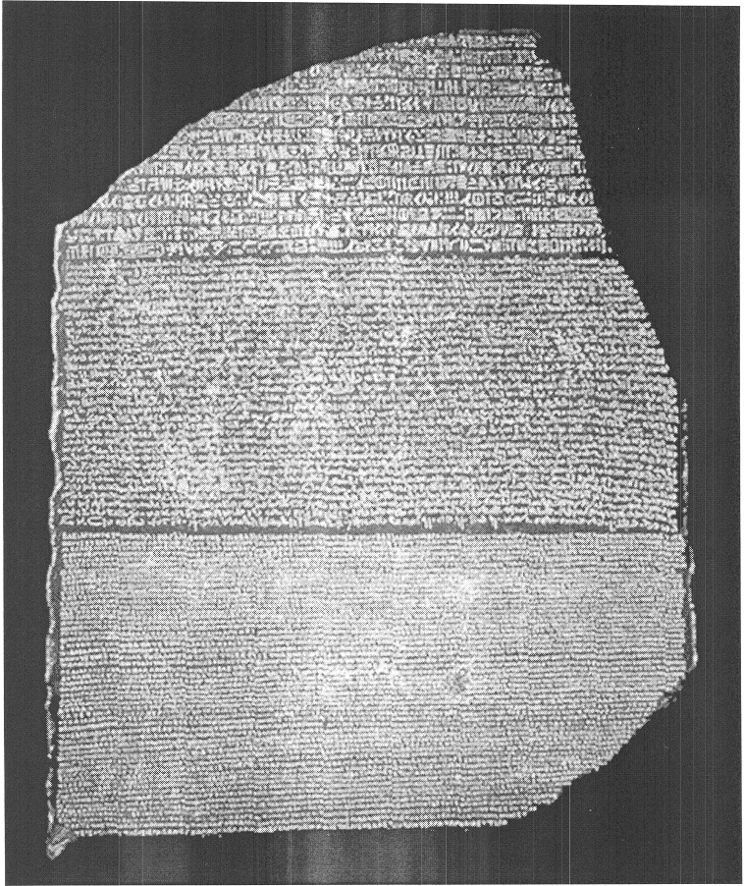
Rosetta Stone Approach: The Need To Master 3 Languages: Legal, RM, IT

Slide 57

Career Paths: How Will You Use Analytics in Your Present Position?

Slide 58
IG Competence in 2016

Slide 59
ABA Model Rules of Professional Conduct 1.1
A lawyer shall provide competent representation to a client. Competent representation requires the legal knowledge, skill, thoroughness and preparation reasonably necessary for the representation.

Slide 60
Comment 8 to ABA Model Rule 1.1 (2013)
To maintain the requisite knowledge and skill, a lawyer should keep abreast of changes in the law and and its practice, including the benefits and risks associated with relevant technology, engage in continuing study and education and comply with all continuing legal education requirements to which the lawyer is subject.

Slide 61
From ABA Commission on Ethics 20/20 Introduction and Overview, Report to the House of Delegates
“Technology is . . . having a[n] . . . impact on how lawyers conduct investigations, engage in legal research, advise their clients, and conduct discovery. These tasks now require lawyers to have a firm grasp on how electronic information is created, stored and retrieved. For example, lawyers need to know how to make and respond to electronic discovery requests and to advise their clients regarding electronic discovery obligations. . . . These developments highlight the importance of keeping abreast of changes in relevant technology in order to ensure that clients receive competent and efficient legal services.”

Slide 62
From “R U Competent,” Washington Lawyer, D.C Bar Ethics Counsel
“A lawyer must understand the rules of discovery and a client’s IT systems. This includes an ability to identify electronically stored information (ESI) that must be produced for the purposes of making and responding to document requests, as well as the associated costs. The report also mentions duties of competence extending to knowledge regarding various file formats, sources of electronic data, and basic information on how a computer operates. This duty is not an empty obligation; a number of cases reaffirm that failure to understand electronic discovery can result in sanctions.” (Quotations and internal citations omitted.)
http://www.dcbar.org/bar-resources/publications/washington-lawyer/articles/november-2008-speaking-of-ethics.cfm

Slide 63
Competence CheckList 2016
Understanding various stages of the eDiscovery process: preservation, identification, negotiation, collection, processing, review, production, analysis, disposition.
  See www.edrm.net for Electronic Discovery Reference Model
Knowing when the duty to preserve evidence has been triggered & ways in which a party may preserve evidence.
Identification of entities or individuals for whom you may be deemed responsible for preservation or production (including consideration of possession, custody & control)

Slide 64
Checklist (con’t)
Outline of data and systems characteristics about which an attorney should ask custodians, IT systems owners, and if applicable, third parties, in order to identify ESI relevant to the dispute.
Understanding document production characteristics that may be discussed in the context of parties’ meet and confer obligations (e.g., PDF/TIFF vs. native productions)

Slide 65



Slide 66

Culture Change is Possible

Slide 67

“The future is here. It is just not evenly distributed.”
--William Gibson

Slide 68
References
Sources Referencing Information Governance, Autocategorization & Predictive Coding
Bennett B. Borden & J.R. Baron, “Finding the Signal in the Noise: Information Governance, Analytics, and the Future of Information Givernance,” 20 Richmond J. Law & Technology 7 (2014)
J.R. Baron, “Law in the Age of Exabytes: Some Further Thoughts on ‘Information Inflation’ and Current Issues in E-Discovery Search, 17 Richmond J. Law & Technology (2011), see http://law.richmond.edu
N. Pace, “Where The Money Goes: Understanding Litigant Expenditures for Producing E-Discovery,” RAND Publication (2012), see http://www.rand.org/pubs/monographs/MG1208.html
The Sedona Conference®, www.thesedonaconference.org (publications)
Information Governance Initiative, www.IGinitiative.com

Slide 69

Jason R. Baron
Drinker Biddle & Reath
1500 K Street NW
Washington DC
(202) 230-5196
Email: jason.baron@dbr.com
twitter: #jasonrbaron1

Slide 70
What’s New in Information Governance for 2016?
The Emerging Role of Shadow IT &
Other Hot Topics
Part 2
ARMA Triangle IG Seminar
Research Triangle Park, NC
April 7, 2016
Jason R. Baron, Esq.
Information Governance and eDiscovery Group
Drinker Biddle & Reath LLP
Washington, D.C. 20005
© Jason R. Baron 2016

Slide 71

Part II: Hot Topics in IG: The Latest Findings of the IGI

Slide 72
What is the
The IGI is a cross-disciplinary think tank and consortium dedicated to advancing the adoption of Information Governance practices and technologies through research, publishing, advocacy, and peer-to-peer networking.
  It provides industry thought leadership and benchmarking designed to foster consensus and conversation
  It is a connector among the stakeholders of information governance
  It is a promoter of industry best practices and standards

Slide 73
Why is the IGI Needed?
We believe that IGI is needed because there is an acute lack of clarity in the marketplace regarding the contours and implications of IG.
Technical capabilities have advanced more quickly than awareness of those capabilities amongst practitioners and purchasers.
The IG workforce is nascent and management responsibility for IG is unclear or unassigned at most organizations.

Slide 74
What is Our Mission?
The mission of the IGI is to sound the clarion call that current information management practices are unsustainable.
Unless corporations and government agencies take serious action, information overload and mismanagement will become a serious threat to the economy, delivery of government services, and to the justice system itself.
We need to work with stakeholders across the IG spectrum to architect a better path forward.

Slide 75
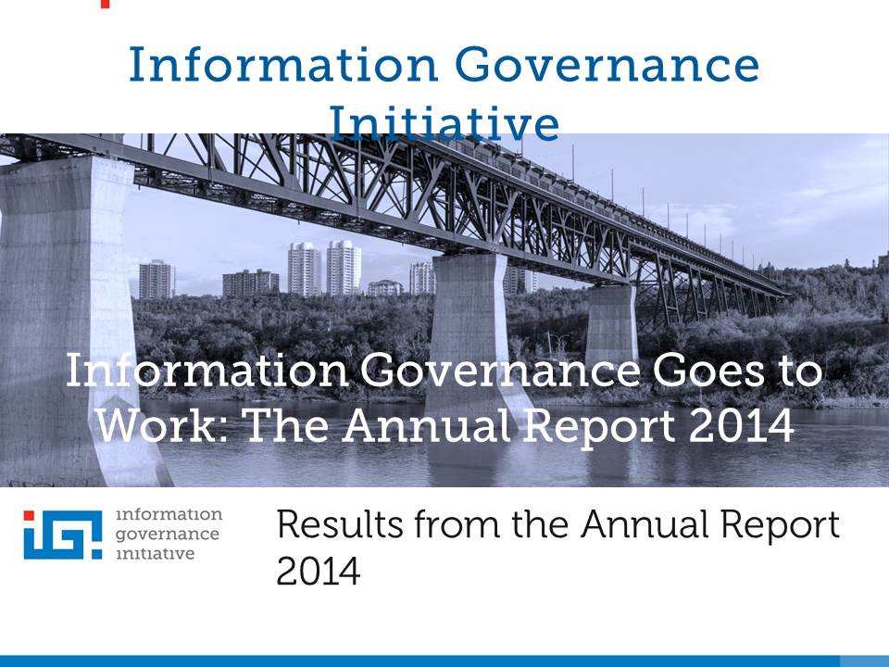

Slide 76
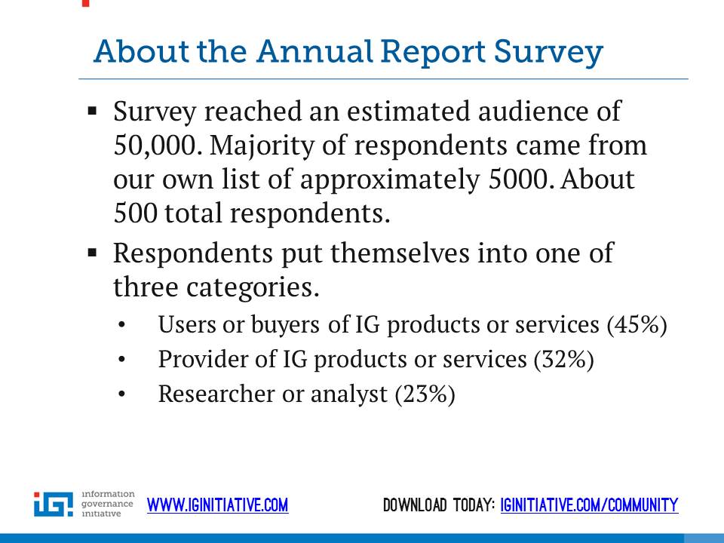

Slide 77
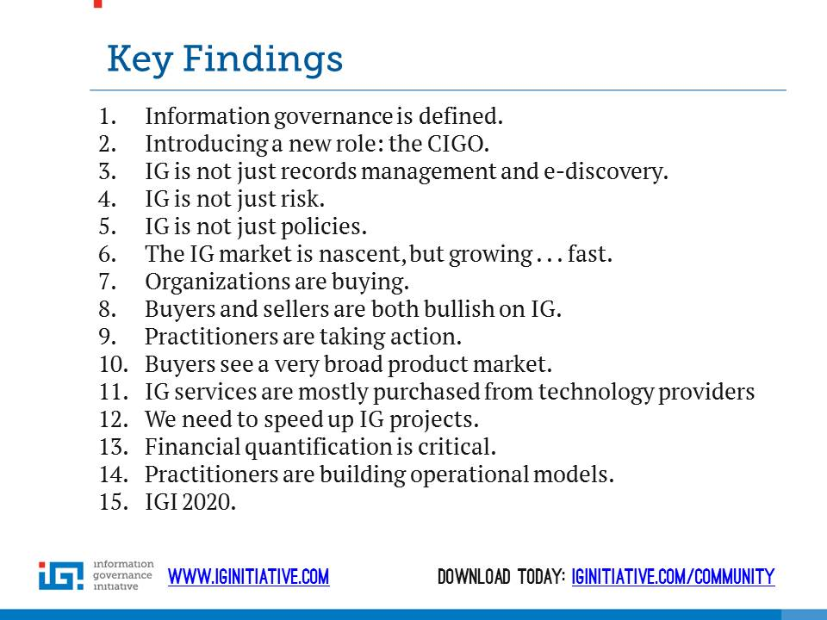

Slide 78
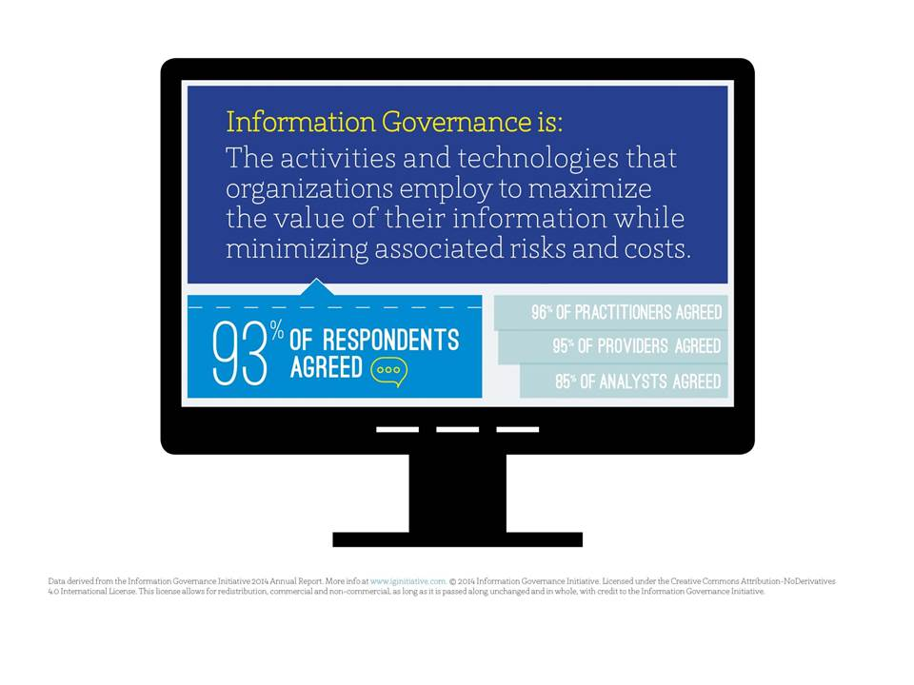

Slide 79
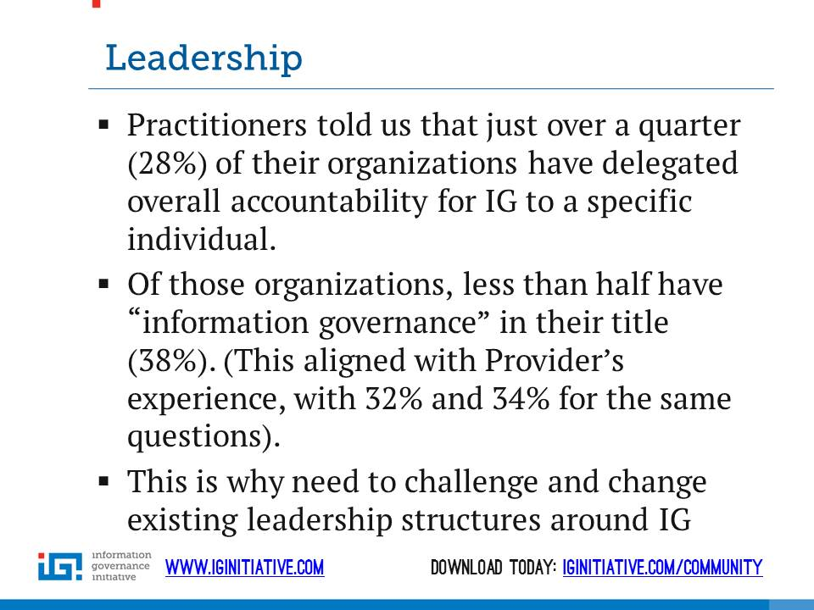

Slide 80
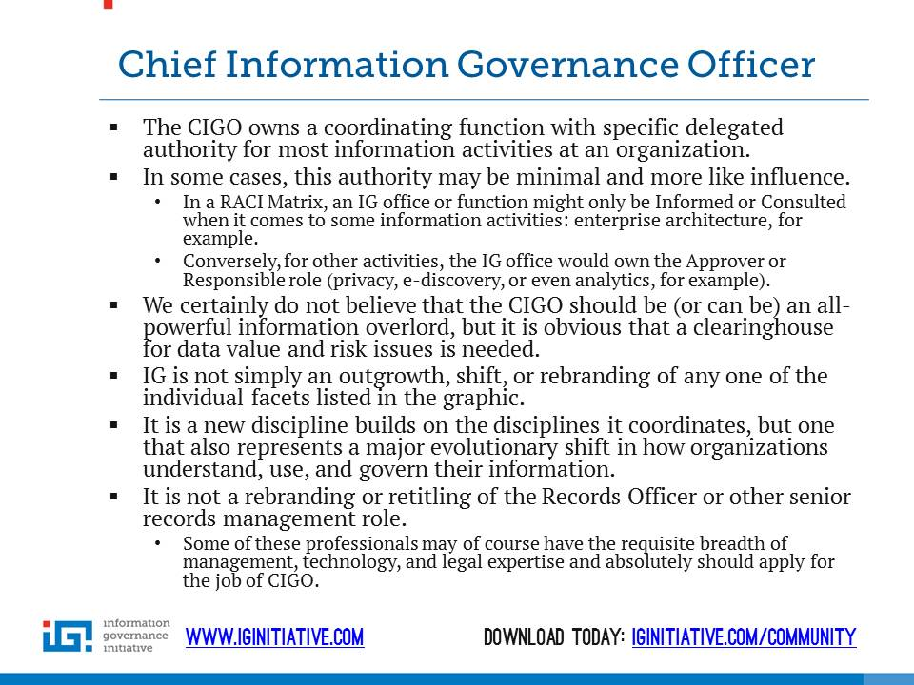

Slide 81
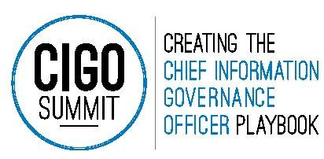
Participants will create the Chief Information Governance Officer Playbook including:
• Chapter 1: The CIGO Job Description
• Chapter 2: Learning from History – The Evolution of the C-Level Role
• Chapter 3: CIGO Power – How Much and What Kind?
• Chapter 4: The CIGO Chair – Where Should it Be Parked?
• Chapter 5:Where Do CIGOs Come From?
• Chapter 6: The CIGO Elevator Pitch
• Chapter 7: The CIGO at Work
www.cigosuimmit.com

Slide 82
Information Governance Initiative Annual Report 2015-2016 Infographics

Slide 83
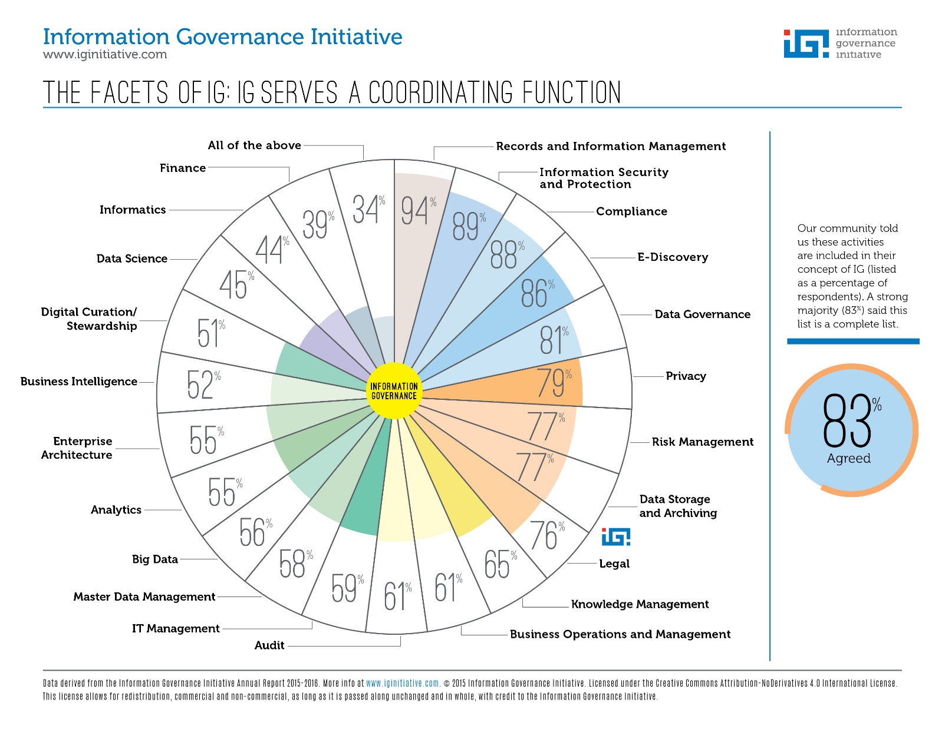

Slide 84
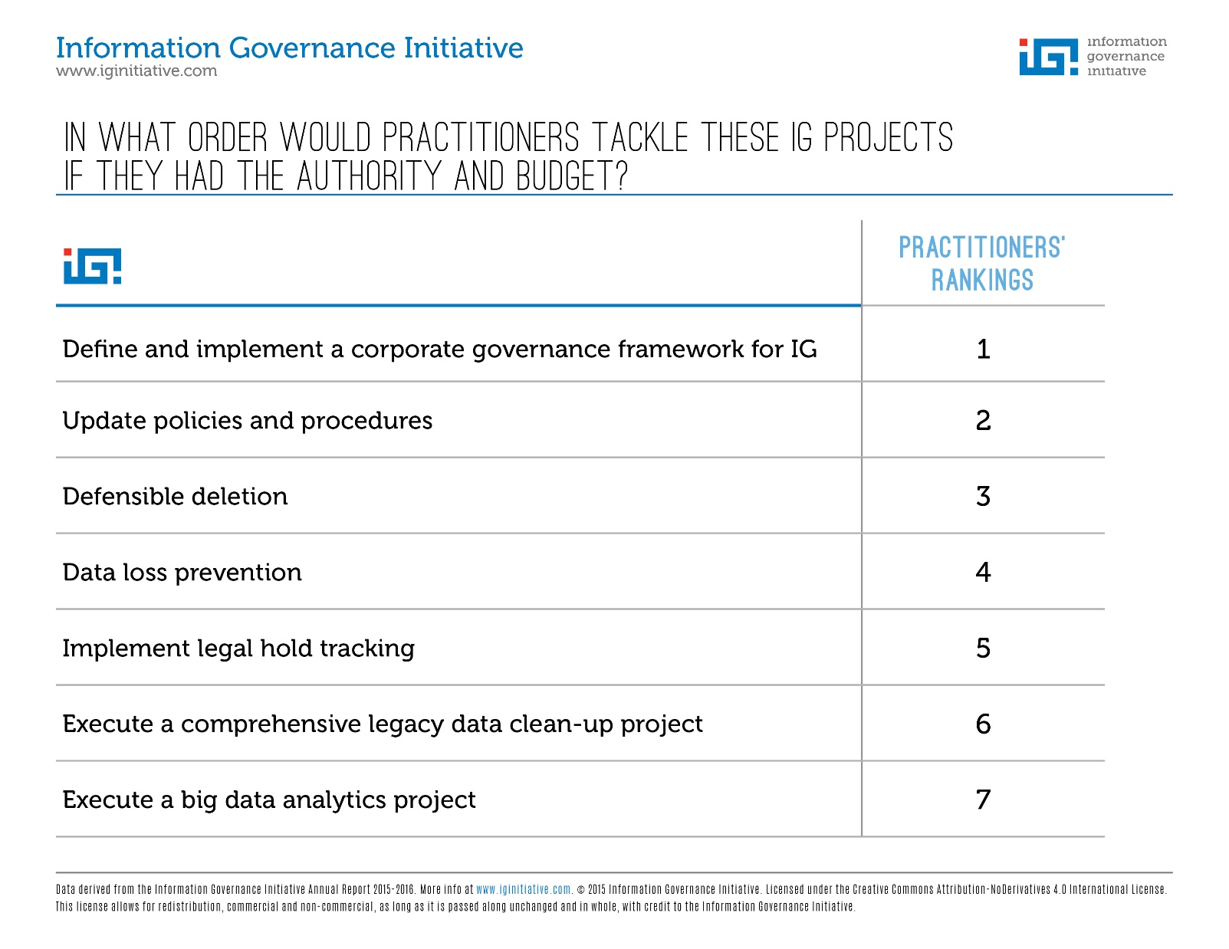

Slide 85
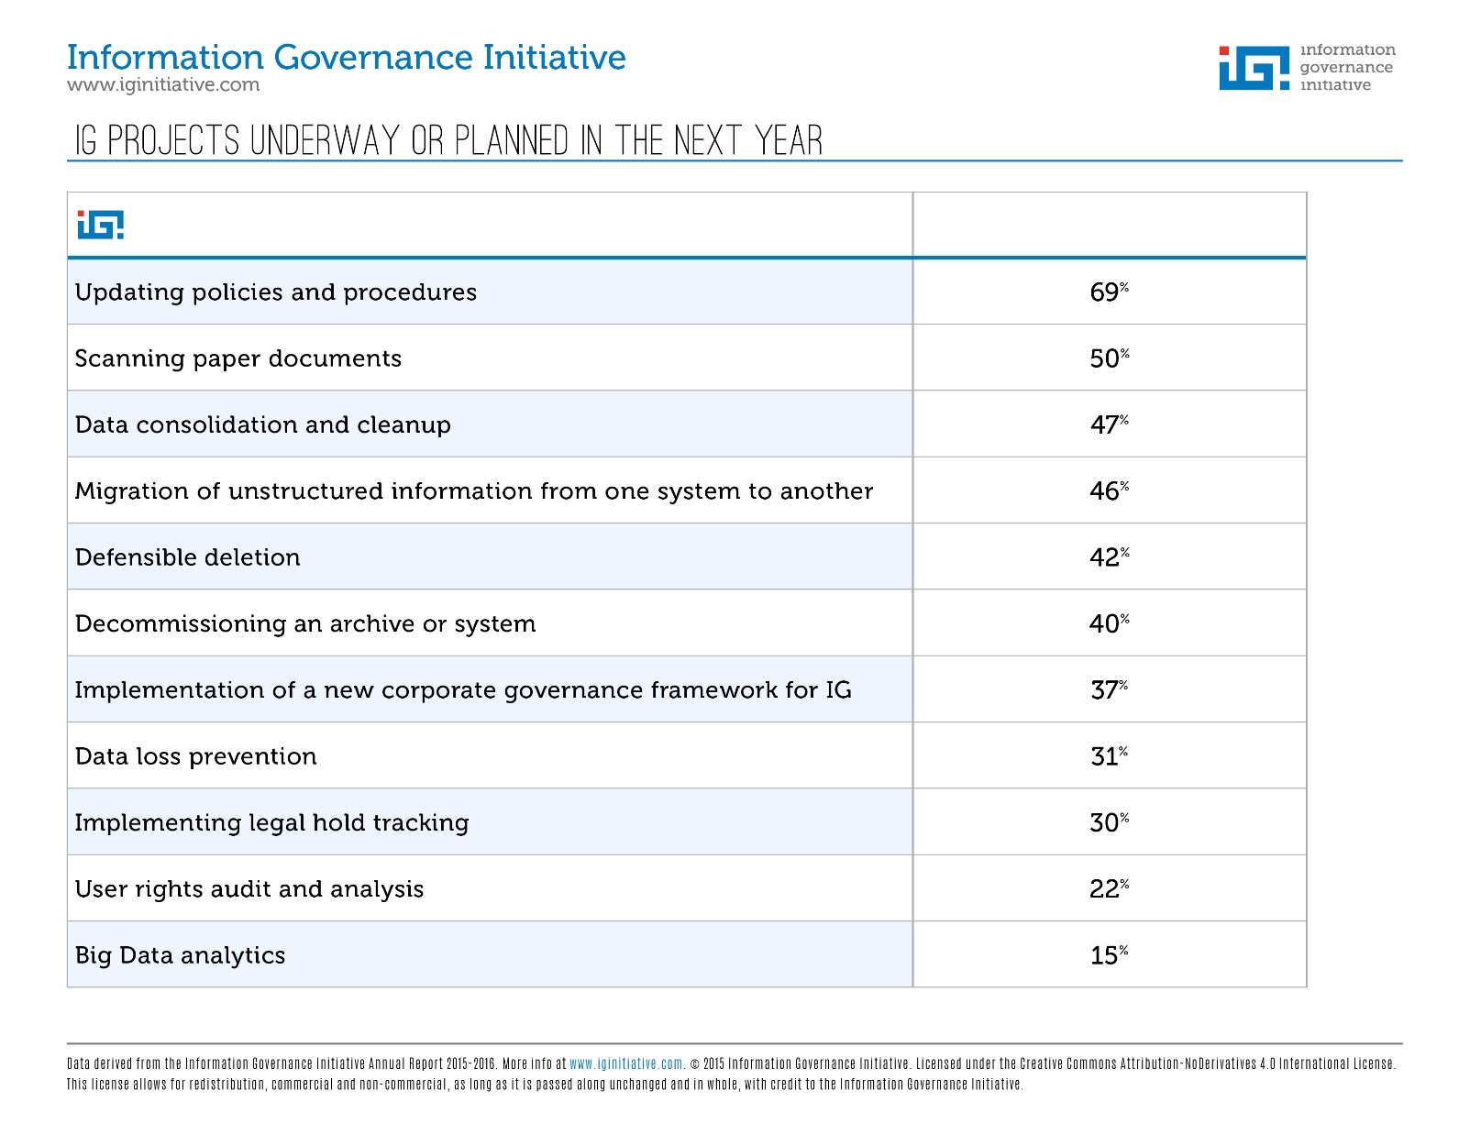

Slide 86
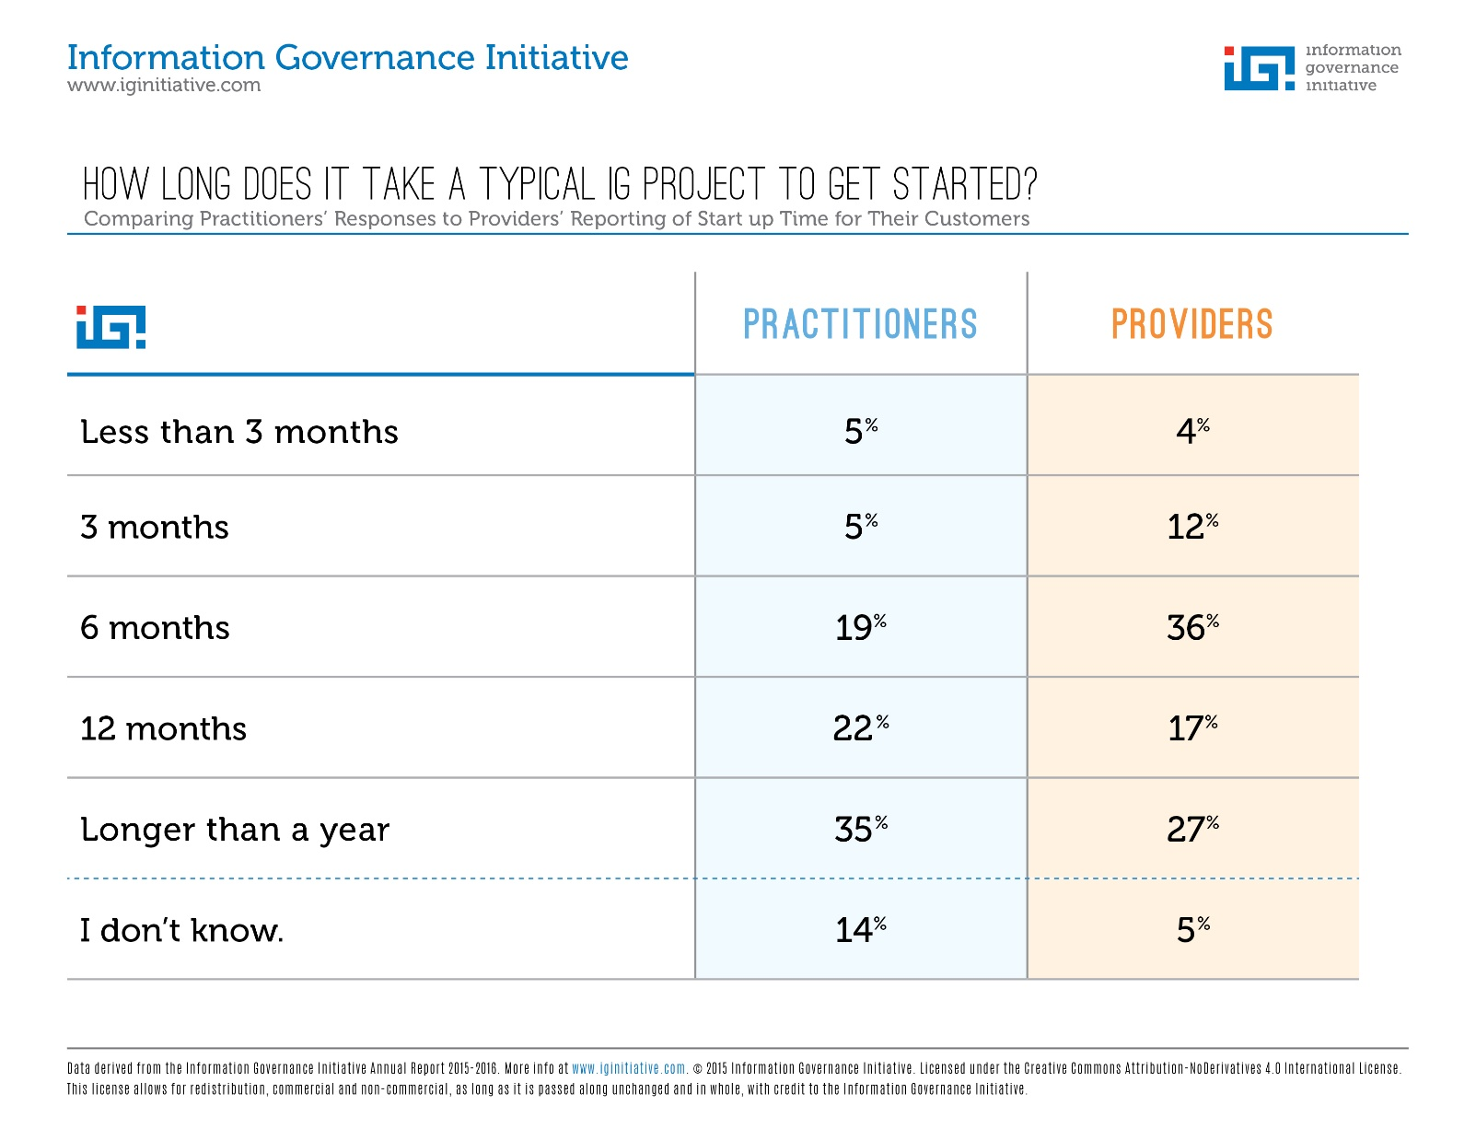

Slide 87
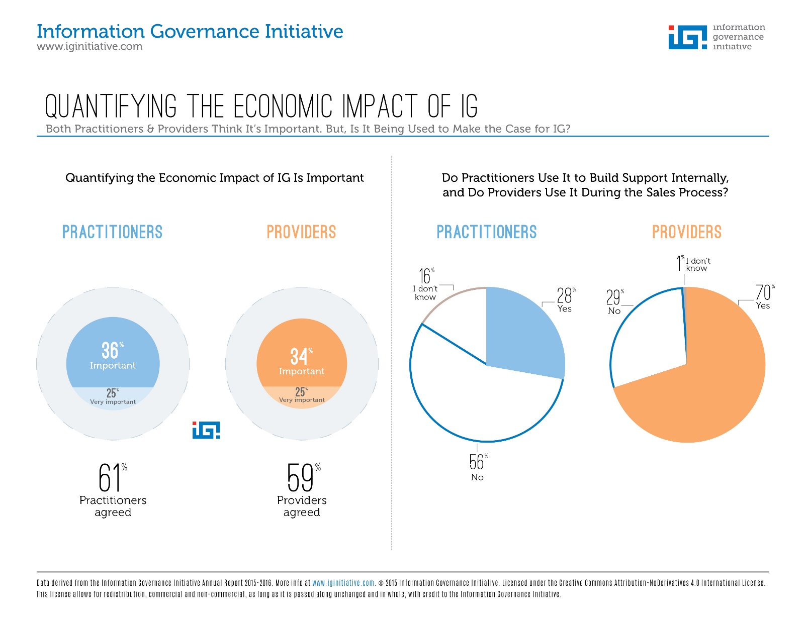

Slide 88
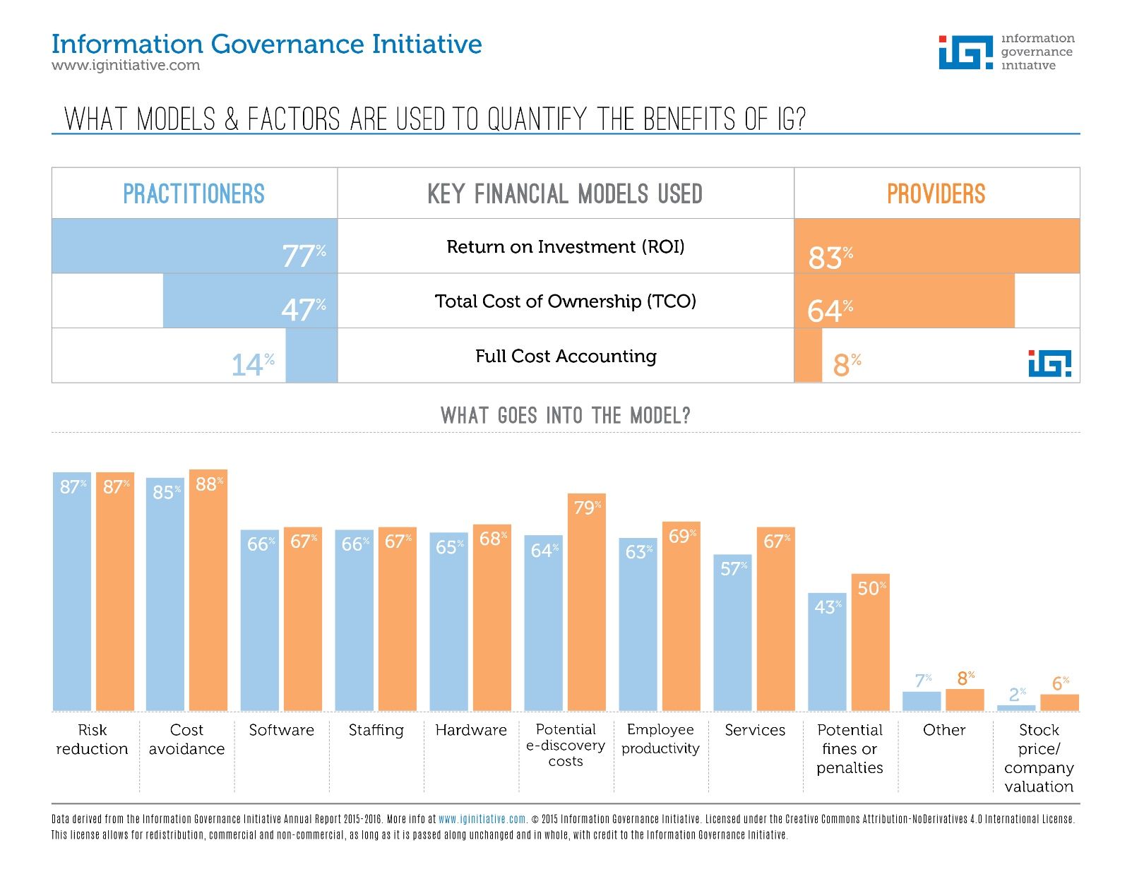

Slide 89
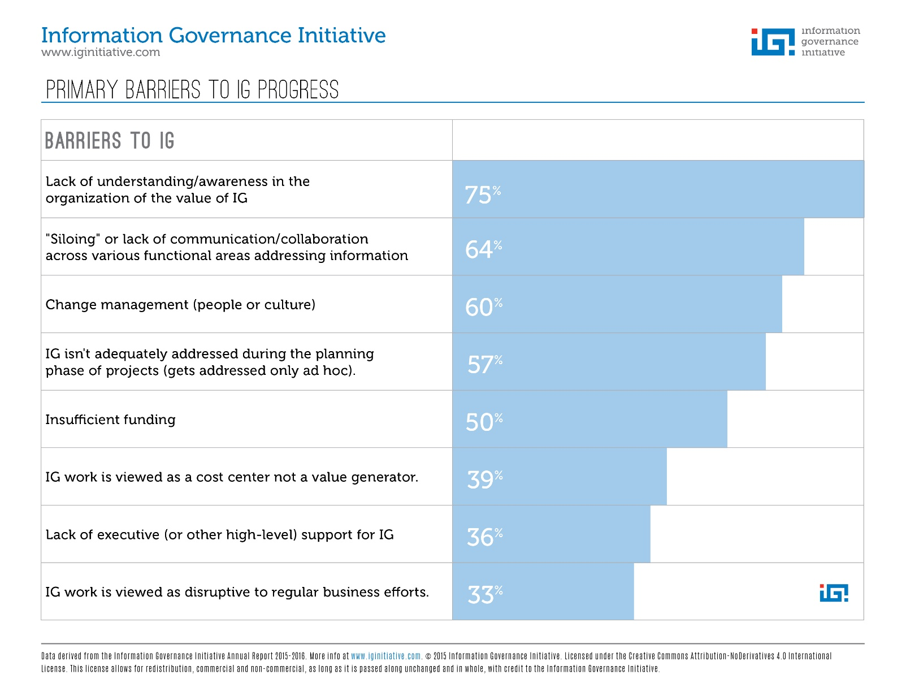

Slide 90
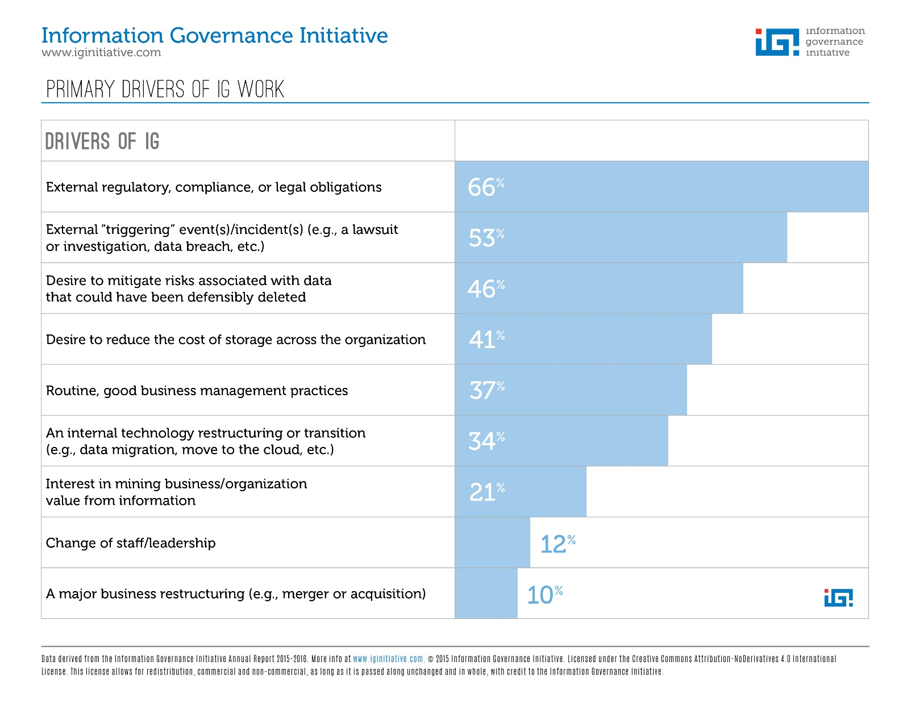

Slide 91
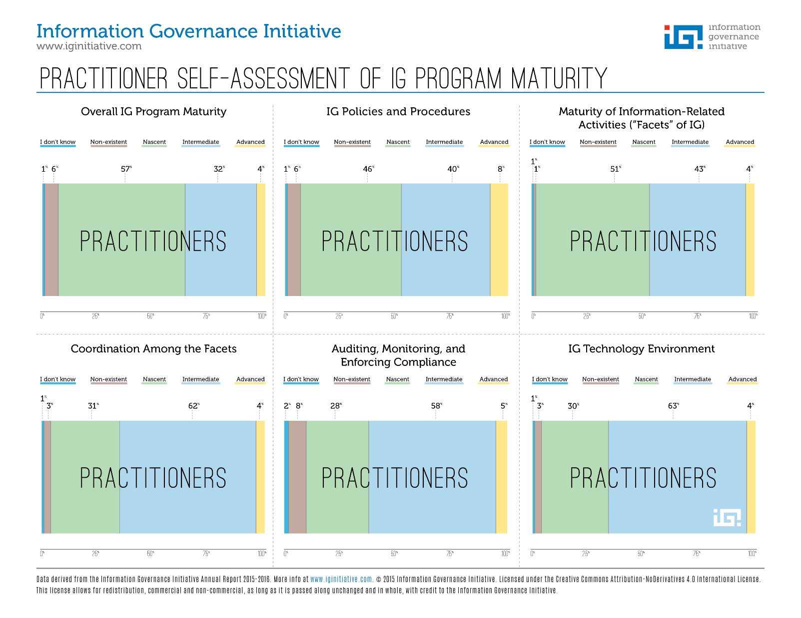

Slide 92
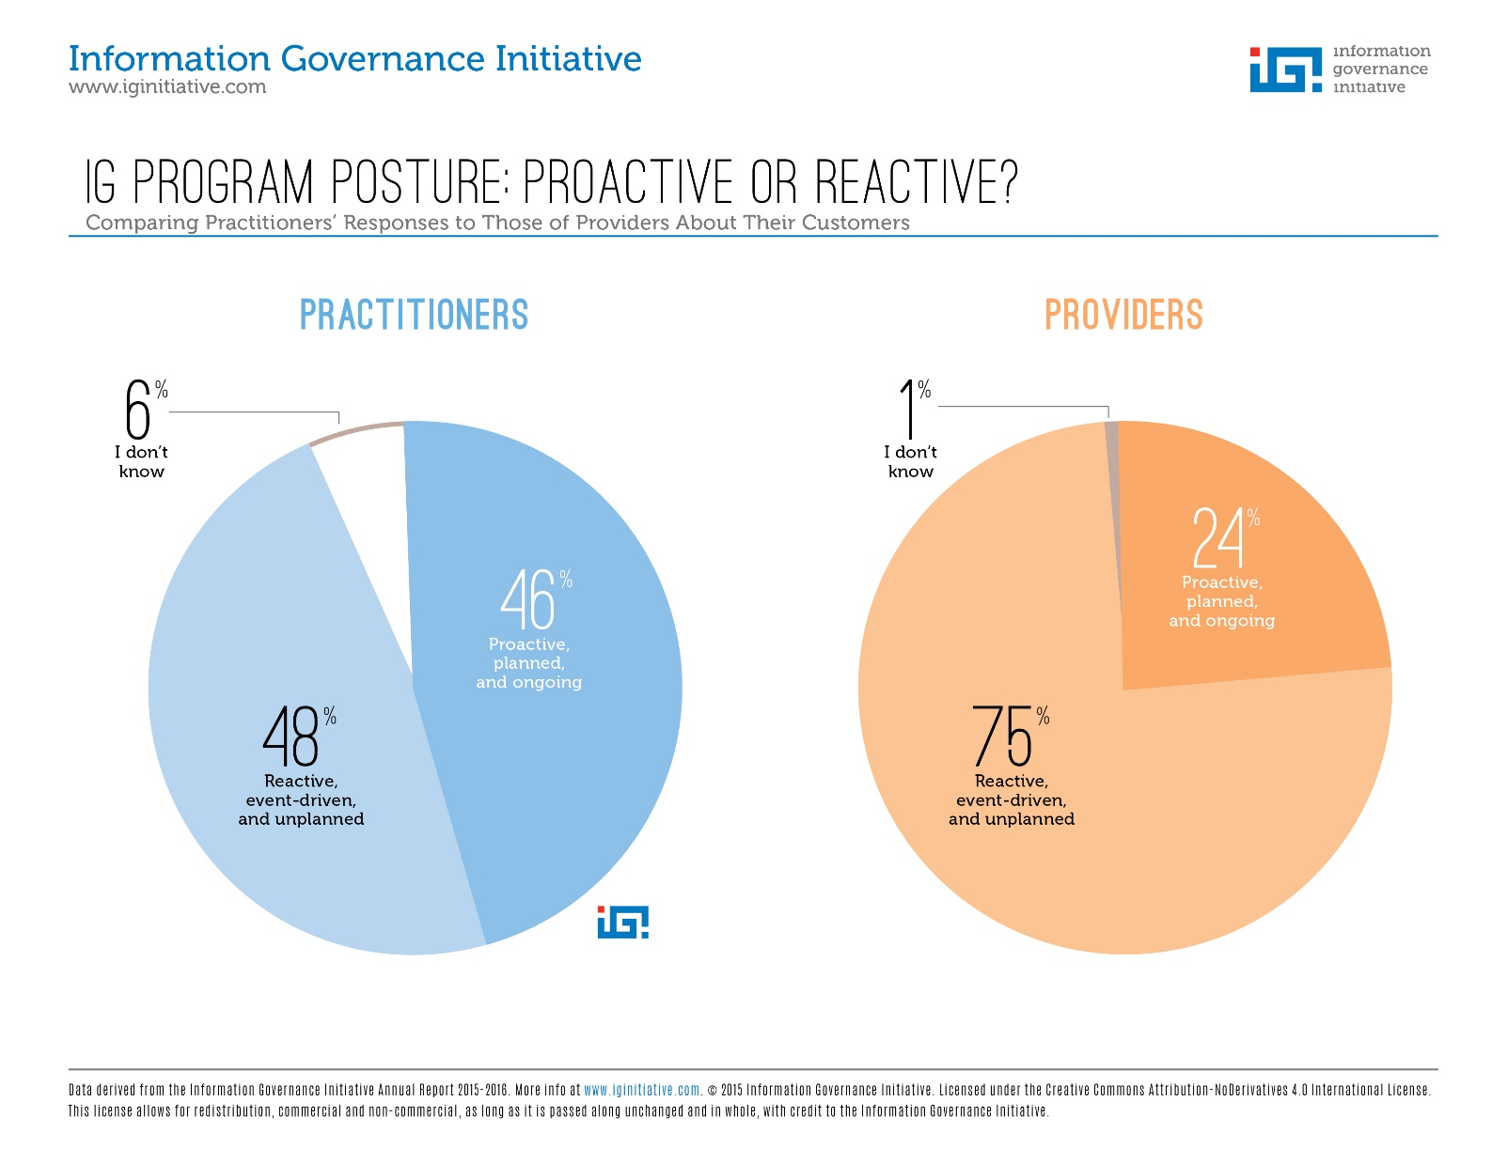

Slide 93
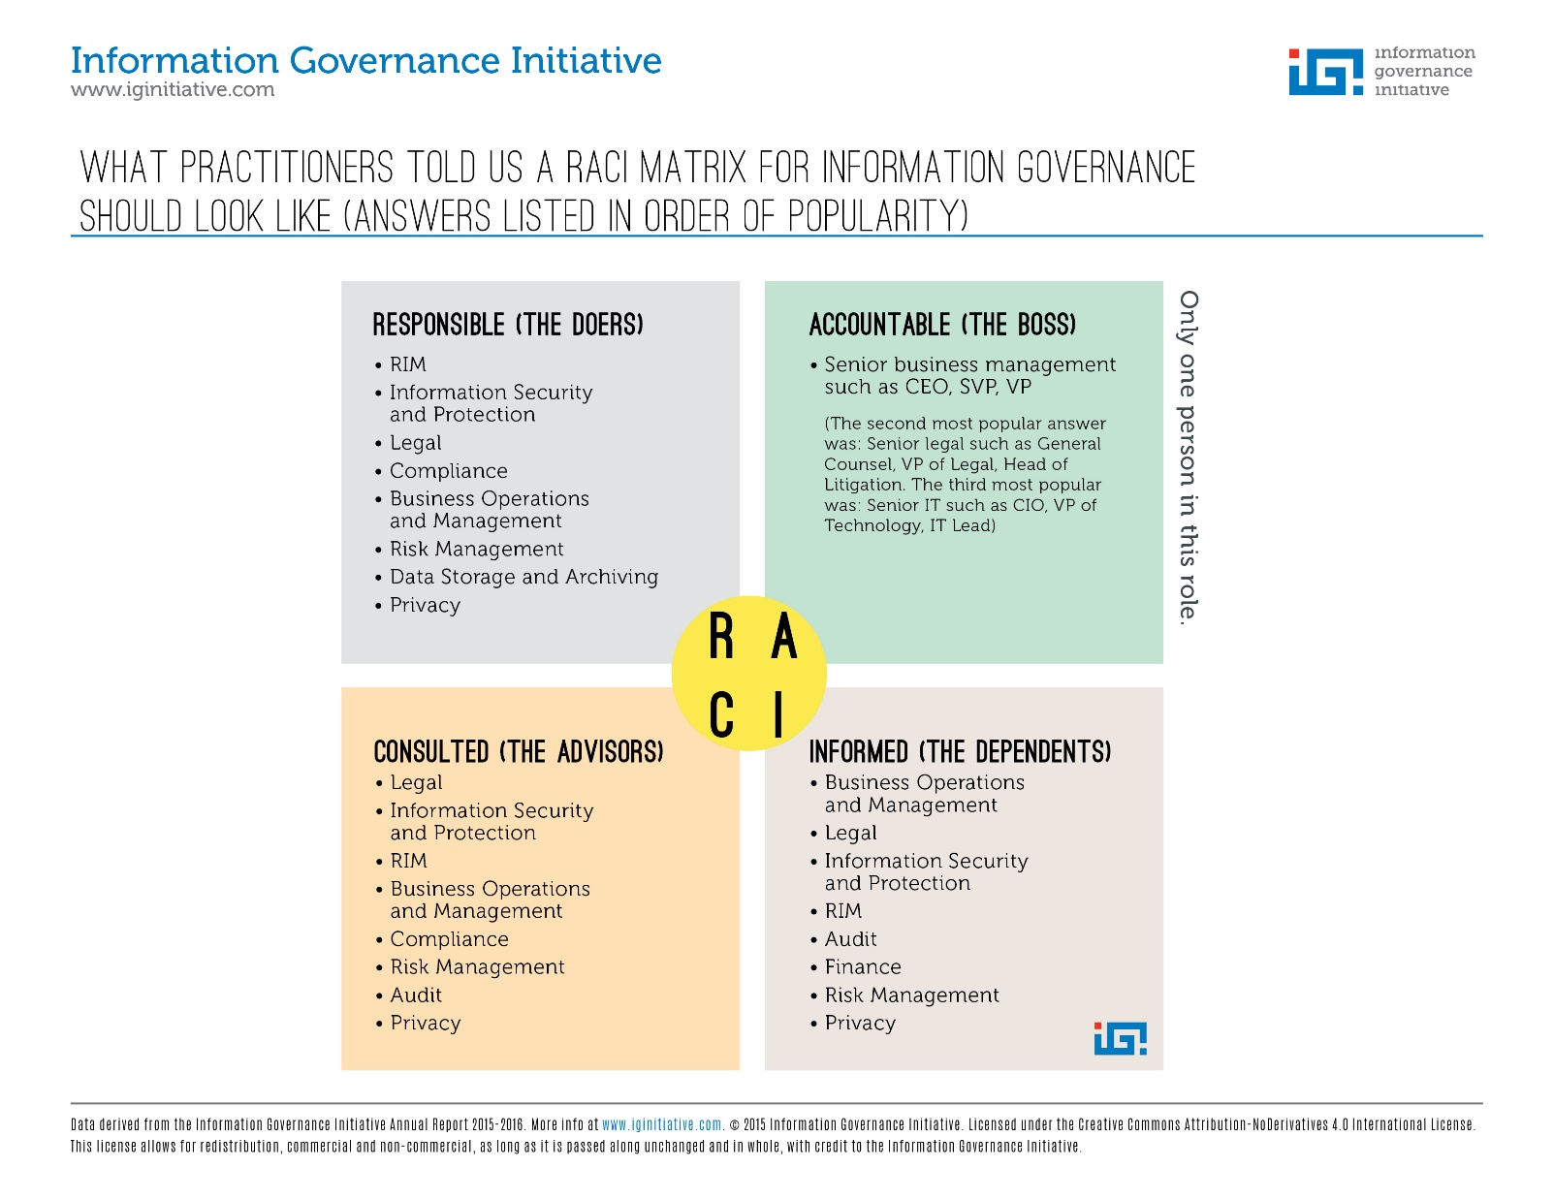

Slide 94
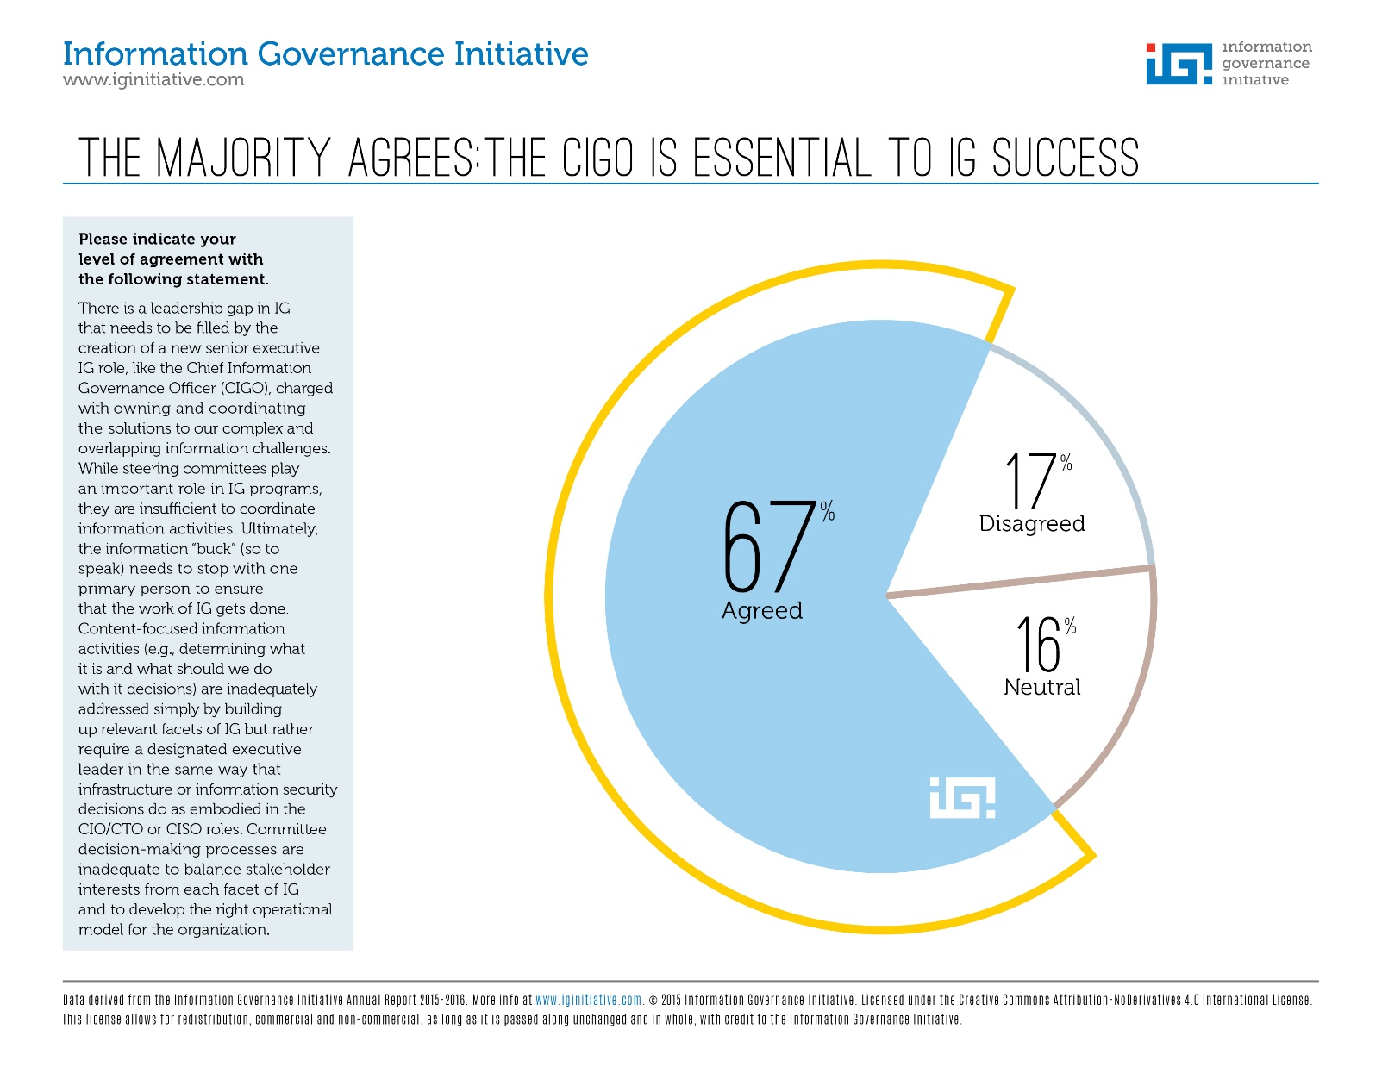

Slide 95
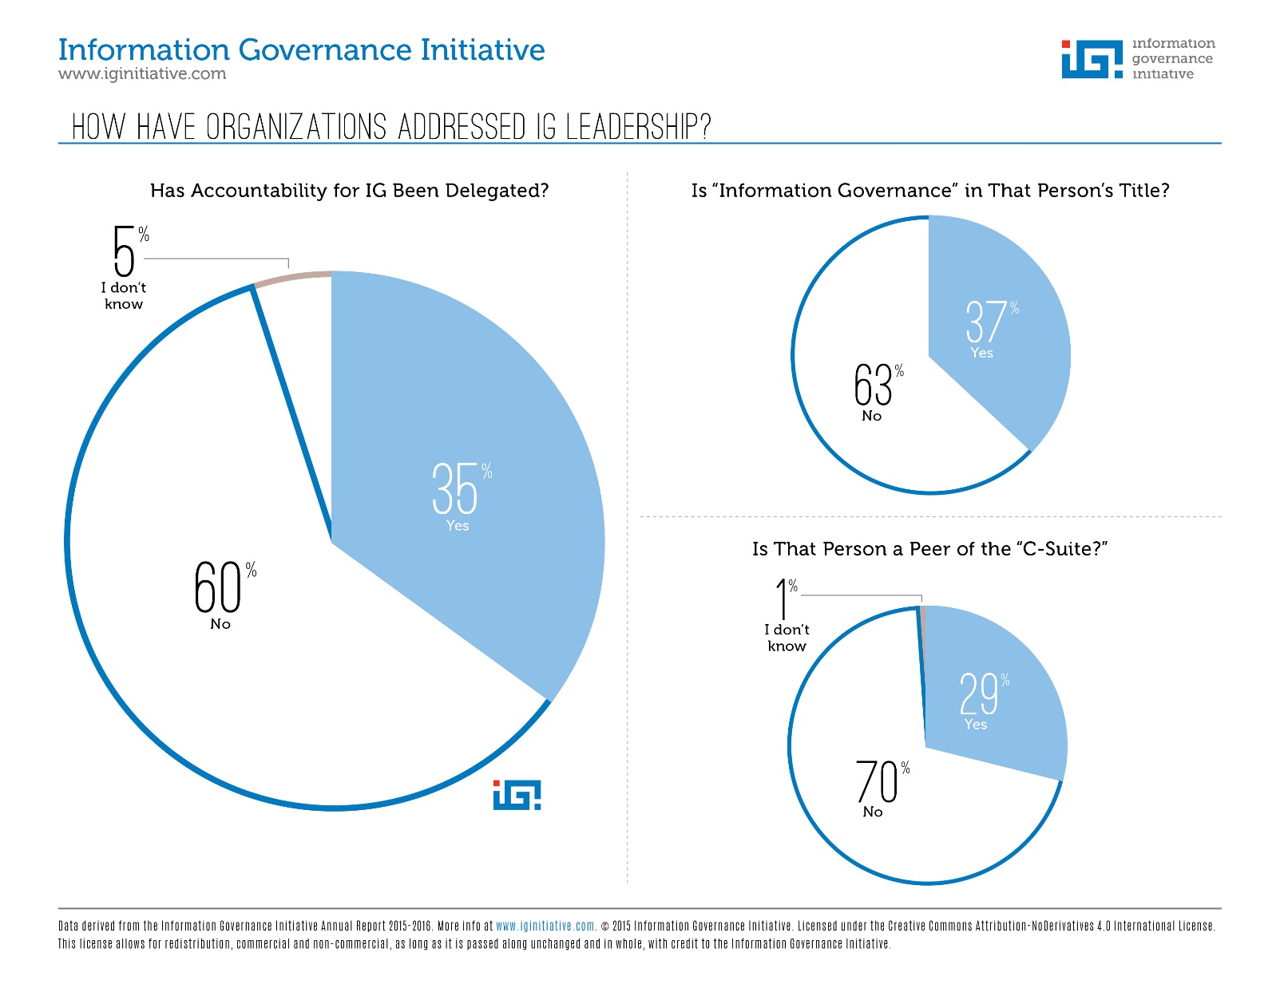

Slide 96
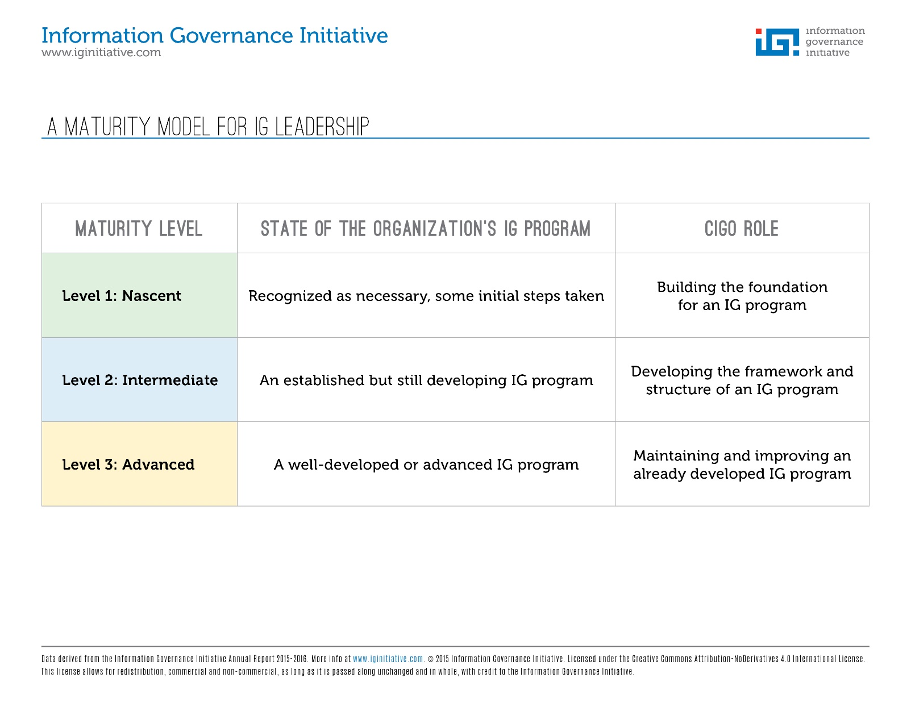

Slide 97
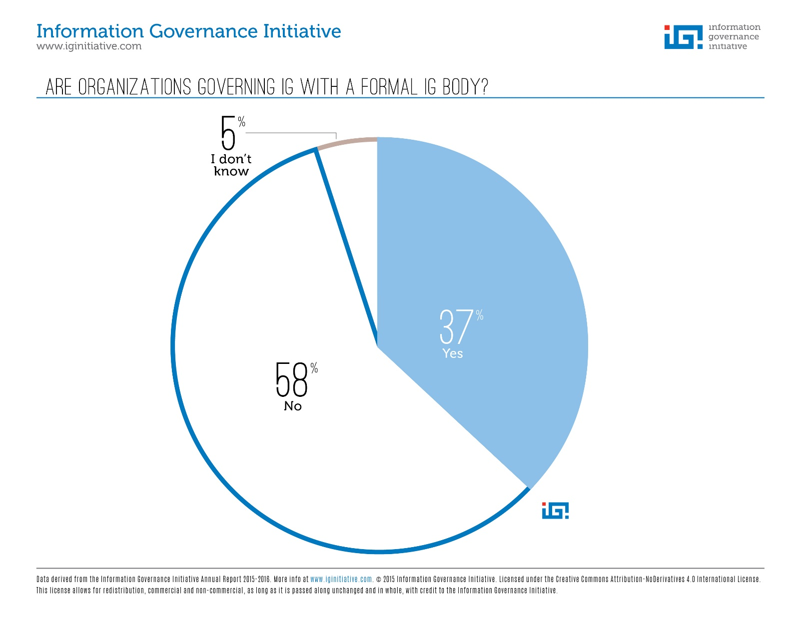

Slide 98
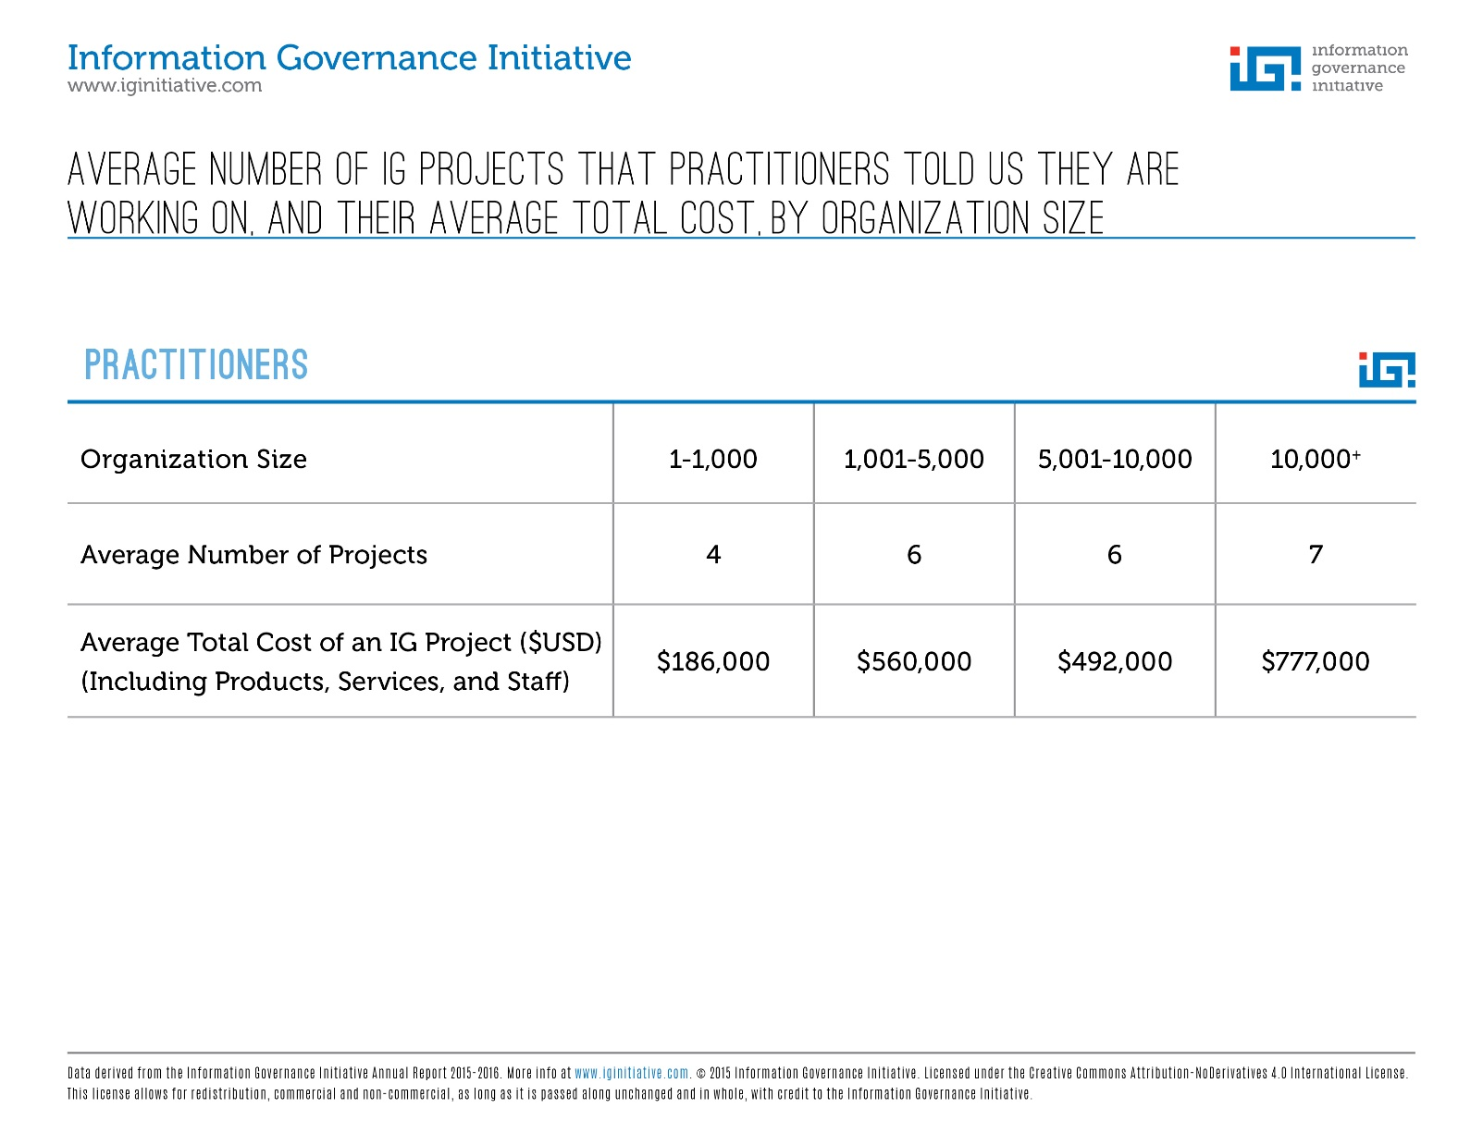

Slide 99
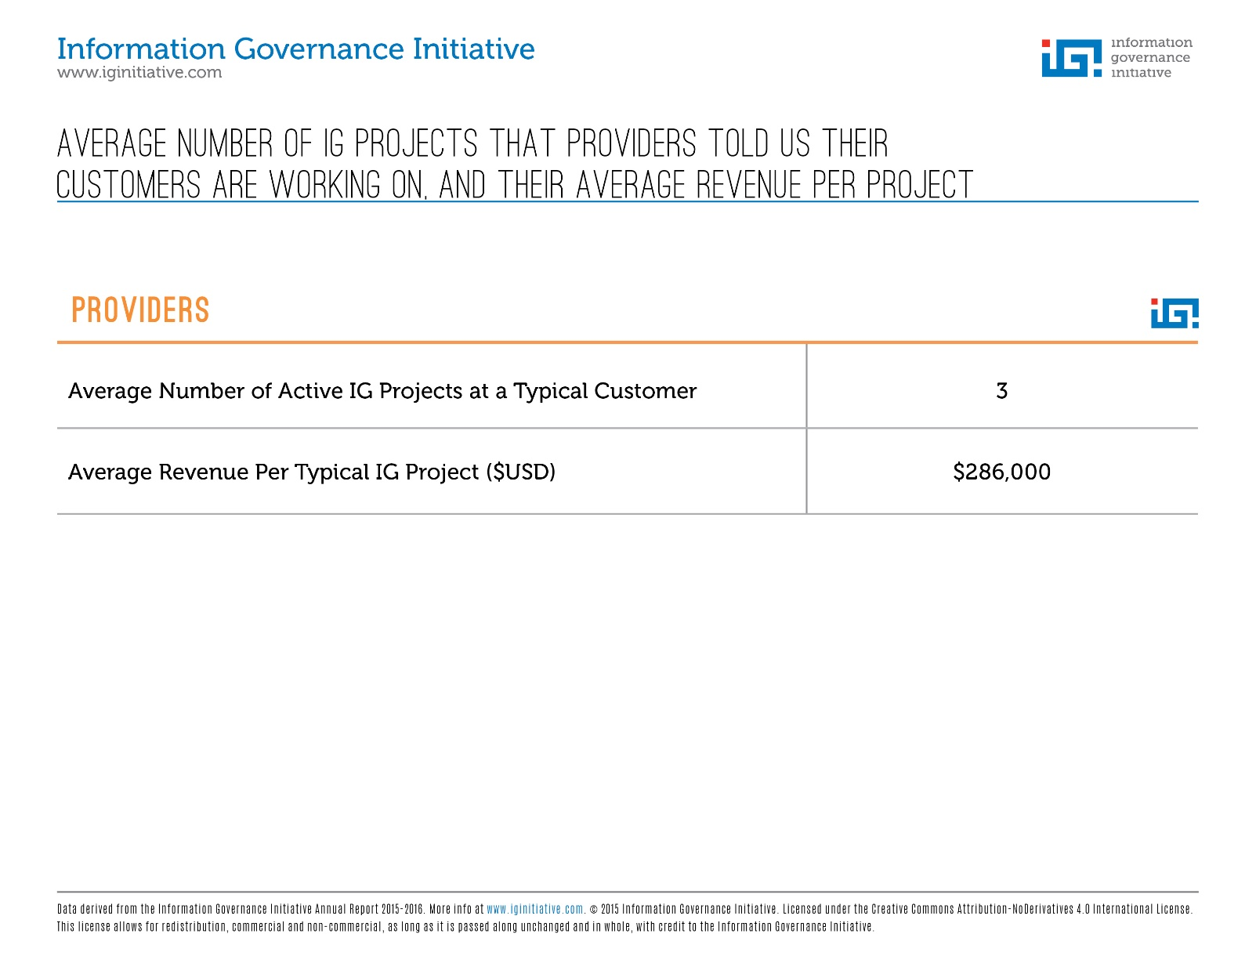

Slide 100
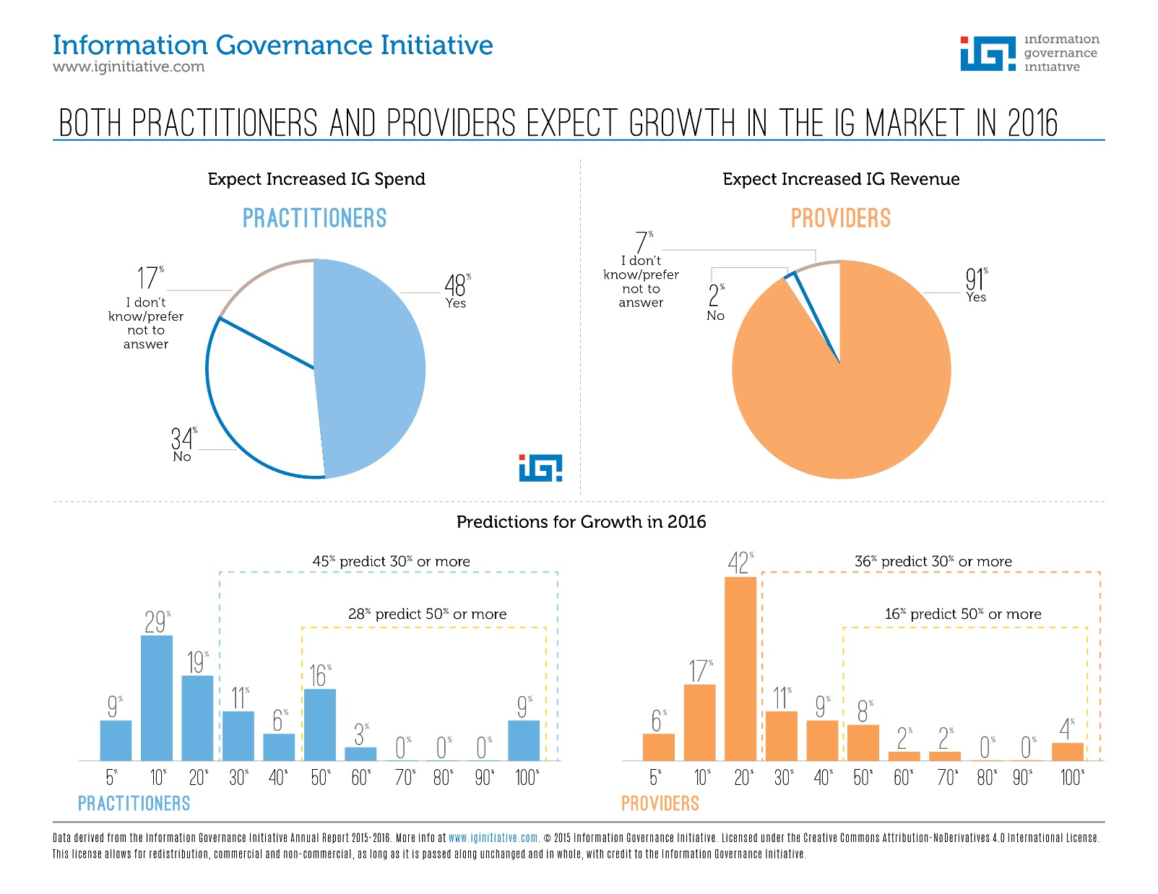

Slide 101
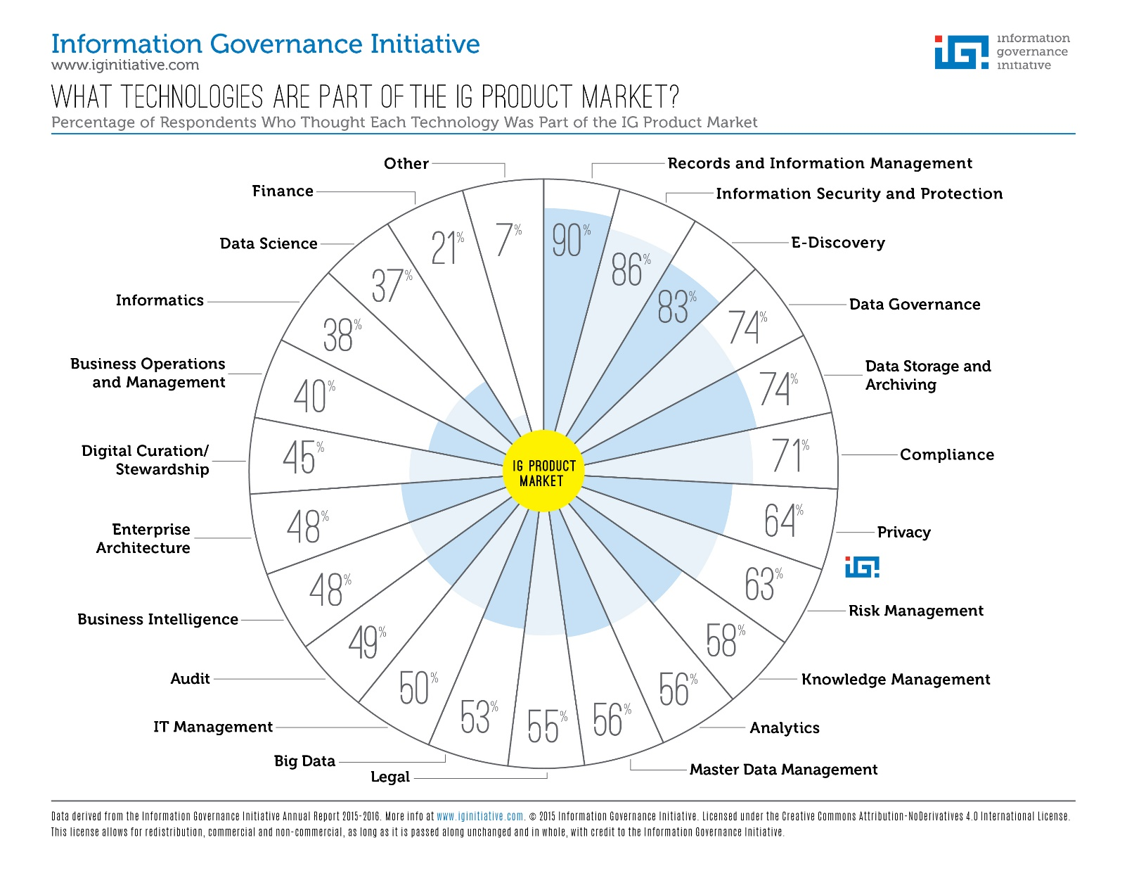

Slide 102
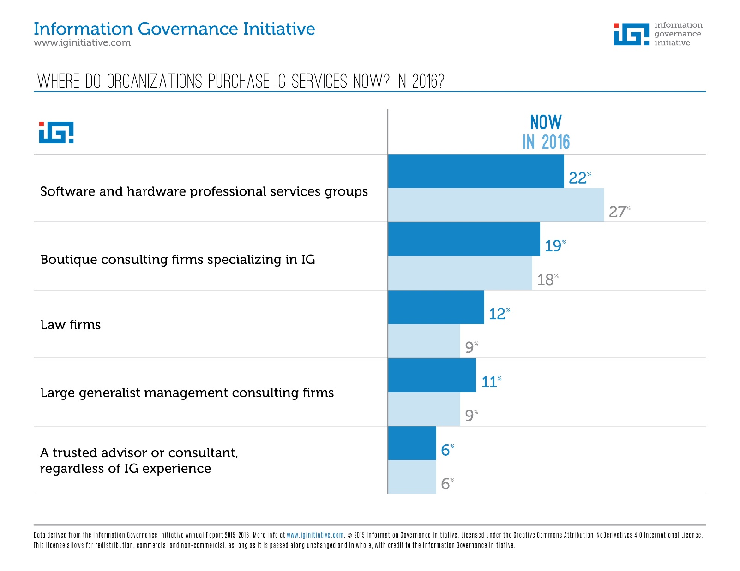

Slide 103
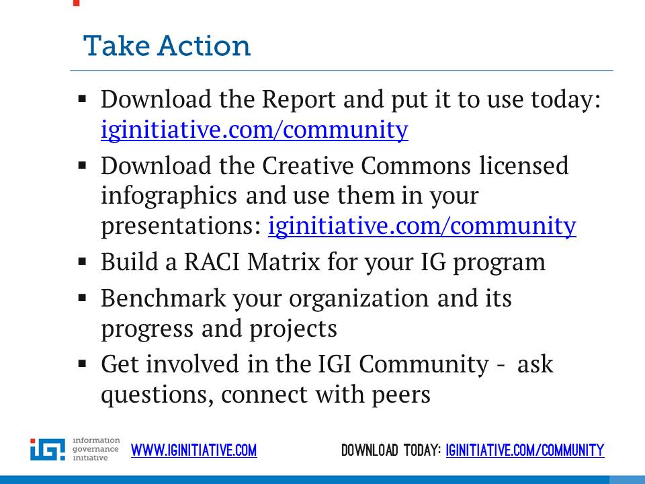

Slide 104
How to become a member…..
www.iginitiative.com

Slide 105
Jason R. Baron
Drinker Biddle & Reath
1500 K Street NW
Washington DC
(202) 230-5196
Email: jason.baron@dbr.com
twitter: @jasonrbaron1

