Slide 1
Archiving strategy for decommissioned systems
Becky Pezzoni, MBA, CRM
May 5, 2016
Notes:
Up front – this presentation is based on my experience in a regulated pharma setting, and is influenced by the structure and processes within which we operate;
the opinions and suggestions within are my own. In preparing for this presentation I have located some very helpful information, checklists, etc and those references are in the notes to my slides, which will be posted on our ARMA chapter website following today’s presentation.
Your own situation may differ, so this is just one approach.
I will use the term ‘system’ today to refer to IT systems and applications
Most of this discussion today will address Retaining data –
Archiving data from a decommissioned system is one solution to retaining, as is migrating data to a new live system.
In reality, both migration to a live system and archiving are actually both forms of data migration, albeit with a different end destination.

Slide 2
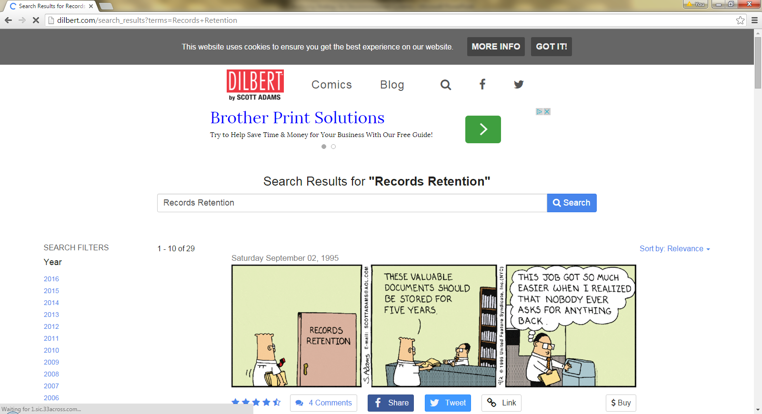
Notes:
Thanks, Dilbert ☺

Slide 3
Decommissioning: What and When
A process by which a business application is removed from use
Requires analysis of the system and identification of:
  data
  metadata
  system documentation that must be brought forward and retained
An accountable process for deletion of residual data in the system
A system should be decommissioned when the system is either:
  replaced by a new target system covering the same functionality, or
  obsolete because it no longer supports the business process
Notes:
http://www.records.nsw.gov.au/recordkeeping/advice/designing-implementing-and-managing-systems/decommissioning-systems-records-and-information-management-considerations#whatis

Slide 4
Situation
Systems / Applications are targeted to be decommissioned
Data contained within such systems may need to be retained
The organizational data preservation / archival strategy will vary depending on the type of data and records retention needs
Notes:
If you work with any sort of database, at some point you may find your system a target of decommissioning efforts.
Then, the data within that system needs to be addressed – does it need to be retained / migrated?
Retention / archiving strategy for an organisation/function will vary depending on the type of data and the records retention needs…
For Example, an organization which has 65 year or permanent retention periods will need a very different strategy and set of solutions to one which has just 7 year retention requirements
Who here has really long (>25) years retention?
Who has nothing longer than 7-10 years (for most of your records, if not all)?
Jonathan Tilbury, Chief Executive Preservica (provider of digital preservation technology, consulting, and research):
“Data and information management is essential within any organisation but is becoming increasingly challenging given the long and increasing time frames over which information is required to be retained.
This means information contained in documents and files created many years ago, as well as those created today and in the future, is often required for time periods exceeding the supported life of the application used to create and render it.
This problem shows no sign of abating, and in addition as the complexity and interconnectivity of information grows, the challenge of long-term access becomes greater.
HERE’S THE KEY: “Digital preservation requires careful planning and implementation to achieve the desired output. You need to be clear why you need to retain information and what needs to be stored as a result. You need to understand how the material will be accessed and by whom, and also how long it needs to be kept and the technical challenges this might pose.
The sooner these challenges are addressed, the earlier the benefits of a smoothly operating, secure, well-organised and accessible archive can be realised.”

Slide 5
Dealing with Misconceptions
There is a assumption that System Decommissioning is
  Difficult
  Expensive
  Un-necessary / Waste of Time
    We need all that legacy data anyway, it’s easier & cheaper to just keep the legacy system!
Challenge | Mitigation
One-off, difficult, expensive decommissioning in isolation | Repeatable, efficient , rapid Decommissioning Service model
“Head in the Sand” | Define decommissioning and archiving approach up front when new system is developed
Assuming all data must be maintained | Understanding the business process driving the perceived need to retain legacy system / data
Notes:
Let’s talk about why we avoid system decommissioning and thereby dealing with all that data – misconceptions. There may also be an assumption that a system can be easily mothballed and then pulled out and started up whenever the data is needed in the future. Not necessarily so! Here are some thoughts on What we have done in my company is to address these false perceptions
Challenges and Mitigation -- Perceived cost of archival vs. cost of maintaining legacy / retired systems (even if “graveyard”)
One-off decommissioning in isolation ➔ implement a repeatable service model; this reduces the cost ** Having dedicated specialized resources ensure cost-effective, rapid, repeatable service delivery
**As a more efficient service model, we have provided a lower cost of archival vs. cost of maintaining legacy / retired systems ‘just in case’
Waiting until you have a system that has outlived it’s useful life ➔ Define decommissioning and archiving approach up front when new system is developed; we group systems by similarity in decommissioning approach (have archiving “patterns” I will explain later on in the presentation)
Assuming all data must be maintained ➔ Understanding business process driving the perceived need to retain system / data
** Define archival costs as separate and distinct from the decommissioning process cost (is data really needed? Is it worth the cost?)
REALITY CHECK For legacy systems you choose to maintain or not – you deal with ‘End Of Life’ decisions – the reality is, if you maintain a system, you need the hardware, software, OS, application and the knowledge of how to use it, which makes the cost of that substantial, and the risks significant (once a system no longer works because one of those components fails, it is quite possibly too late to rectify already)
BOTTOM LINE: “Begin with the end in mind” - Ensure archiving requirements are included for any new systems under development. Example - the 25 years plus retention of clinical study records mandated by the EU in their new regulations
ASK if anyone has any 25 year old applications they use today, NOTE how much faster applications evolve these days.
Conclusion - You must plan to migrate out of the system you are putting in place today, it will happen…..

Slide 6
Why Retain?
Triggers and Pre-requisites to retaining data/records
Triggers - legal, fiscal, regulatory & business requirements to retain records:
Business Process (i.e., approval of record, closure of project)
System Decommissioning
System Performance and Capacity Constraints
Mergers, Acquisitions or Divestitures
Pre-requisites:
Knowledge/understanding of the data/records
Knowledge of hardware, software, OS, system and how to use it
Thorough assessment of the real need to retain data/records
Identified business data/record owner
Knowledge of the future use / readability / retrievability requirements
Notes:
So, to Recap – you are facing a system that is being decommissioned
Something in your environment triggers the need to retain data in that system
TRIGGERS to Retain information:
Regulatory
Business
Financial
Legal
Or just ongoing need to re-use the knowledge
To prepare, the organization (Business and IT collaboration) Need to meet what I’m calling ‘pre-requisites’
FYI: Types of data to be retained:
Operational
Incident
Routine business activities
Project
Environmental
Compliance
Human Resource

Slide 7
Decommissioning Checklist
Protection of records
  Have records been mapped to specific Records Retention category?
  Does system contain records scheduled for long term retention?
  Are there records in the system not covered by an existing record retention category?
  Has metadata and system documentation necessary to support the integrity of the records been identified?
Notes:
You may have statutory obligations to protect Records and information from unauthorized or unlawful destruction, loss, deletion or alteration.
Protecting records and information is a core responsibility of an organization during a decommissioning project, and will often require migration of records/information to the new system. However, decommissioning also provides a natural opportunity to dispose of records which are no longer required. If you are missing items on this checklist – that may be a good place to start
Mapped to specific Records Retention category?
Review your organization-specific retention and disposal rules, policies and retention schedules for specific categories of records/ information.
If no Records Retention schedule category exists for these specific records/information, it is recommended that you start with getting approval for the new category
Does the system contain records/information scheduled for long term retention?
If organizational use has ceased for archival-value records/information, consider establishing an archive transfer project, utilizing standard templates for specific categories of records, with documented indexing guidelines. GIVE ADA EXAMPLES
Not covered by an existing record retention category? If not, establish a procedure to gain authorization for destruction
Has metadata and system documentation necessary to support the integrity of the records been identified?
If so, the organization should have specific retention rules on records generated in the course of application development and management, security management, and other common technology management processes. These provide rules for specific categories of system documentation and metadata.
SOURCE: http://www.records.nsw.gov.au/recordkeeping/advice/designing-implementing-and-managing-systems/decommissioning-systems-records-and-information-management-considerations#checklist

Slide 8
Decommissioning Checklist
Requirements relating to retention of data
  Have information architectures been reviewed to ensure all dependencies on the data in this system have been resolved?
  Are the records/information in this system duplicated across multiple systems or repositories?
  Does the system contain information which is personally valuable to individuals?
  Does the system function as a source of authority for a high value dataset?
  Does the system contain valuable information about businesses and individual clients’ interactions with the organization?
  Does the system contain records/information which otherwise have a high public or commercial value?
Notes:
While an organization may have met its legal or regulatory obligations for the retention of data, there may be other important reasons to migrate and retain records from a legacy system before decommissioning. This could occur either through migration to the new or other existing target system, or management in another repository.
Information architectures -- reviewed to ensure all dependencies on the data in this system have been resolved?
Example: An Identity and Access Management Directory may contain data which is needed to verify action / approval metadata in a system workflow.
information in this system duplicated across multiple systems or data repositories?
Example: In complex digital environments, information may be duplicated across several systems, particularly where the functions of backup and “archive” are not clearly defined. There may be an opportunity to analyze, document and consolidate these data repositories as part of decommissioning.
Long term information access is one of the purposes for organizational recordkeeping and information management strategies. This makes backups unsuitable for long term information management, because they do not provide an easy means to go back and analyze past data.
Information which is personally valuable to individuals?
Example: are their processes and systems that may also be dependent on data in other linked system in order to be complete.
Source of authority for a high value dataset?
Example: Does another business unit or public sector entity rely on the data in the system, despite business value having ceased for your organization and application? DNG EXAMPLE
An Asset Register provides searchable metadata and contact details for a list of core-value information assets, including datasets, in order to facilitate their sharing between agencies. It does not host data, only metadata about datasets.
Valuable information about businesses and individual clients’ interactions with the organization?
Example: Does the community at large have a reasonable expectation that data in the system about interactions with the organization will be maintained on an ongoing basis?
Records/information which otherwise have a high public or commercial value?
Example: Emerging or unexpected uses may make it relevant to retain information for longer and/or make it available to the public. Does the organization have an ‘open data’ policy?

Slide 9
Retrieval / Future Use Considerations
Data recovery strategies
 | Re-Integration of Data | Structured Query/ Transformation | Read Only
Definition: | Data flows from/to live system allowing re-processing | Stored in database or in structured format | Extract and save in long term formats (e.g. PDF, Text)
Requirements to create: | Migration from source format into application Import/export process in receiving org | Formatted Data Extracts Metadata / schema for rebuilding Documented data definitions & relationships | Format of report to link data Creation of the report
Requirements to keep current: | Routine testing of interface | For proprietary formats, need to upgrade when supported version changes | Use of long term formats
Recovery Options: | Execute the import | SQL expertise for export and assistance | Search within PDF or retype data
Continuity Approach: | Execute the import and pre-defined tests by user | Project to rebuild data SQL experts to build queries Evaluation by user via pre-defined queries | Periodic verification by user (manual - open and search)
Notes:
Diving a bit into thinking ahead about future use of the data – it is imperative to consider strategies IN CASE you need to recover the data!
I wont go through ever point on this chart, as it essentially applies to all IT data, not just that from systems being decommissioned – but if you might need to:
Re-create data / information – if you use PDF format, will it be full-text searchable or just an image?
Keep Current – think about LONG TERM FORMATS, or support new versions of proprietary data as upgrades take place
So, I’m sharing this to simply say you also need to consider future use of data PAUSE FOR EXAMPLES OF WHERE FUTURE USE WAS NOT CONSIDERED
It is very likely that the future users of this data are not the system owners or generators, so identifying who the possible future users might be a worthwhile exercise
The really difficult piece from a system decomm perspective is what happens if the future need is for reprocessing……..(I don’t have the answer by the way!) (EG, having to re-run data analysis from a clinical trial; or where you divest of a product, and the future owner need to re-process data, etc)

Slide 10
Migration for Further Retention
Objectives
  Support business needs
  Maintain accountability
  Create Documented Migration Strategies
  Ensure Data Integrity
  Maintain Information accessibility
Migration is very system specific, and the methodology should be structured and support the process of migrating records required to be kept as digital archives
Notes:
Best Practice ensure that records and information are sustained through system and service transitions by strategies and processes specifically designed to support business and accountability.
This means organizations should document their migration strategies
and, that migrating records and metadata from one system to another is a managed process
Which results in trustworthy and accessible records and information
Source: http://www.records.nsw.gov.au/digitalarchives/digital-archives-migration-methodology/digital-archives-migration-methodology

Slide 11

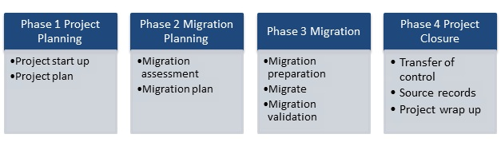
Migration Methodology
Notes:
Phases:
Project Planning -- establishes responsibilities and sets out the scope of the project and its deliverables.
Migration Planning -- defines the processes to be undertaken in the Migration phase.
Project Closure -- closes the project and identifies any required post-project activities (such as the disposal of source records).
Activities in each phase:
The first two phases of the methodology deliver two key documents:
project plan, which manages the overall migration project
migration plan which identifies actions to be performed during the migration phase.
The key deliverables of both plans are reviewed at project closure.
The activities and actions that take place during each phase are determined based on the identified requirements of each migration project.
Source: http://www.records.nsw.gov.au/digitalarchives/digital-archives-migration-methodology/digital-archives-migration-methodology

Slide 12
Migration Methodology: Key Elements
Your Records Retention Policy should provide for the authorized disposal of records that have been used as the input or source records for successful migration
The policy or procedure should define conditions which must be satisfied before source records can be destroyed, as well as guidelines on documenting and preserving the essential characteristics of digital records through migration
Notes:
You will develop a table of actions for each phase, such as
Project Planning:
Roles, responsibilities, scope, costs, risks / mitigation, timeframes
Disposal determination (REFER TO YOUR RETENTION POLICY AND SCHEDULE)
Assessment of access requirements and restrictions
Migration Planning:
Description of records to support ongoing management and access
Format assessment to ID transformations required for digital continuity
Metadata assessment and mapping
Outline the migration process, including path, timeframes, responsibility, resourcing
Migration
Preparation
Testing
Validation
Project Closure
Take Action on Source Records from the migration (don’t just leave them out there!) NEXT SLIDE
Source: http://www.records.nsw.gov.au/digitalarchives/digital-archives-migration-methodology/digital-archives-migration-methodology

Slide 13
Managing Residual Data
Some systems still containing key data stay in an ‘operational state’ with reluctance to decommission
Risks to this approach if this data:
  Poses significant privacy risks
  Poses significant commercial risks
  Poses other significant organizational risks
Notes:
So what to do with what’s left? Get rid of it!
Example:
A government organization continued to maintain a web-facing application containing client contact information, despite records retention rules and business use having been met.
These systems, if unmaintained, are vulnerable to being breached by hackers, necessitating the organization telling clients their contact information and interactions had been compromised despite their being no valid reason for its ongoing retention.
Source: http://www.records.nsw.gov.au/digitalarchives/digital-archives-migration-methodology/digital-archives-migration-methodology

Slide 14

There’s got to be a better way…
Notes:
So, we’ve talked about how to determine what to do, and how to migrate data – but what can you put in place to address the eventual day when a system has outlived it’s useful life
➔ Define decommissioning and archiving approach up front when new system is developed; we group systems by similarity in decommissioning approach

Slide 15
Selecting an Archiving Pattern
Pattern Decision Process:
File / object
Data
Database
Graveyard
Strategy and Policies
Regulatory or Legal Requirements
Mandatory Business Requirements
Business & System Analysis
Record Category
Retention Period
Preservation Notice
Information Sensitivity
Data Privacy
Regulatory need for retention
Regulatory need for analysis and retrieval
Specific Regulatory in-market / country requirements
Can content be extracted from legacy system
What formats are available for extracted data
Are there data validation requirements
Will the business be able to support User Acceptance Testing and verification
What are the data volumes
Life cycle of existing business process
Define users, scope and frequency
Who is business owner of data
Existing risks
Notes:
I mentioned that we have defined “Archiving Patterns” – common traits we see in the data we generate. We consider this during a system’s development phase
When you are developing a system, you factor in
Organizational strategy and policies (your retention policy, see call out)
Regulatory and legal environment (see callout)
Business requirements (who are your users, how do they use the system and data, etc) Examples of risks / challenges: Media and File Format Obsolescence
And Business / Systems analysis (see callout – facts about the system and data)
Considering all of that, we have come up with four typical ‘patterns”:
Files (which may be Structured or Unstructured),
Structured Data,
Entire relational Database, and
Graveyard System (giving up!)
Selecting your archiving pattern, as mentioned, may be an iterative process –given the type of data, and circumstances at hand ( see ‘when to use this option’ on prior table / chart)

Slide 16
Archiving Pattern Guidelines
Pattern – typically dealing with: | Description | Solutions Examples | When to use
1. Files / Object (structured or unstructured data) | Files in archive-agreed format, extracted from system and transferred to managed archive repository system | Electronic archive repository (i.e. Documentum) Other solutions according to specific needs | For file preservation and viewing For files extracted from source system (especially where source is being decommissioned)
2. Structured Data | Vendor-provided capability to support archiving | ECM for data Various solutions | Specific tool for viewing and analysis Existing capability within IT May require archiving within the system (in place) for shorter retention period
3. Database (Structured) | Required data extracted and migrated into purpose-built relational database (with reporting capability) | Oracle DB service, SAP / Data Warehouse
4. Graveyard (Structured) | Dedicated instance of the system retained; may aggregate data from decommissioned systems into single instance | Retain existing system | Higher risk; for short-term retention period (e.g., two years, with low activity)
Notes:
This is a quick overview of the Patterns we have defined in our business environment – yours may look different.
Quick Definitions:
Structured Data: refers to any data that resides in a fixed field within a record or file. This includes data contained in relational databases and spreadsheets. Structured data has the advantage of being easily entered, stored, queried and analyzed. At one time, because of the high cost and performance limitations of storage, memory and processing, relational databases and spreadsheets using structured data were the only way to effectively manage data. Anything that couldn't fit into a tightly organized structure would have to be stored on paper in a filing cabinet.
Unstructured Data: information that doesn't reside in a traditional row-column database. As you might expect, it is the opposite of structured data.
Pattern 1 would be the ‘preferred’ standard. Extract the data and put it elsewhere – this can be accomplished with commonly preferred file formats
Pattern 2 - Some systems have built-in archiving capability, and the retention may be shorter. If not, assess Pattern 1 as the standard solution.
Patterns 3 and 4 should required higher-level / exceptional approvals.
Preferred Formats:
Video Images – MPEG (Moving Picture Expert Group) or WMV (Windows Media Video) formats
Standalone Images – TIFF (Tagged Image File Format)
Documents – PDF or PDF/A (Portal Document Format)
Scanned Documents – PDF
Spreadsheet or Alphanumeric Data – XML (eXtensible Markup Language)
Data – ASCII / Base 64

Slide 17
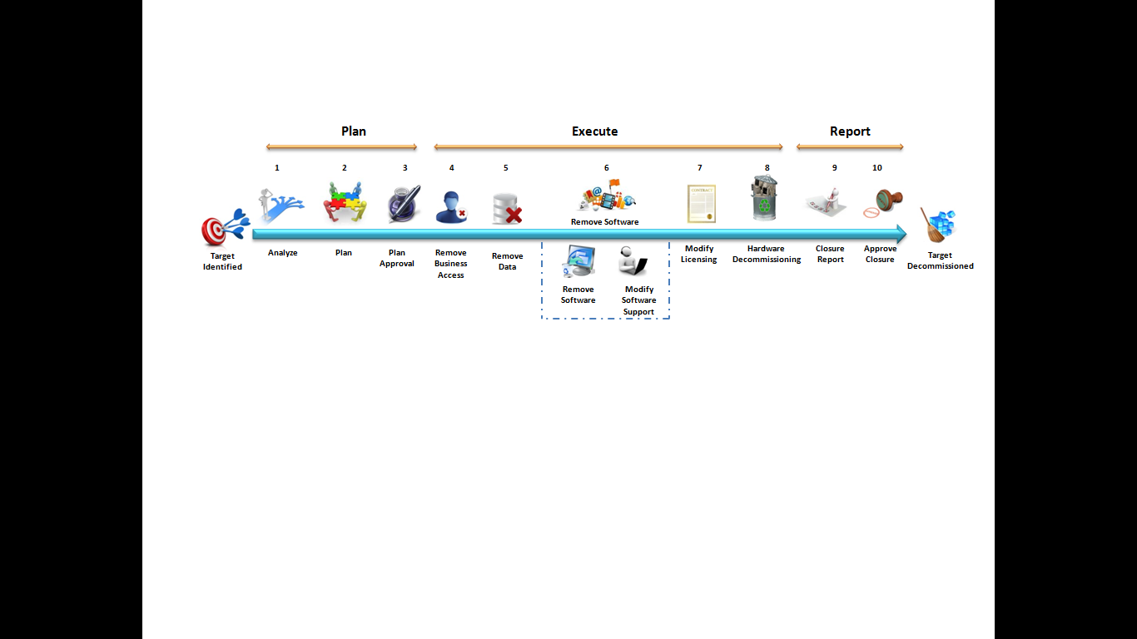
System Decommissioning Process
Key Activities
Archival/Data Migration Plan
Archival/Data Migration Report
Optional Deliverables
Project Plan
Decommissioning Report
Project Management / Quality Management
Liaison with various functional groups
Data Extraction & transformation (if required)
Data testing / Verification (if required)
Standard Deliverables
Decommissioning Plan
Test / Verification Plan
Test Cases
Test / Verification Report
Requirements Gathering / Analysis
Weekly Progress Report
NOTE: Ensure data migration / archival is verified complete before executing decommissioning tasks.
Notes:
This is a sample IT process followed when decommissioning a system, Planning, Executing and Reporting on the process
See the red circle and the bottom note
It is generally IDEAL when IT systems DEVELOPMENT projects define archiving requirements up front!
Business-aligned IT Support are accountable for collaborating with the business to determine archiving solution

Slide 18
Data Retention / Archiving
The system may have built-in reports that enable data to be printed out, such as to PDF/A files, which can be moved to target repository (Pattern 1)
Where reports are not possible or sufficient to support the type of access, use of data needed, an alternative solution could be investigated
For each decommissioning, a plan should be created with the data owners input to confirm the requirements for:
  Retaining the data (scope and timeframe)
  Archive approach (eg pattern, future use, search, and access needs)
Working with IT Support, the data owner(s) may need to provide:
  Input and approval of the data Retention and Archival requirements
  Accountability for the continued ownership & eventual deletion of the archived data / documents
  Timely approval for formal plans and reports
  Necessary accounts & access to the system and its data for those who will carry out the archiving
  Appropriate test environments which replicated the production environment for script or code tests
  Someone to verify data extraction is accurate and complete
Notes:
PDF/A is a global standard for preserving electronic documents
Alternative file formats – see below
Responsibility for data lifecycle management actions may be delegated to the service managing the Archive repository
Preferred Formats:
Video Images – MPEG (Moving Picture Expert Group) or WMV (Windows Media Video) formats
Standalone Images – TIFF (Tagged Image File Format)
Documents – PDF or PDF/A (Portal Document Format)
Scanned Documents – PDF
Spreadsheet or Alphanumeric Data – XML (eXtensible Markup Language)
Data – ASCII / Base 64
Acceptable Formats:
Video Images – AVI (Audio Video Interleave)
Standalone Images – JPG (Joint Photographic Experts Group)
Medical Imaging – DICOM or DCM (Digital Imaging and Communications in Medicine)
Documents – DOC or DOCX (Microsoft Word)
Presentation Documents – PPT or PPTX (Microsoft PowerPoint)
Text Documents – TXT
Documents – RTF (Rich Text Format)
Spreadsheet Data – XLS or XLSX (Microsoft Excel)
Data – CSV (Comma Separated Values)
Statistical Data – SAS Xpt
Database Data – SQL (Structured Query Language)
Repository Basics – characteristics of a successful repository:
Ingest – automate the gathering of information into a central location
Data Management – includes tools to edit and dispose of information in a controlled manner, editing of metadata
Storage – bulk storage using commercially available file storage; disk or tiered, fast and slow disks with full mgmt system, with easy checksum and electronic signing technologies
Access – consumers with full search and browsing tools with intuitive interface, fast access to complex data structures; integrated with other ECM systems allowing fully federated searches
Administration – security system allowing the definition of open and closed information and role-based task allocation, possibly integrated with identity management system.

Slide 19
Putting it into Action
Establish Digital Preservation Mandate
Understand current situation
Define where you want to be
Develop business case
Define and communicate requirements
Develop and deliver a model
Notes:
To Summarize: Long-term information management strategies are now recognizing that the systems in place for short-term data management are not sufficient for extended time frames.
Plans for long-term information access must take into account many factors to ensure access to critical information. This starts with the initial creation and approval of the information through to its archival and long-term preservation and access. Preservation must operate at the byte level but also at the file format and information level, both of which are threats to long-term access.
Digital Preservation mandate: Get “in principle” agreement from stakeholders to move forward. Key first step is to understand the threats from a poor policy and the opportunities enabled by implementing a good policy.
Current Situation: Understand what the data types and retention needs are when systems are first developed. Having a “Digital Asset Register” documents the different categories of information, the threats they are under, and the consequences of not having access to this information, be it a negative consequence that becomes real (e.g. regulatory penalty) or the inability to exploit a positive consequence (e.g. cannot improve business processes). What is the organizational appetite for in house or external solutions, use of cloud services, etc. (different topic!)
Where do you want to be: Articulate a vision of the end point in organizational terms – what will digital preservation in action look like. Is the solution addressing a specific kind of data, structured or unstructured data, special retention needs? Long medium or short retention timeframes, etc?
Develop a business case: This is one of the more difficult aspects of the process. It is greatly supported by a good Digital Asset Register, but must add a return on investment calculation and may incorporate a risk-consequence plot for each if the asset types.
Understand and articulate your requirements: This formally documents the specific features you wish to implement, the stakeholders that need to be involved and the non-functional aspects of the system that must be taken into account.
Develop and deliver a model: Given the growing availability of commercial and open source products this can be the more straightforward part of the process. (Example I gave of how we have a Specialized Decomm Service, defined archiving patterns, etc)
Once implemented, the challenge then becomes to operate and refine the approach. The growth of the collection and the enhancement of the processes will continue long into the future as the collection grows in size, diversity and usefulness
Reference: “Practical Digital Preservation” by Adrian Brown on creating and implementing a Digital Preservation strategy (Facet Publishing, ISBN-13: 978-1856047555)

Slide 20
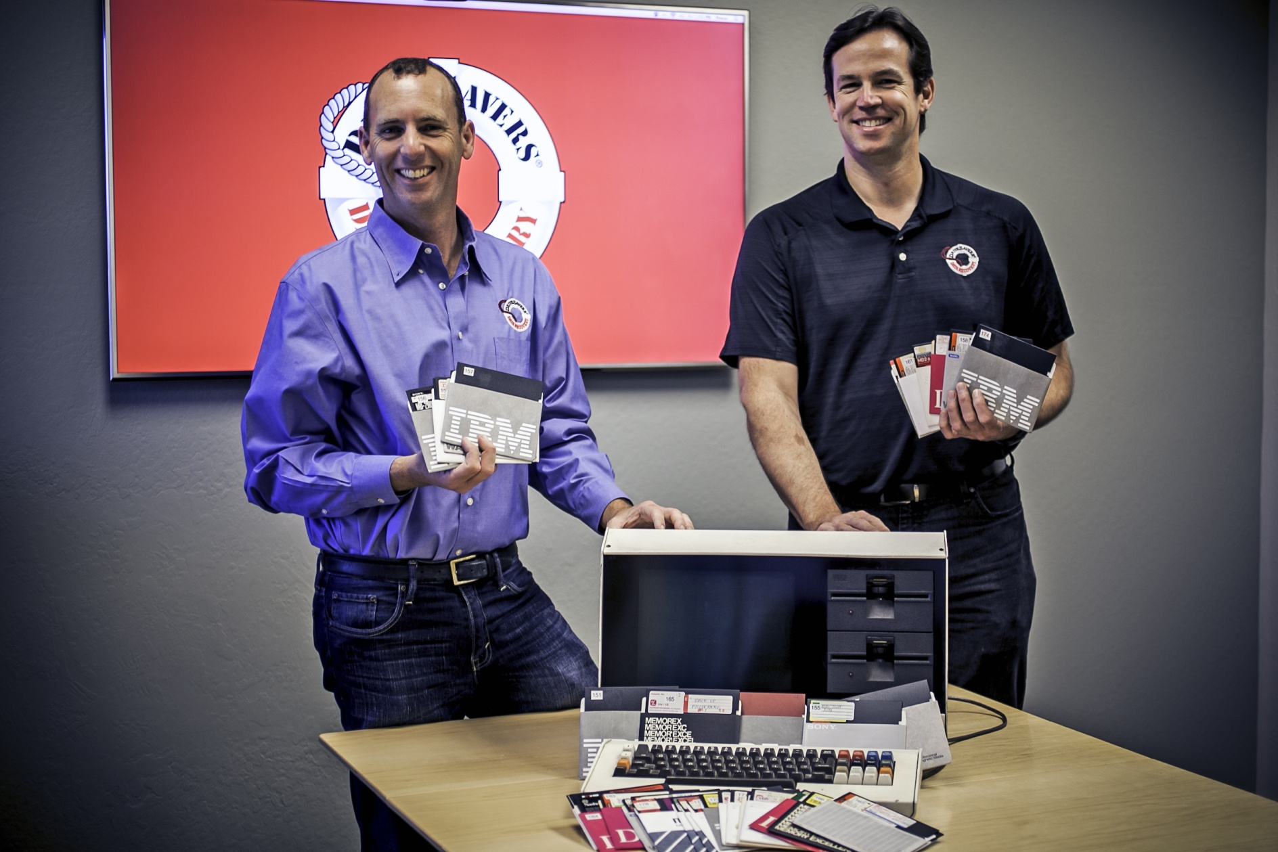
Gene Rodenberry’s Lost Writings
Notes:
Call the engine room and get Scotty to the bridge: The long-lost words of Star Trek creator Gene Roddenberry were found on 5.25-inch floppies—yes, floppy disks—it would take a Starfleet-level engineering effort to recover them.
Roddenberry, who died in 1991, apparently left behind a couple of shoebox-sized containers of those big floppy disks.
The problem? As any techie knows, floppy drives went out off fashion around the turn of the 21st century.
Even if you bought a used 5.25-inch floppy drive off of Cyrano Jones on space station K7, you wouldn't be able to read the files on a modern computer, let alone plug in the drive.
Roddenberry's estate knew of two possible computers the author had used to write those final words. One had been sold off in a charity auction and the second wouldn't boot when plugged in.
Roddenberry's estate turned to DriveSavers Data Recovery. The lack of an operative computer was less than ideal..
The majority of the disks were 1980s-era 5.25-inch double-density disks capable of storing a whopping
A few of the disks were formatted in DOS, but most of them were from an older operating system called CP/M, or Control Program for Microcomputers, a popular operating system of the 1970s and early 1980s that ultimately lost out to Microsoft's DOS. In the 1970s and 1980s it was the wild west of disk formats and track layouts, Cobb said. The DOS recoveries were easy once a drive was located, but the CP/M disks were far more work.
They had to actually figure out how to physically read them; The difficult part was CP/M and the file system itself and how it was written.
As the data recovery firm couldn't get Roddenberry's old computer to power on, it had to sleuth the physical layout of the tracks on the disk. That alone took three months to reverse engineer
Then, 30 of the disks were damaged, with deep gouges in the magnetic surface. Most of the physical damage was over empty portions of the disks; about 95 percent of the data was recovered.
Besides seeking the technical expertise required for the task, the estate also wanted high security, The estate wasn't going to just drop all 200 disks in a FedEx box and pray to the shipping gods they wouldn't get lost. Only small batches of the disks were doled out at a time, and each batch was hand-delivered to DriveSavers' secure facility in Novato beginning in 2012.
Once DriveSavers had recovered the data, the data had to be converted into a format the estate could open. It's not like you can feed a 1980s-era CP/M word processor format into Microsoft Word, so each file was converted to a readable text file.
All told, 2-3MB of data was recovered from the 200 floppies. That may seem like a minuscule amount by today's standards, but in the 1980s, document files were small. Roddenberry's lost words were substantial.

Slide 21
Q&A

