Slide 1
File Share Cleanup:
Getting Started
(or… “Just start somewhere!”)
ARMA Triangle Chapter
September 3, 2020
Lisa Coombes & Becky Pezzoni, CRM
Notes:
Silver linings from quarantining/ working remote – some folks have actually had time, due to cancelled / postponed projects, to work on their fileshares!

Slide 2
Agenda and Learning objectives
Steps in Cleaning up a File Share
Where to Start: Obtaining Support
The First Meeting: Make a Plan
What’s left: Measuring Progress
Q&A, Sharing Best Practices
ID What You Have: File Analysis
Delete Delete Delete!
Sample Folder Structure, File Naming
What’s left: File Storage Options
Notes:
Give credit to Caroline for letting us steal with pride on the approach they’ve used at UVA. Continually tweaking as we see how folks approach their cleanups.

Slide 3

File Share Clean Up Steps
Where to Start?
Obtain Leadership support
Discuss at a staff meeting
Create a committee (Representative from each work area, IT)
4. Delete!
Met retention?
Available elsewhere?
Duplicate or older version?
Empty your trash
5. What's Left?
Create an inventory
Develop new folder structure
Map new folder structure in inventory
Identify duplication across sections
2. The First Meeting
Share your screen, display the current file share
Divide drive into work areas
Devise a plan of attack
Don't move/delete anything yet!
Tips:
Electronic retention same as paper
Use years in folder names
Don't use employee names as folder
Don't create "Misc" folders
Control access to sensitive data
Review shared drive regularly
6. Reorganize
Use inventory as map
Move by section
Create new folders
Use consistent naming
Model after paper filing
Communicate changes to staff
3. The Plan
Identify what you have
Section assignments
Set deadlines by section
Report plan at staff meeting
Courtesy of UVA
Notes:
Credit to Caroline
These are not hard & fast rules, but rather suggested steps that we’ve been practicing – feel free to take this and make it your own
We will be walking through these steps during our presentation

Slide 4
1: Where to start?
Easier retrieval of information (time-saving)
Reducing cost of increasing space
Reducing duplication and redundancy
Encouraging sharing of information
Related documents are together
Provide context for individual documents
Standardized titling terminology for searching
Identified ownership of a group of records for ongoing maintenance
Obtain Support by sharing the benefits of cleaning up / clearing out
Notes:
We have a group of 42 “records champions” across our 14 departments in the County.
They are our ‘first line’ of communication, so we began this spring by reaching out to our Champions, and suggesting if they have time during our re-grouping for working from home / remotely.
Champions took the information back to their leadership teams and our work began.

Slide 5
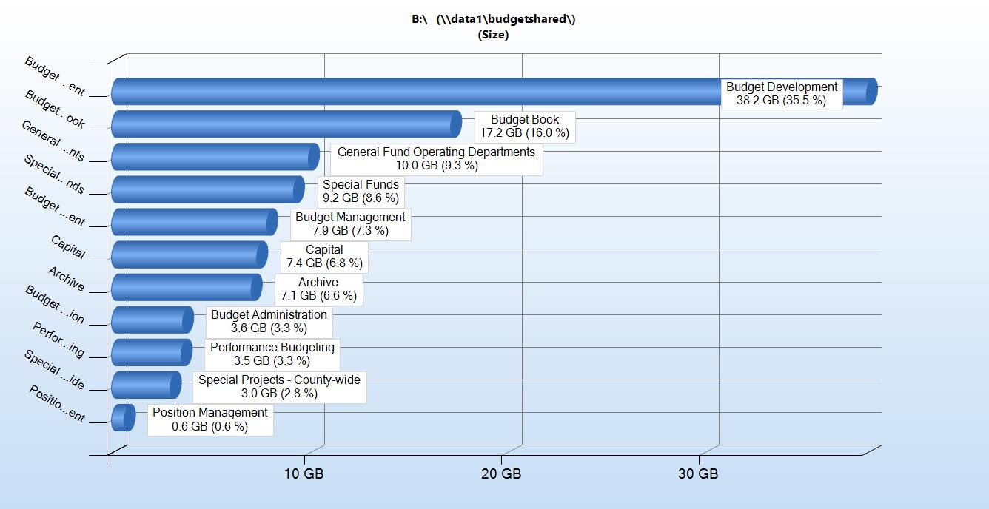
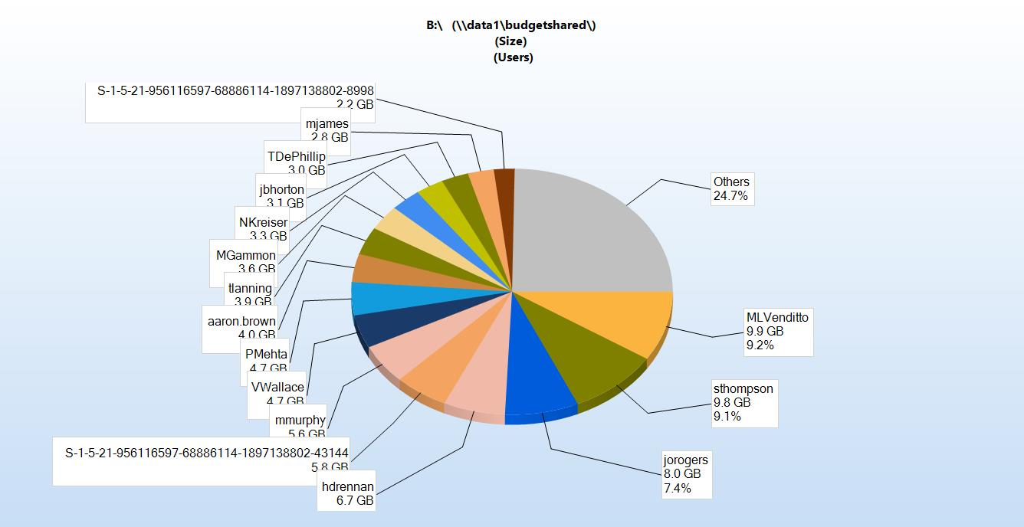
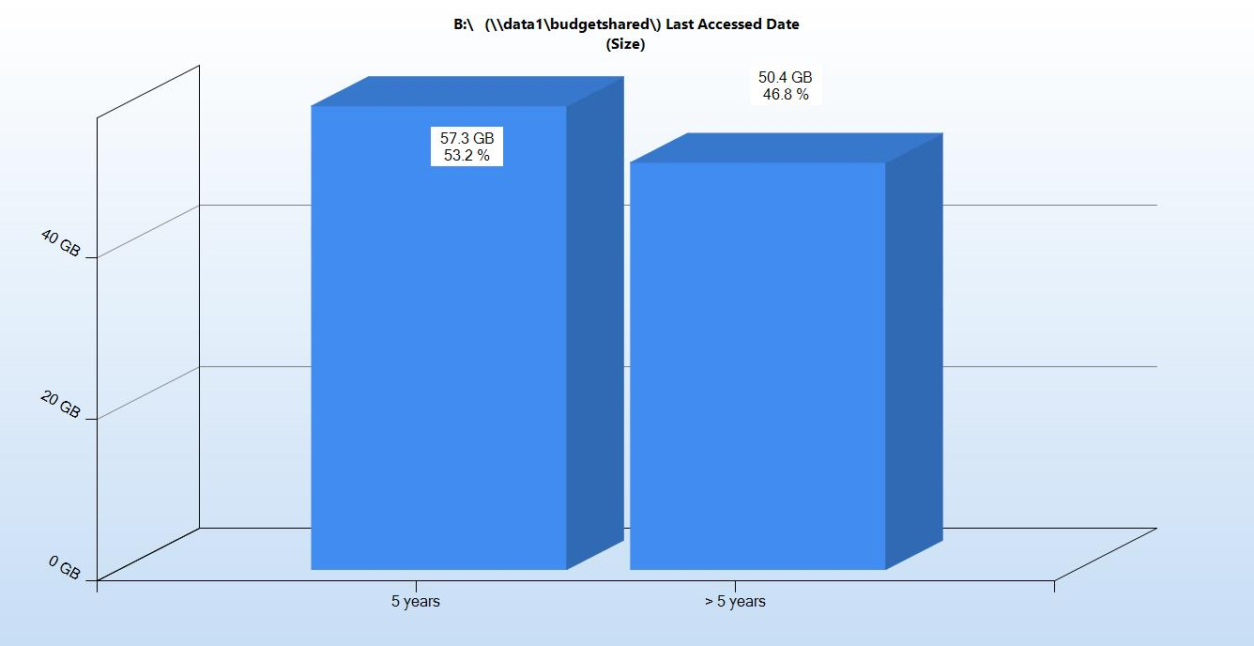
2: The First Meeting
Share the facts!
Get a plan!
Assign tasks and agree to accountability and reasonable deadlines.
Notes:
We use a file share analysis tool called TreeSize Pro. The annual license is relatively inexpensive, and Becky will show you more about that in a bit.
The analysis is often eye-opening for the department. It helps them see where they can focus their efforts – on ‘low hanging fruit’, or easy opportunities.
The pie chart is an example of files by ‘owner’, so we see this create a nice friendly competition between team members. Having owner’s information also helps in assigning tasks and holding folks accountable for their actions in the cleanup.
The magnitude of the cleanup is also pretty clear, so we encourage folks to set reasonable deadlines – AND we promise to check in with them every two weeks (and we always ask what we can do to make things easier to accomplish… More on this later!

Slide 6
3: The Plan
August 2020
Create Active/Inactive Folders
Create Folder Plan / Structure
Remove or relocate loose documents
Identify working files/folders to move to One Drive
Map records to retention schedule
Identify silent period for move to new structure and notify staff
Identify division level files/folders to move to SharePoint
Remove or relocate duplicates
IS create backup of Drive to retain until finalized
December 2020
Monitor and Maintain
Roles and Responsibilities
Deadlines
Communications on Progress
Notes:
The team will establish a cleanup plan, including Roles and responsibilities, deadlines, and how and when we will measure and share progress on the cleanup.
This is just a sample, but we have found this to be ‘repeatable’ and have used essentially the same plan repeatedly.
We happen to be using OneDrive / Teams / Sharepoint, and we are all learning as we go.
One of the silver linings of the pandemic – our implementation of MS Teams and SharePoint Online was already underway, so the pandemic has really escalated our implementation, and that’s mostly been a good thing.
Folks are motivated to set up their Sharepoint sites, and that makes the timing perfect to clean up and get better organized before they transition.
Handoff to Becky

Slide 7
4: Delete!
Utilize analysis tools where available (e.g. TreeSize)
Size and quantity of files and folders
Age of files, created, accessed and modified dates
Check your Schedule
Highlight Oldest
Investigate trends in Duplicates – you may find bad habits…
TreeSize Report, 8/10/2020 11:10 AM
B:\ (\\data1\budgetshared\)
Drive: B:\ Size: 11,263.7 GB Used: 9,657.7 GB Free: 1,606.0 GB
Name | Size | Size | Allocated | Allocated | Files | Folders | % of Parent (Size) | Last Modified | Last Accessed | Owner | Content created | > 5 years (Size)
Budget Development | 38.2 GB | 38.2 GB | 38.3 GB | 38.3 GB | 26450 | 3801 | 35.5% | 8/10/2020 | 8/10/2020 | WCS2384 | 7/12/2010 1:41 PM | 17.4 GB
Budget Book | 17.2 GB | 17.2 GB | 17.2 GB | 17.2 GB | 8011 | 361 | 16.0% | 8/7/2020 | 8/7/2020 | WCS2485 | 3/14/2012 9:40 AM | 4.9 GB
General Fund Operating Departments | 10.0 GB | 10.0 GB | 10.0 GB | 10.0 GB | 13418 | 2379 | 9.3% | 8/10/2020 | 8/10/2020 | WCS2384 | 7/12/2010 1:42 PM | 4.1 GB
Special Funds | 9.2 GB | 9.2 GB | 9.2 GB | 9.2 GB | 14697 | 2171 | 8.6% | 8/7/2020 | 8/7/2020 | WCS2384 | 7/12/2010 1:42 PM | 5.3 GB
Budget Management | 7.9 GB | 7.9 GB | 7.9 GB | 7.9 GB | 11303 | 938 | 7.3% | 8/10/2020 | 8/10/2020 | WCS2384 | 7/12/2010 1:40 PM | 3.6 GB
Capital | 7.4 GB | 7.4 GB | 7.4 GB | 7.4 GB | 10095 | 1692 | 6.8% | 8/10/2020 | 8/10/2020 | WCS2384 | 7/12/2010 1:42 PM | 3.2 GB
Archive | 7.1 GB | 7.1 GB | 7.1 GB | 7.1 GB | 18217 | 2370 | 6.6% | 3/25/2020 | 3/25/2020 | jorogers | 7/21/2010 6:56 PM | 7.1 GB
Notes:
Lisa introduced the fileshare analysis tool we use –
you can find others out there, but our IT folks were big fans of TreeSize, so we knew we would have experts to go to if we needed help.
Turns out we probably use it more now than they do, especially when we are producing metrics for teams as they progress
So, when folks have their plan in place, we provide them a fresh scan of the specific folders they will target for cleanup.
It shows them the file sizes, the file and folder counts, the relative % of total, and three dates: Modified, Accessed, and Created.
We use modified as the basis for aging files, since ‘accessed’ can be misleading.
For me, I dare you all to count how many times I say ‘low hanging fruit’ or ‘quick wins’ !! Or even ‘get started’

Slide 8
4: Delete!
Duplicate, patterns
Files by year modified and owner
Name | Containing Path | Files | Size | Last Modified | Last Accessed | Type
FInal packet to BOC.pdf | [multiple] | 2 | 39.4 MB | 8/3/2007 |  | PDF File
FInal packet to BOC.pdf | B:\General Fund Operating Departments\46 - Human Services\Analyst Files Prior to FY2010\Sara Yanosy\Human Services\Special Projects\Z-Old files from Denise\Mental Health Reform\Continuum of Care\Holly Hill Replacement Beds\BOC Meeting and Worksession Materials\Dec 4 meeting to approve agreement\ | 1 | 19.7 MB | 8/3/2007 | 7/14/2008 | PDF File
FInal packet to BOC.pdf | B:\General Fund Operating Departments\46 - Human Services\Analyst Files Prior to FY2010\Denise Harb\Denise\Human Services\Special Projects\Mental Health Reform\Continuum of Care\Holly Hill Replacement Beds\BOC Meeting and Worksession Materials\Dec 4 meeting to approve agreement\ | 1 | 19.7 MB | 8/3/2007 | 12/21/2008 | PDF File
CIP Work Session FY 2017-23 Presentation 5.4.16 updated 5.20.16.pptx | [multiple] | 2 | 39.3 MB | 5/20/2016 |  | Microsoft PowerPoint Presentation
CIP Work Session FY 2017-23 Presentation 5.4.16 updated 5.20.16.pptx | B:\Capital\Development\FY 2017 - 2023\Recommended CIP Work Session\ | 1 | 19.7 MB | 5/20/2016 | 9/4/2018 | Microsoft PowerPoint Presentation
CIP Work Session FY 2017-23 Presentation 5.4.16 updated 5.20.16.pptx | B:\Capital\Development\FY 2018 - 2024\Feb 15 CMO Mtg\Archive\ | 1 | 19.7 MB | 5/20/2016 | 1/27/2017 | Microsoft PowerPoint Presentation
ATT-53.jpg | [multiple] | 2 | 39.0 MB | 7/19/2017 |  | JPG File
ATT-53.jpg | B:\Budget Development\FY 2021\Budget Messaging\Pictures\From Communications Office\Images\Community Services\Parks\Selected\ | 1 | 19.5 MB | 7/19/2017 | 3/30/2020 | JPG File
ATT-53.jpg | B:\Budget Development\FY 2021\Budget Messaging\Pictures\From Communications Office\Images\Parks\Selected\ | 1 | 19.5 MB | 7/19/2017 | 4/16/2020 | JPG File
Wake Images.zip | [multiple] | 2 | 38.9 MB | 5/10/2008 |  | Compressed (zipped) Folder
Wake Images.zip | B:\Budget Development\FY 2009\Budget Document\CIP Photos and Maps\ | 1 | 19.5 MB | 5/10/2008 | 6/3/2012 | Compressed (zipped) Folder
Wake Images.zip | B:\Budget Development\FY 2010\Budget Document\Budget Document\CIP Photos and Maps\ | 1 | 19.5 MB | 5/10/2008 | 6/3/2012 | Compressed (zipped) Folder
commissioner_sullivan.tiff | [multiple] | 17 | 330.7 MB | 4/24/2013 |  | TIFF File
commissioner_sullivan.tiff | B:\Budget Book\Budget Book - Wake County\FY 2002 - FY2020\FY 2017 Budget Book Files\Current Book Files (Static)\Images\Board of Commissioners\ | 1 | 19.5 MB | 4/24/2013 | 5/27/2016 | TIFF File
Check your Schedule
Highlight Oldest
Investigate trends in Duplicates – you may find bad habits…
Count of Name | Last Modified
Owner | 1994 | 1995 | 1996 | 1997 | 1998 | 1999 | 2000 | 2001 | 2002 | 2003 | 2004 | 2005
MLVenditto |  |  |  |  |  |  |  |  | 3 | 111 | 48
jorogers | 1 | 30 | 4 | 13 | 15 | 25 | 43 | 10 | 2 | 69 | 766 | 767
jbhorton |  |  |  |  |  | 1 | 6 | 29 | 22 | 72 | 185 | 157
NKreiser |  |  |  |  |  |  |  |  |  |  |  | 201
Admin | 6 | 49 | 80 | 139 | 273 | 906 | 1638 | 547 | 8 |  | 1
VWallace |  |  |  |  | 1 | 4 | 1 | 10 | 51 | 6 | 209 | 23
Notes:
Another feature of tree size is a deeper analysis of files by age (you set the parameters), and duplicates (not just as indicated by file names, but it uses the bits & bytes within the file itself to determine if duplicates exist).
It can seek out temporary files and internet links / shortcuts and such. Clutter.
Then the tool can be used to actually select what you want to delete and either delete it or move it to a temporary location, with it’s file path in tact to review once more before really moving to the trash.
I advise people to review these analyses first and identify trends and quick wins – then we even offer, if they can ID a pattern or a file path , to do the deleting for them!
Pivot table is old files by ‘owner’ – this is always a real eye opener… helps them prioritize where to get started

Slide 9
4: Delete!
Redundant, Obsolete, Trivial
  Irrelevant to the organization
  Unusable file extensions
  Duplicates
  Orphaned and Abandoned
Best to clean before you migrate to new storage option, but it’s never too late!
What’s not there cannot be stolen!
Organize with ‘findability’ in mind
  Carefully designed classification / taxonomy allows for more granular access controls and improves search efficiency
Where’s the ROT?
Notes:
ROT – we all have it, it’s clutter! And a great place to start.
Duplicates is one way to ferret out redundant content, Aged files analysis is another way to clear out Obsolete stuff, and the temporary analysis finds the broken shortcuts.
The treesize results are also broken down by file extension.
Any way I can help folks by slicing and dicing the data that can help people START SOMEWHERE is good!
We have a great time finding ‘former employee files’ and folders named for departments that don’t even exist anymore!

Slide 10
5: What’s left?
OneDrive
  Working files (Collaboration / Sharing!)
SharePoint
  Specific division level files
  Final Documents
  Specific purpose documents, like policies & procedures
Teams
  Meeting Minutes
  Project Tasks, activity tracking
Create a new inventory – what do you have and how is it used?
Compare Storage Options: How to choose?
Notes:
So, they are cleaning up their file share, getting more organized, and they may very well continue to just use File Shares.
But if you happen to be one of the lucky ones implementing Microsoft365, you have more options….
Here’s some guidance based on what we have found out there in M365 world to help decide what storage options might work best.
Not hard & fast rules, just suggestions.
But start with a file inventory – what you have left after clearing out the clutter, rot, and expired records / files

Slide 11
5: What’s left?
Map Inventory to Folder Structure
Beware of Duplication, Inefficiencies, Inconsistencies
Notes:
Create an inventory structure that works for you – it should show organization, and have columns to indicate dates, retention category and times, custodial responsibility, etc.
Use your file or record inventory to create a new folder structure.
Be sure to avoid temptation to duplicate (where multiple people use the same filesded.
Also consider establishing ‘archive’ structure, where files can be locked down / no editing, only copying for new versions, are allowed.
These are just two examples from different departments. The same sorts of files, but one is more centered on their submission schedule for reporting to the federal government. They will be very focused on using time elements / reporting dates in how they organize. The finance group will likely start with the WHAT, and WHEN will be secondary in their file structure

Slide 12
5: What’s left?
Monitor Process
Celebrate Successes!
Make if a fun competition!

Slide 13
6: Reorganize
Administrative Files
Administration and Operational
Organizational Files
Division level
Program Files
Sections
Activities
Case Files
Events
Projects
Transactions
Record Series
Personnel
Planning
Use inventory as your map
Agree and establish consistent folder structure
Communicate to staff / train!
Notes:
This has to be agreed upon and it has to work for the team, or they won't use it and they won't stay disciplined
This works whether you are talking file shares or one drive or SharePoint or teams…. Just good organization practices

Slide 14
6: reorganize
Avoid using special characters
Use underscores instead of periods or spaces
Err on the side of brevity (file path + file name < 256 char)
Include necessary content descriptors
If using dates, format consistently so they sort correctly (e.g., YYYYMMDD)
Include version numbers to manage drafts and revisions where needed
BE CONSISTENT
Good Practices for File (Re)Naming
Notes:
These are good practices – how many folks have run into issues with File names / file paths being too long? MS limitation of 256 Characters – especially an issue if you upload files into ECM systems!
CONSISTENCY is key!!
Show how to sync a sharepoint / onedrive document library to your file navigation panel
https://wakecountync.sharepoint.com/sites/IS-EnterpriseRecordsManagement/Shared%20Documents/Forms/AllItems.aspx

Slide 15
Q&A, Sharing!

