Slide 1


Elevating the Records Management Profession With ARMA At Your side
Notes:
Each of us share how ARMA involvement and certification have helped in our career paths (as part of introduction / bio)
Brad go first!
<<Have www.ARMA.org , www.ARMATriangle.org , and http://armaedfoundation.org/ websites open>>

Slide 2
What’s Happening with ARMA International?
Notes:
Becky

Slide 3
ARMA is the strongest community of professionals in the information management industry with educational resources and networking opportunities here at home and around the world.
It is an exciting time to be in this profession as it is rapidly changing and as a member of the ARMA community you can be part of it. ARMA is shaping the industry and can help you shape your career and add value to your organization.
When it comes to managing an organization’s vital asset, information, ARMA has the most comprehensive approach. We set the standards and best practices that address the full information lifecycle.
Notes:
Becky
What do you say when someone asks you ‘what is ARMA’
Here’s some examples of the language being used by ARMA International - examples of what you could say – which of these most resonate with you?
The underlined portions are the common language we should all be using for brand clarification purposes. Be sure to emphasize those portions…
If you need more specifically targeted language for a particular segment / industry, let us know so that we can customize our language within those segments.
Brad will talk more about elevator speeches in a bit!

Slide 4
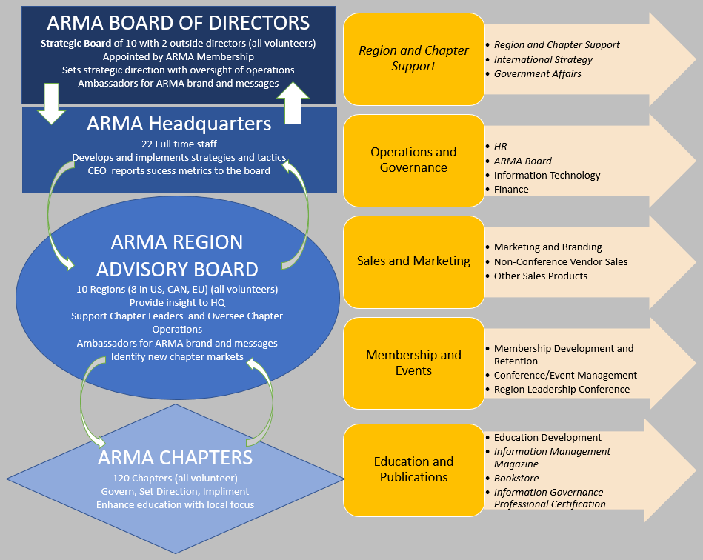
Notes:
Becky
Just to share the current structure of ARMA International – today we will be talking about how you can get more value out of your membership!

Slide 5





Students
Mentors
New Members
Incentives
New Website
Share Data
Boost Messages
Coordinate initiatives, data, resources
Highlight Value
Leverage IP
Volunteer
How can ARMA support you?
Face to Face
ID Potential Members
Create Energy in our Community
Notes:
Becky
So here are the things ARMA is focusing on that will directly impact Members:
Attracting students, retaining mentors, welcoming new members with intention, and offering membership incentives campaigns.
Sharing data and encouraging others to share with more personalized communication methods. Also just re-post on social, forward emails and resources to prospects. ARMA International is working on doing a better job of leveraging technology and sharing more data.
Differentiating value of our organization. Fully leverage that IP. AI wants to make sure members have a common understanding of RM / IG best practices and standards and arm you with those resources that will empower them to move the needle in their organization (soft skills and awareness of our roles are a big part of this).
Doing more to streamline communications and reduce the noise. We are working hard to better serve you and enhance the face to face experience (which tech. can’t replace). This is where you can make a huge difference on the ground and in your communities. What we need to ensure is that we’re spending our time on the right things that will make the biggest impact for you all.

Slide 6

We need YOU!
Your representation
Your leadership
Your participation
Your networking – Bring a colleague or a friend!
Notes:
Becky
It’s all about elevating our profession!

Slide 7

Step Out!
Reach Out!
Grow
Together!
Notes:
Becky
>> Neale Donald Walsch
Jocelyn Gunter, CEO of ARMA International, had a member ask her to explain what we wanted her to do as a member. Not what resources I wanted her to leverage or how I wanted her to engage with ARMA, but what I wanted her to get from it.
The bottom line is that we want all members, new and existing, to leave every interaction with ARMA feeling excited about what they do as a professional and empowered to work together with ARMA to shape the ever changing industry.
The more our messages about the profession are both personalized and synchronized, the better chance we all have of leaving this powerful impression.
I like this slide because much like the waves of change, we’ll all be challenged to get outside of our comfort zone. For ARMA HQ, that means listening and being nimble and considering how they can serve you each in an equal yet unique way because one size doesn’t fit all.
It’s not always easy to step outside your comfort zone but it gets easier. What can you each do to step out? Reach out to a colleague… a friend… a supervisor… anyone who you think could benefit from a membership in ARMA.
The profession is changing… our roles are changing… and our influence is growing.

Slide 8

What’s Your Elevator Speech?
What do you Do?
So What Do YOU Do?
What’s Records Management?
What’s Information Governance?
What’s ARMA
  NOT Association of Records Managers and Administrators
UHH….
Notes:
Brad
What’s your elevator speech?
What do you say when someone asks you what Records Management is or Information Governance or ARMA? Deer in the headlights?
Do you have an elevator speech? Are you proud of your career? Or do you just laugh it off with a joke?
PROUD
Information is THE key to everything that everyone else does at their job and without that they couldn’t be. Remember that.
Give folks a few minutes to jot down their speech, look back on slide 3 as well. Challenge folks to finish this exercise as homework!
Information Governance, or IG: the set of multi-disciplinary structures, policies, procedures, processes and controls implemented to manage information at an enterprise level, supporting an organization’s immediate and future regulatory, legal, risk, environmental and operational requirements. Shorter version: All encompassing coordination of all organization Information. Making sure consistency in information from all departments.
Records Management: the professional practice of managing the records of an organization throughout their life cycle, from the time they are created to their eventual disposition. Shorter Version: The act of managing the information (policy and procedure)
ARMA: ARMA International is a not-for-profit professional association for records and information managers and related industry practitioners and vendors. The Association provides educational opportunities and educational publications covering the principles of records management. It is also known worldwide for its standards and guidelines. Shorter Version: ARMA is a community of professionals that provides standards, guidelines and educational opportunities to those in the Records and Information Management profession
In order to elevate our profession, we all have to be PROUD of what we do
We must remember that information is the KEY to everything any organization does, and therefore we are indispensable as a profession!

Slide 9

“Information is to a Corporation as our vital organs are to the existence, operation and health of our bodies”
Notes:
Brad (this is my own quote!)
Why do we not have the fortitude to stand up for our professions and really make a move toward the table.
One reason is because many of our professional duties have been mixed up and confused with those of IT.
In many organizations, IT is an acronym, that like ARMA, that has become its own noun without needing to know the acronymic values.
We have been mistakenly placed under the umbrella of IT and our positions governed by those individuals whose knowledge revolves around how to stand up a server or roll out the next edition of Windows and not around how information should be governed or coordinated among departments – for example – a firm exists that has multiple systems all capturing information a different way among various departments. None of which speak to the others…
I am not by any means belittling what IT does because we all know that we would not have the infrastructures on which to build our policy and procedure without IT.
But is IT where the functionality of governing and managing corporate information should lie? This has been the subject of much debate.

Slide 10
THE DEBATE:
Who is in Charge of the INFO?
1980’s
2017
Notes:
Brad
As IT moved to mainstream in the 80’s it was debated who should be in charge of information. The CIO emerged and dominated but 30 years later most organizations seem to still be without a rudder.
The most critical questions about our information assets go unanswered.
30 years have passed and we are still without a solution to the problem.
Organizations such as the IGI (Information Governance Initiative) which is made up of many big name ARMA members have been meeting for years now to discuss what the solution is and who should lead this charge in organizations and from this the concept of a new title C level position has come to fruition that is being supported with much research.

Slide 11

INTRODUCING
The CIGO
Notes:
Brad
Introducing the Chief Information Governance Officer
A position created to give our profession a better place at the table.
The topic of the CIGO could be an entire presentation in itself so I just want to give a few key points about the “WHY’s of the CIGO.

Slide 12
WHY CIGO?
Information Focused Leadership
Organization-Wide Information Coordination
Balancer of Information Value and Risk
Notes:
Brad
Those in the IG community understand the necessity of the CIGO role, but for those outside of the world of IG it is critical to explain why CIGO’s are needed. This is a new role and not a rebranding of an existing one.
The CIO position of the 1980’scentered on the automation of financial and accounting processes using new database technologies. As more technology entered the workplace, this technology was given to the CIO. Overtime, the CIO went from leveraging new technology to improve business to becoming the custodian of all technology. They got bogged down in making sure organizations had reliable infrastructure leaving little time to pay attention to the information itself.
CIO became focused on simply supplying basic computer services to the business. Time pressure increased, which led to high failure rate of IT projects. This led to increased pressure to deliver and thus the cycle became self perpetuating. The road of the CIO has been tough and so its important in the creation of the CIGO that the goals and purpose are clearly defined.
These are the three gaps filled by the CIGO
Information Focused Leader – At most organizations nobody owns the information problem, at least not like the CIO owns infrastructure or the CISO owns information security. The CIGO fills that gap. The CIGO would address and understand the information itself as this is critical. There are vast amounts of information that in most organizations accumulate and remain unassessed or dark. Understanding what your information is converts an undifferentiated mass into something useable and actionable.
An Organization Wide Information Coordinator – CIGO fills a coordinating role for all information related functions at an organization. A commonly reported problem is that these facets often act separate from one another sometimes called silo-ing. So much sometimes, that the coordination is often haphazard, incidental and not maximized. Because pieces of information is likely to be important in various parts of an organization, this lack of coordination can be a severe impediment to the effective use of an organization’s information. The CIGO serves as a coordinating role for the different facets of IG across the entire organization and brings the proper people to the table.
A Balancer of Information Risk and Value: Information is a business asset. It has both risk and a value side. Most orgs have barely begun to think of their information this way. To the extent that they have there is no one tasked with balancing and prioritizing the organizations’ interests in risk and value. To do this the CIGO must be able to look at each equally and tie information and its effective governance to the business strategy.
There is so much more that we could discuss about the CIGO but what this should show is that there is mobility being created in the profession and with this comes hope for many who feel like their positions are a dead end.
With this push for a CIGO position and a seat at the table with the rest of the C-Suite, many doors are opened for better salaries, better and increased positions within the organization and a line of site that will raise the profession from the doldrums to a much more pivotal part of the organization. (i.e. title changes from records clerks to records governance assistants, etc.) And with this as an example we can see that ARMA’s goals hold true and that they are really and truly working for us and that we should be sure to invest back into ARMA and our profession as they are helping to pave the way for us by doing the research and providing the verification that was for so long impossible to find.

Slide 13

ARMA Goals
As the authority on RIM and a leader in IG, our goals are to:
Employ progressive and sustainable technologies
Provide an exceptional membership experience
Improve the satisfaction and success on a local level
Increase and engage membership
Increase visibility and influence of ARMA
Pursue professional opportunities for ARMA members
Notes:
Brad
ARMA Goals (At a highest level, what we want to accomplish this fiscal year)
As the authority on RIM and a leader in IG, our goals are to:
Employ progressive and sustainable technologies
Provide an exceptional membership experience
Improve the satisfaction and success of Regions and Chapters, on a local level
Increase the size and engagement of membership
Increase visibility and influence of ARMA
Pursue professional opportunities for ARMA members
Internal Efficiencies

Slide 14
INVEST IN YOUR PROFESSION
Presented by
  Carolyn Offutt and Ray Davis
  Regional Leadership Conference, July 22, 2017
Notes:
Becky
This next bit of our presentation is about the ARMA International Educational Foundation Two of the Trustees on the Board from our MA Region are Carolyn Offutt and Ray Davis – remember those names, hit them up on LinkedIn, and stay in touch over email.

Slide 15
This is YOUR Foundation
With Your Support, the Foundation gives back to the Records and Information Management community
Our Vision is to be the leading foundation that enhances the practical and scholarly knowledge of information management.
Our Mission is to fund and promote research, scholarship, and educational opportunities for the information management profession.
Strategic Goals: The Foundation concentrates its funding and promotional activities in three areas:
  Supports research to address critical issues in information management
  Provides funding opportunities to enhance knowledge, skills and abilities of practitioners in the field
  Fosters educational initiatives that develop information management skills and programs
Notes:
Becky
This is your Foundation. With your support – you, your Chapters and other Chapters, your Region and other Regions, Vendors, prior Awardees and Researchers, we invest in the future of records and information management. You can read our vision and mission statements here but most important is the fact that we focus on providing funding for research to address critical issues in information management, to enhance the knowledge, skills and abilities of practitioners in the field – like yourselves – and to foster educational initiatives that develop RIM skills and programs.

Slide 16
NE/MID-ATLANTIC
$21,600
in 5 years
Katelyn Bucher
Jacqueline DiOrio
Chad Doran
Haley Doty
Phillip Guenther
Nora Mattern
Daniel Paquette
Shante Ruffin
Ashley Shimer
Caroline Simpson
Notes:
Becky
These are the names of everyone from either the NE or the Mid-Atlantic Regions who received Scholarships or Tuition Reimbursement from the Foundation over the past five years. During these years, the Foundation has awarded and invested over $21,000 in scholarships and CRM and RIM reimbursements to RIM practitioners in your Regions. Do you know anyone listed here?

Slide 17
SCHOLARSHIPS AND TUITION REIMBURSEMENTS
1
$202,000 over ten years
Notes:
The first thing I am going to talk about is our scholarship and tuition reimbursement programs.

Slide 18
SCHOLARSHIPS
Graduate Scholarships Awarded
  52 awards over 10 years
  $152,000 awarded
  Graduate programs across the U.S. and Canada
Notes:
Over the past ten years, the Foundation has awarded 52 graduate scholarships totaling $152,000 to students in colleges and universities across the U.S. and in Canada.

Slide 19

WHERE ARE THEY NOW?
Graduate Awardees
  Susan Duis Haigh (2013) now Deputy City Clerk, City of Bonney Lake
  Chad Doran (2014) now Enterprise Records Manager, Johns Hopkins Applied Physics Lab
  Sherry Xie (2007) now Professor, School of Information Resource Management, iSchool at Remnin University, China
Notes:
All three of these individuals received an AIEF graduate scholarship in the years indicated.
Susan Duis Haigh received an award in her second semester in the Master of Archives and Records and Administration program at San Jose State. Since then she completed her degree in December of 2015, received a promotion and has become more active in the professional community. As of Fall 2016, she is serving as the VP for the Puget Sound ARMA Chapter, is working toward additional professional certifications and is participating as a trainer in a records management training for municipal clerks.
Chad Doran is currently responsible for the governance and administration of the records and information management program for an organization consisting of over 5,000 employees and over $1 billion in annual revenue. In 2015 Chad earned a PhD in Information Studies from the University of Maryland, College Park. He is the author of a recent Foundation - sponsored Research Report. He is also a member of the Foundation Research Committee.
Sherry Xie is now Professor, School of Information Resource Management at the iSchool of the Reminin University in China. She is also Associate Director of the Center for Electronic Records Management Research and Co-Director of the ITrust Team Asia, and involved in Research on Digital Records and Their Management Transformative Technological Environments . She is also an Adjunct Professor at the iSchool at the University of British Columbia.

Slide 20
TUITION REIMBURSEMENT
College Reimbursement
  $27,000 total (2014-2016)
    Chapters across the U.S.
    All RIM professionals
  3 awards of $1,000
  “Access Leadership Scholars Program” (Sponsored by Access)
    3 awards of $2,000
    3 awards of $6,000
Professional Development
  $23,000 total (2014-2016)
  CRM exams
  RIM training
  IG certifications
  Conference attendance
  31 people, nationwide
Notes:
Becky
Since 2014, the Foundation has invested $27,000 in college tuition reimbursement for RIM practitioners.
During the same time period, the Foundation invested $23,000 in other professional development support for RIM practitioners by providing reimbursement for CRM exams, RIM training, certifications, and conference attendance.
Take advantage of this and tell your colleagues and fellow Chapter members about this opportunity! It’s worth the time to complete an application…

Slide 21

WHERE ARE THEY FROM?
Access Scholars
  Each received assistance for college while working
  Ruben Vargas – Arizona
  Lisa Padilla – Houston
  Jessica Harman – Tulsa
  Susan Wheeler – Louisiana
  Ashley Shimer – Virginia
  Judi Long – South Florida
Why not someone from our Region/Chapter?
Notes:
Becky
These are all individuals who received Leadership Scholarships under a program administered by the Foundation and funded by ACCESS. Each of them applied for assistance with collegiate schooling while at the same time working at least part time in the RIM field. ACCESS has just agreed to continue this program for another three years.
Do you know someone who is working and going to school and could use financial support?
Why not someone from ARMA Triangle??
The only sure thing is that if you don’t apply, you won’t receive the financial support.
What have you got to lose!

Slide 22
RESEARCH
2
Notes:
Becky
The Foundation also invests in relevant research and wants to hear from you about what would be useful to you.

Slide 23
RESEARCH PROJECTS
25 Research Projects Completed
Online Directory/Searchable Database of English Language Collegiate RIM Courses, updated annually
All available for free download or use at :
www.armaedfoundation.org
Notes:
Becky
Examples of research that has been completed and which is available for free download from the website – www.armaedfoundation.org (Free research results are rare – if they are free, they typically come with tons of solicitation emails!)- includes:
Metadata in Court: What RIM, Legal and IT Need to Know by John Isaza
Mergers, Acquisitions, Divestitures and Closures – Records and Information Management Checklist by John Phillips
Updated Guide to Commonly Used National and International Management Standards and Best Practices, by Virginia Jones
Seeking the Core: The Development of the Core Works Bibliography for the RIM Profession by April Norris
Also available on the website is the Online Directory of English Language Collegiate RIM Courses, which is updated annually, and is sponsored by the Greater Washington DC Chapter.
All of this is free!

Slide 24
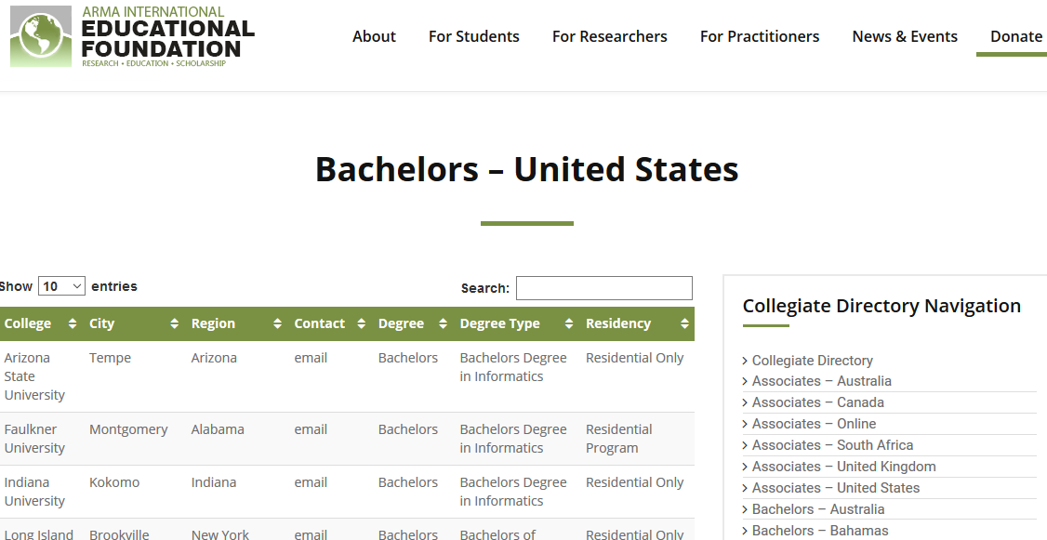
Notes:
Becky
This is a screen shot from the Online Directory of English Language RIM Courses, available free on the Foundation website: www.armaedfoundation.org.
It allows anyone to look for any college level RIM courses in their area or anywhere.
Thanks to the Washington DC chapter for compiling this and keeping it current ☺

Slide 25
Current Research
U.S. Current Court Cases (in process) – will gather recent, important and relevant IG/RIM orders and opinions issued by the Courts since 1994, updating an earlier publication that addresses pre-1994
Information Governance and Public Engagement: How U.S. Federal Department Policies Are Addressing Social Media Records (2016)
Social Media Systems Records and Information Governance Challenges (2015)
Download at no charge from: www.armaedfoundation.org
Notes:
Becky
The Greater New York Chapter is funding a research project that is currently in process: U.S. Current Court Cases. This will gather the recent, important and relevant information governance and records and information management orders and opinions issued by the Courts since 1994. An earlier book compiled cases before 1994. Thank you, Greater NY!
And thanks also for funding a 2008 research project relating to Requirements for Personal Information Protection.
And here are to others completed in the past couple of years…
All free for the downloading!

Slide 26
SUPPORTING THE PROFESSION
3
Notes:
Becky

Slide 27
HOW CAN YOU HELP?
Remember, this is your profession and your Foundation!!
Become a Chapter Foundation Champion – one per Chapter, who serves as a liaison to and representative of the Foundation to your Chapter Board and to Chapter members
Set up a monthly, recurring tax-deductible donation to the Foundation
Talk up the Foundation’s programs to your colleagues
Volunteer for the Foundation Board of Trustees or serve on a Foundation Committee (Scholarships, Research, Fundraising, Marketing, Finance,….)
Notes:
Becky
So, how can YOU help? Remember, this is your profession and your Foundation.
Think about becoming an AIEF Chapter Foundation Champion – the person in the Chapter who serves as a liaison to and representative of AIEF to Chapter members & your Board. We are ramping up a new CFC program and we want to work with each Chapter to identify a Champion. We will be providing each CFC with a CFC Handbook and then be in touch with regular updates. If you are interested or know someone who you think would be a great CFC, please see me after the presentation or reach out to Deb Marshall, our Coordinator.
Another way to support the Foundation is to set up a recurring monthly donation/pledge to the Foundation.
Talk up AIEF and its programs. Take advantage of the Foundation’s programs or research yourself.
Also, keep in mind that the Board of Trustees has nine members and they serve rolling terms – there are often openings and we want to hear that you are interested. Contact our Coordinator to help with how you want to contribute or reach out to any Trustee.

Slide 28
CHAPTER SUPPORT
How can your Chapter support the Foundation?
Encourage your members to apply for Tuition Reimbursement
Fund a specific project of interest to your Chapter through the foundation’s Research Program
Add a donation to the Foundation to your Chapter’s Annual Budget
Contribute Speakers’ Fees
Donate In Memory of a colleague
Sell Raffle Tickets, hold 50/50 events in your Chapter
Notes:
Becky
How can your Chapter help the Foundation?
Especially encourage your Chapter members to apply for the tuition assistance program. Like we are doing today! How many of you knew about AIEF before today?
Provide funding for a specific project that is important to your chapter.
Now more than ever, it would be an enormous help if every chapter included a yearly donation to the Foundation in its annual budget. For many of us, ARMA is where we get the majority of our professional development
Finally, we can let AIEF know if there are other programs that are important to our Chapter and members.

Slide 29
Are you Ready?
HOW WILL YOU AND YOUR CHAPTER/REGION DECIDE TO GIVE BACK TO MOVE THE PROFESSION FORWARD??
Notes:
Becky
Are you ready? We are. And we need your help.
There are additional research projects ready to roll out—but funding is needed.
Additional scholarships could be awarded with more funding; there are more qualified applicants than scholarship monies available – we currently have 29 graduate applications for only 3 awards.
AIEF believes that many more RIM practitioners could use professional development tuition reimbursement.
Building the Foundation’s endowment will allow for greater investment back into the RIM community.
Please contact Ray or Carolyn (names at the beginning of this section) for more details!

Slide 30
Open Discussion:
Share what you are working on and what resources would help you…
Notes:
Becky
Starters:
Policy & Procedure
Data Classification

Slide 31
Nov 2, 2017 – JC Raulston Arboretum
In 1975, J. C. Raulston arrived in the Department of Horticultural Science at NC State University to teach and to start an arboretum which would serve as a living laboratory for students and faculty, and a resource for professionals in the green industry and for the public.
In 1976, with a master plan drawn up by his graduate student, Fielding Scarborough, J. C. made the first plantings at the North Carolina State University Research Farm Unit 4 (now the Horticultural Field Laboratory) on Beryl Road on portions of an eight acre parcel designated as the NCSU Arboretum, assisted by his research technician Newell Hancock and a few dedicated students.
Over the years, the Arboretum has grown to ten and a half contiguous acres, renamed in his memory as the JC Raulston Arboretum at NC State University, and achieve international recognition for its imaginative use of resources and the excellence of its plant collections. (https://gardening.ces.ncsu.edu/)
Mission
The mission of the JC Raulston Arboretum is to introduce, display, and promote plants that diversify the American landscape, thereby benefiting our communities economically, environmentally, and aesthetically, as well as provide educational experiences to the general public, students of all ages, and the green industry.
Strategic Goals
Collecting, evaluating, and selecting for introduction landscape plants for their most beneficial economic, ecological, and aesthetic value;
The gardens as a living laboratory which resides in and complements the curricula of NC State University;
Educational experiences for plant enthusiasts, Green Industry professionals, adults, and children;
The Arboretum by compelling casual visitors to become supporting members and long-term stakeholders;
The Arboretum by successfully marketing the benefits of its facility, events, workshops, programs, and plant sales;
Fund-raising initiatives of the JC Raulston Arboretum.
Notes:
Becky

