Slide 1

Five Universal Requirements of All Data Protection Regulations
Bob Johnson, CEO
National Association for Information Destruction

Slide 2



Slide 3

The regulations…
HIPAA/HITECH
GLBA
FACTA
State Laws
EU Data Protection Directive
PIPEDA (Canada)
Privacy Act (Australia)

Slide 4

NOTIFICATION

Slide 5


Slide 6

Employee training…

Slide 7
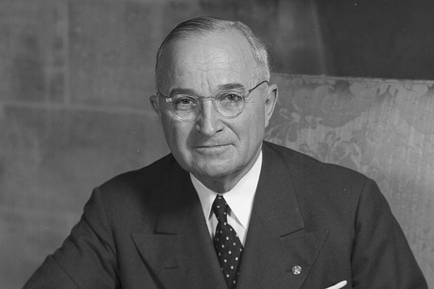
Accountability

Slide 8

Vendor selection due diligence

Slide 9
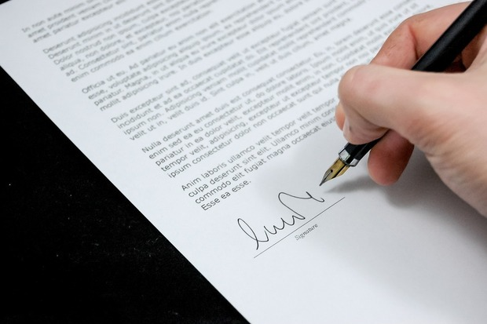
Contracts

Slide 10

Universal requirements
Written procedures
Employee training
Accountability
Vendor selection due diligence
Contracts

Slide 11

Plotting a course

Slide 12
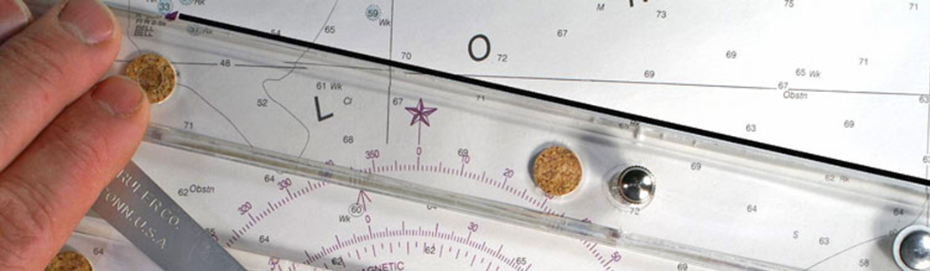
Plotting a course
Keep it simple
Assign accountability
Enlist a service provider with expertise
Demonstrating compliance is compliance

Slide 13


Slide 14

Thank you!
Robert (Bob) Johnson
rjohnson@naidonline.org
www.naidonline.org

